Slide 1
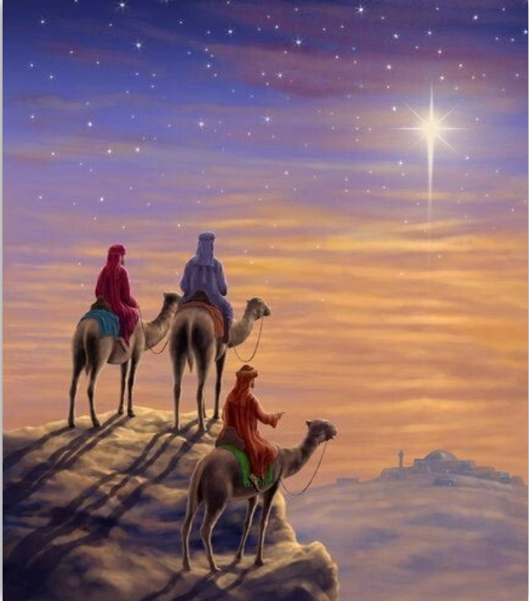
Scandals and Signs
Matthew 1-2
Agape Fellowship
December 28, 2025

Slide 2
Christmas Messages
Date | Theme | Scripture
Nov. 16 | A Christmas Setting | Luke 1:1-7
Nov. 23 | A Christmas Offering | Luke 1:8-17
Dec. 7 | A Christmas Conflict | Luke 1:18-22
Dec. 14 | A Christmas Precursor | Luke 1:23-38
Dec. 21 | The Christmas Messiah | Luke 2:1-14

Slide 3
Gospel of Matthew, 1-2
1:1-17. The Genealogy of Jesus
  Messiah, Son of David, Son of Abraham
1:18-25. The Birth of Jesus the Messiah
2:1-12. The Visit of the Wise Men
  Seeking the King of the Jews.
2:13-18. Escaping Herod’s massacre
2:19-23. Return from Egypt

Slide 4
The Genealogy of Jesus
An account of the genealogy of Jesus the Messiah, the son of David, the son of Abraham. Matthew 1:1 (NRSVue)
Messiah = Christ = Anointed One
Son of David = model king of Israel
Son of Abraham = common ancestor

Slide 5
The “Begats” – Matthew 1:2-16
Older versions (KJV and older)
  ² Abraham begat Isaac begat Jacob, and Jacob begat Judah and his brothers…
Translation changes (NASB 2020)
  ² Abraham fathered Isaac fathered Jacob, and Jacob fathered Judah and his brothers…
Newer versions (NIV and forward)
  ² Abraham was the father of Isaac, and Isaac the father of Jacob, and Jacob the father of Judah and his brothers…

Slide 6
Genealogy – Fits the mold
Who is a true Israelite? Who qualifies as Messiah? | ¹⁷ So all the generations from Abraham to David are fourteen generations; and from David to the deportation to Babylon, fourteen generations; and from the deportation to Babylon to the Messiah, fourteen generations. Matthew 1:17 (NRSVue)
Abraham to David | 14 Generations
David to Babylon | 14 Generations
Babylon to Messiah | 14 Generations

Slide 7
What is a scandal?
Scandal: Something unusual that brings public outrage or disgrace.
Greek word σκάνδαλον skandalon
Trap, stumbling block, offense
Messiah as a pure-blooded Jew(?)
Can a scandal become a sign?

Slide 8
Genealogy – The scandals
Woman | In Matthew | In Old Testament
Tamar - ³ and Judah the father of Perez and Zerah by Tamar… | 1:3 | Genesis 38 1 Chronicles 2:1-4
Rahab - ⁵ and Salmon the father of Boaz by Rahab… | 1:5 | Joshua 2, 6:22-25
Ruth - ⁵ … and Boaz the father of Obed by Ruth… | 1:5 | Book of Ruth
Bathsheba - Matthew (NRSVue) ⁶ And David was the father of Solomon by the wife of Uriah… | 1:6 | 2 Samuel 11-12 1 Kings 1:11-53
Mary - ¹⁶ and Jacob the father of Joseph the husband of Mary, who bore Jesus, who is called the Messiah. | 1:16, 18-25 | Isaiah 7:14

Slide 9
Judah and Tamar – Genesis 38
Judah married a Canaanite woman.
Their first son, Er, married Tamar.
Er and his brother Onan, died as a result of God’s judgment.
Tamar schemed to give Judah an heir by playing the prostitute.
One of twin sons was ancestor of Jesus.

Slide 10
Rahab
Rahab is a prostitute in pagan city of Jericho.
Joshua 2. Saves the spies that Joshua sent to Jericho.
Joshua 6:22-25. Family is saved when Israel conquers Jericho.
Matthew 1:5. Marries Salmon and has son, Boaz, in the line of Jesus.

Slide 11
Ruth – Book of Ruth.
A Moabite foreigner who married into a family of the tribe of Judah.
Went with mother-in-law, Naomi, after Naomi’s husband & sons died.
Schemed to get next-of-kin, Boaz, to redeem her, and continue family line.

Slide 12
Bathsheba – wife of Uriah
Married a Hittite, one of David’s soldiers.
David raped Bathsheba and murdered Uriah to marry her.
First son died in infancy. 2 Samuel 11-12
Second son, Solomon, followed David as king instead of Adonijah (1 Kings 1:11-53)

Slide 13
Joseph and Mary
¹⁶ …and Jacob the father of Joseph the husband of Mary, who bore Jesus, who is called the Messiah. Matthew 1:16 (NRSVue)
¹⁸ Now the birth of Jesus the Messiah took place in this way. When his mother Mary had been engaged to Joseph, but before they lived together, she was found to be pregnant from the Holy Spirit.
Matthew 1:18 (NRSVue)

Slide 14
Joseph, the human father
¹⁹ Her husband Joseph, being a righteous man and unwilling to expose her to public disgrace, planned to divorce her quietly. ²⁰ But just when he had resolved to do this, an angel of the Lord appeared to him in a dream and said, “Joseph, son of David, do not be afraid to take Mary as your wife, for the child conceived in her is from the Holy Spirit. ²¹ She will bear a son, and you are to name him Jesus, for he will save his people from their sins.” Matthew 1:19-21

Slide 15
Matthew’s commentary
²² All this took place to fulfill what had been spoken by the Lord through the prophet:
²³ “Look, the virgin shall become pregnant and give birth to a son,
and they shall name him Emmanuel,”
which means, “God is with us.”
²⁴ When Joseph awoke from sleep, he did as the angel of the Lord commanded him; he took her as his wife ²⁵ but had no marital relations with her until she had given birth to a son, and he named him Jesus. Matthew 1:22-25

Slide 16
The titles of this baby
  Son of David. From a royal family.
  Messiah. Promised “anointed” one.
  Emmanuel. God with us in the flesh.
  Jesus. Savior from the Lord God.
  God has turned scandal into sign!

Slide 17
The next scandal - worship
2 In the time of King Herod, after Jesus was born in Bethlehem of Judea, magi from the east came to Jerusalem, ² asking, “Where is the child who has been born king of the Jews? For we observed his star in the east and have come to pay him homage.” (Matthew 2:1-2)

Slide 18
Wise men, meet…
King Herod – Matthew 2:3ff
  ³ When King Herod heard this, he was frightened, and all Jerusalem with him…
Israel’s “wise men” -- Matthew 2:4
  …⁴ and calling together all the chief priests and scribes of the people, he inquired of them where the Messiah was to be born.

Slide 19
Response to Wisemen
Herod
⁷ Then Herod secretly called for the magi and learned from them the exact time when the star had appeared. ⁸ Then he sent them to Bethlehem, saying, “Go and search diligently for the child, and when you have found him, bring me word so that I may also go and pay him homage.”
Matthew 2:7-8
Chief priests and scribes – No response

Slide 21
Scandal becomes sign
The Jewish leaders remain silent.
The nations (Gentiles) come and worship with gifts:
  Gold -- the currency of kings.
  Frankincense -- temple gift to God.
  Myrrh -- foreshadows the suffering and death of Jesus.

Slide 22
Escape to Egypt
¹³ Now after they had left, an angel of the Lord appeared to Joseph in a dream and said, “Get up, take the child and his mother, and flee to Egypt, and remain there until I tell you, for Herod is about to search for the child, to destroy him.”
¹⁴ Then Joseph got up, took the child and his mother by night, and went to Egypt ¹⁵ and remained there until the death of Herod. This was to fulfill what had been spoken by the Lord through the prophet, “Out of Egypt I have called my son.” Matthew 2:13-15

Slide 23
Called out of Egypt
¹⁹ When Herod died, an angel of the Lord suddenly appeared in a dream to Joseph in Egypt and said, ²⁰ “Get up, take the child and his mother, and go to the land of Israel, for those who were seeking the child’s life are dead.” ²¹ Then Joseph got up, took the child and his mother, and went to the land of Israel. ²² But when he heard that Archelaus was ruling Judea in place of his father Herod, he was afraid to go there. And after being warned in a dream, he went away to the district of Galilee. ²³ There he made his home in a town called Nazareth, so that what had been spoken through the prophets might be fulfilled, “He will be called a Nazarene.” Matthew 2:19-23

Slide 24
Matthew’s message
Jesus is a stumbling block, a scandal.
Jesus is a sign fulfilling the prophetic tradition of Israel.
God’s people are not defined…
  Through a perfect bloodline.
  Through a perfect sinless life.
God’s ways advanced thru’ faithfulness

Slide 25
The rest of the story
² When John heard in prison what the Messiah was doing, he sent word by his disciples ³ and said to him, “Are you the one who is to come, or are we to wait for another?” ⁴ Jesus answered them, “Go and tell John what you hear and see: ⁵ the blind receive their sight, the lame walk, those with a skin disease are cleansed,
the deaf hear, the dead are raised,
and the poor have good news brought to them.
⁶ And blessed is anyone who takes no offense [σκανδαλίζω skandalizō ] at me.” Matthew 11:2–6

Slide 26
God with us…in Jesus
The prophecy:
²³ “Look, the virgin shall become pregnant and give birth to a son, and they shall name him Emmanuel,” which means, “God is with us.” Matthew 1:22-23
The Great Commission:
¹⁸ And Jesus …said to them, “All authority in heaven and on earth has been given to me.
¹⁹ Go therefore and make disciples of all nations… And remember, I am with you always, to the end of the age.” Matthew 28:18-19

Slide 27
The Great Commission
¹⁸ And Jesus came and said to them, “All authority in heaven and on earth has been given to me. ¹⁹ Go therefore and make disciples of all nations, baptizing them in the name of the Father and of the Son and of the Holy Spirit ²⁰ and teaching them to obey everything that I have commanded you. And remember, I am with you always, to the end of the age.” Matthew 28:16-20

