Slide 1
A Day of Fire
A Baptism and Membership Service
Mt 3:11-12
Rom 6:1-4
Gal 3:26-29
1 Cor 12:12-13
8/17/25
7/20/25

Slide 2
John the Baptist:
about Jesus
“I baptize you with water for repentance, but He who is coming after me is mightier than I, whose sandals I am not worthy to carry. He will baptize you with the Holy Spirit and fire. ¹² His winnowing fork is in his hand, and He will clear his threshing floor and gather His wheat into the barn, but the chaff He will burn with unquenchable fire.” Mt 3:11-12

Slide 3
We are buried into
Jesus’ Death
Do you not know that all of us who have been baptized into Christ Jesus were baptized into his death? ⁴ We were buried therefore with him by baptism into death, in order that, just as Christ was raised from the dead by the glory of the Father, we too might walk in newness of life. Rom 6:3-4

Slide 4
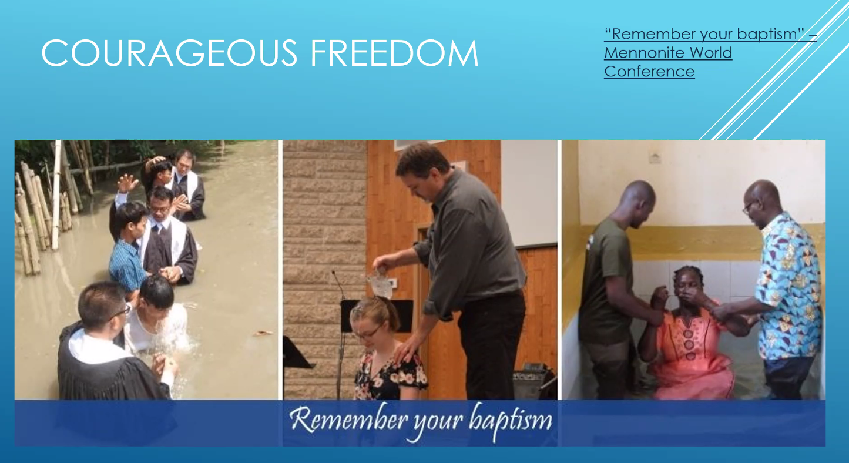

Slide 5
We are clothed with Jesus Christ into a body
… for in Christ Jesus you are all sons of God, through faith. ²⁷ For as many of you as were baptized into Christ have put on Christ. ²⁸ There is neither Jew nor Greek, there is neither slave nor free, there is no male and female, for you are all one in Christ Jesus. ²⁹ And if you are Christ’s, then you are Abraham’s offspring, heirs according to promise. Gal 3:26-29

Slide 6
We are clothed with Jesus Christ into His “one” Body
having been buried with Him in baptism, in which you were also raised with him through faith in the powerful working of God, who raised Him from the dead. ¹³ And you, who were dead in your trespasses and the uncircumcision of your flesh, God made alive together with Him, having forgiven us all our trespasses… Col 2:12-13

Slide 7
Apostle’s Creed:
I believe in God, the Father Almighty, Maker of heaven and earth.
And in Jesus Christ, His only Son, our Lord, who was conceived by the Holy Spirit, born of the Virgin Mary, suffered under Pontius Pilate, was crucified, dead, and buried. He descended into hell.

Slide 8
The third day He rose again from the dead. He ascended into heaven and sits on the right hand of God, the Father Almighty. From thence He shall come to judge the living and the dead.
I believe in the Holy Spirit, the holy Christian church, the communion of saints, the forgiveness of sins, the resurrection of the body, and the life everlasting. Amen.

