Slide 1
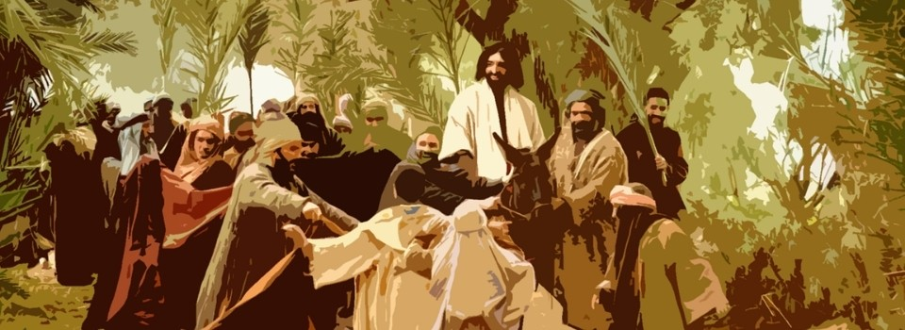
Use the Momentum!
Mt 14:22-24
Jn 6:14-17
---------------------------------------------
Jn 3:16-17
Jn 7:1-9
Jn 12:49-50
1 Cor 3:19
6/15/25

Slide 2
Immediately he made the disciples get into the boat and go before him to the other side, while he dismissed the crowds. ²³ And after he had dismissed the crowds, he went up on the mountain by himself to pray. When evening came, he was there alone… Mt 14:22-23
Immediately he made his disciples get into the boat and go before him to the other side, to Bethsaida, while he dismissed the crowd. ⁴⁶ And after he had taken leave of them, he went up on the mountain to pray. Mk 6:45-46

Slide 3
When the people saw the sign that he had done, they said, “This is indeed the Prophet who is to come into the world!” ¹⁵ Perceiving then that they were about to come and take him by force to make him king, Jesus withdrew again to the mountain by himself. ¹⁶ When evening came, his disciples went down to the sea, ¹⁷ got into a boat, and started across the sea to Capernaum. It was now dark, and Jesus had not yet come to them. Jn 6:14-17

Slide 4
Jesus responds to
public discernment.
Jn 6:14-15
When the people saw the sign that he had done, they said, “This is indeed the Prophet who is to come into the world!” ¹⁵ Perceiving then that they were about to come and take him by force to make him king, Jesus withdrew again to the mountain by himself. Jn 6:14-15

Slide 5
This is human wisdom.
1 Cor 3:19
Let no one deceive himself. If anyone among you thinks that he is wise in this age, let him become a fool that he may become wise. ¹⁹ For the wisdom of this world is folly with God. For it is written, “He catches the wise in their craftiness,” 1 Cor 3:18-19

Slide 6
Jesus only responds to
His Father’s voice.
Jn 12:49-50
For I have not spoken on my own authority, but the Father who sent me has, Himself, given me a commandment - what to say and what to speak. ⁵⁰ And I know that his commandment is eternal life. What I say, therefore, I say as the Father has told me.” Jn 12:49-50

Slide 7
The people wanted a powerful king.
Jn 6:15
When the people saw the sign that he had done, they said, “This is indeed the Prophet who is to come into the world!” ¹⁵ Perceiving then that they were about to come and take him by force to make him king, Jesus withdrew again to the mountain by himself. Jn 6:14-15

Slide 8
In Contrast:
God wanted them to experience a Savior!
Jn 3:16
For God so loved the world, that he gave his only Son, that whoever believes in him should not perish but have eternal life. ¹⁷ For God did not send his Son into the world to condemn the world, but in order that the world might be saved through him. Jn 3:16-17

Slide 9
