Slide 1
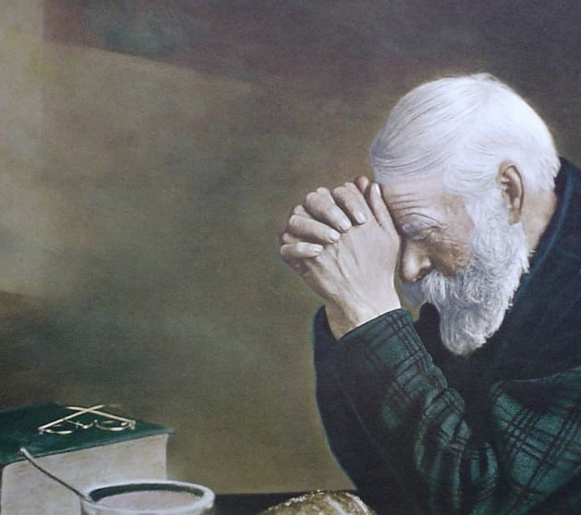
My Prayers
An intimate look into my soul
Mt 18:19-20
Rev 5:8-10
Rom 3:21-26 Mk 2:1-12
Jer 17:9
1/5/25

Slide 2
A Prayer Insight
Again, I say to you, if two of you agree on earth about anything they ask, it will be done for them by my Father in heaven. ²⁰ For where two or three are gathered in my name, there am I among them.” Mt 18:19-20

Slide 3
And I saw a mighty angel proclaiming with a loud voice, “Who is worthy to open the scroll and break its seals?” ³ And no one in heaven or on earth or under the earth was able to open the scroll or to look into it, ⁴ and I began to weep loudly because no one was found worthy to open the scroll or to look into it. ⁵ And one of the elders said to me, “Weep no more; behold, the Lion of the tribe of Judah, the Root of David, has conquered, so that he can open the scroll and its seven seals.” Rev 5:2-5

Slide 4
And between the throne and the four living creatures and among the elders I saw a Lamb standing, as though it had been slain, with seven horns and with seven eyes, which are the seven spirits of God sent out into all the earth. ⁷ And he went and took the scroll from the right hand of him who was seated on the throne. ⁸ And when he had taken the scroll, the four living creatures and the twenty-four elders fell down before the Lamb, each holding a harp, and golden bowls full of incense, which are the prayers of the saints. Rev 5:6-8

Slide 5
What does a prayer look like in heaven?
And when he had taken the scroll, the four living creatures and the twenty-four elders fell down before the Lamb, each holding a harp, and golden bowls full of incense, which are the prayers of the saints. Rev 5:8

Slide 6
What does a prayer look like in heaven?
1 Slain Lamb
1 Scroll
4 Living Creatures
24 Falling Down Elders
- Holding a harp
- Holding bowls of incense
(prayers of the saints)

Slide 7
Prayer is a soul (heart) cry
You desire and do not have, so you murder. You covet and cannot obtain, so you fight and quarrel. You do not have, because you do not ask. ³ You ask and do not receive, because you ask wrongly, to spend it on your passions. Ja 4:2-3
Again, I say to you, if two of you agree on earth about anything they ask, it will be done for them by my Father in heaven. ²⁰ For where two or three are gathered in my name, there am I among them.”
Mt 18:19-20

Slide 8
My heart is made to be healthy. Rom 3:22
My heart is broken. Rom 3:23
My heart needs a transplant. Jer 17:9

Slide 9
… the righteousness of God through faith in Jesus Christ for all who believe. For there is no distinction: ²³ for all have sinned and fall short of the glory of God… Rom 3:22-23
The heart is deceitful above all things, and desperately sick; who can understand it? ¹⁰ “I the LORD search the heart and test the mind, to give every man according to his ways, according to the fruit of his deeds.”
Jer 17:9-10

Slide 10
Prayers are soul cries
for renewal. Rev 5:8
Our hearts are wired to respond to Jesus. Mk 2:11-12

Slide 11
And immediately Jesus, perceiving in his spirit that they thus questioned within themselves, said to them, “Why do you question these things in your hearts? ⁹ Which is easier, to say… , ‘Your sins are forgiven,’ or to say, ‘Rise, take up your bed and walk’? ¹⁰ But that you may know that the Son of Man has authority on earth to forgive sins” he said to the paralytic ¹¹ “I say to you, rise, pick up your bed, and go home.” ¹² And he rose and immediately picked up his bed and went out before them all, so that they were all amazed and glorified God, saying, “We never saw anything like this!” Mk 2:8-12

Slide 12
I remember the incense
I pray according to the incense
I let the Lord change my heart… and my prayers are changed according to His sacrifice

