Slide 1
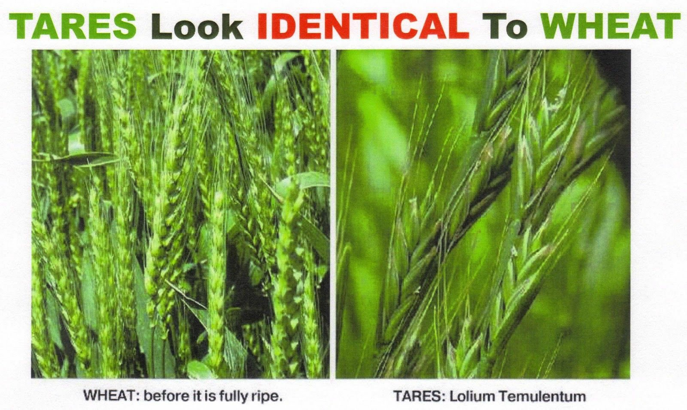
Wheat and the Word
Matthew 13:36-43; John 1:1-9; Hebrews 4:12-13;
2 Timothy 3:12-17; Psalm 19:1-4
11/17/24

Slide 2
Then he left the crowds and went into the house. And his disciples came to him, saying, “Explain to us the parable of the weeds of the field.” ³⁷ He answered, “The one who sows the good seed is the Son of Man. ³⁸ The field is the world, and the good seed is the sons of the kingdom. The weeds are the sons of the evil one, ³⁹ and the enemy who sowed them is the devil. The harvest is the end of the age, and the reapers are angels.
Mt 13:36-39

Slide 3
Just as the weeds are gathered and burned with fire, so will it be at the end of the age. ⁴¹ The Son of Man will send his angels, and they will gather out of his kingdom all causes of sin and all law-breakers, ⁴² and throw them into the fiery furnace. In that place there will be weeping and gnashing of teeth. ⁴³ Then the righteous will shine like the sun in the kingdom of their Father. He who has ears, let him hear. Mt 13:40-43

Slide 4
Worldview Paradigm
Son of Man (Jesus)
Angel “messenger”
[ Servants of The Son ]
Son of Man (Jesus)
Sower of Good
Devil (Satan)
Sower of evil
Children of
The Kingdom
Children of
the evil one

Slide 5
Words from God
The heavens declare the glory of God, and the sky above proclaims his handiwork. ² Day to day pours out speech, and night to night reveals knowledge. ³ There is no speech, nor are there words, whose voice is not heard. ⁴ Their voice goes out through all the earth, and their words to the end of the world. In them he has set a tent for the sun, Ps 19:1-4a

Slide 6
In the beginning was the Word, and the Word was with God, and the Word was God. ² He was in the beginning with God. ³ All things were made through him, and without him was not any thing made that was made. ⁴ In him was life, and the life was the light of men. ⁵ The light shines in the darkness, and the darkness has not overcome it… ⁹ The true light, which gives light to everyone, was coming into the world. Jn 1:1-5, 9

Slide 7
The Word of God
God’s Son
Jesus
Long ago, at many times and in many ways, God spoke to our fathers by the prophets, ² but in these last days he has spoken to us by his Son, whom he appointed the heir of all things, through whom also he created the world. Heb 1:1-3

Slide 8
God’s Word:
Created all things
Continues to speak
- through creation
- through Jesus…
The speech is
in the midst of weeds!

Slide 9
“No one can come to me unless the Father who sent me draws him. And I will raise him up on the last day. ⁴⁵ It is written in the Prophets, ‘And they will all be taught by God.’ Everyone who has heard and learned from the Father comes to me— ⁴⁶ not that anyone has seen the Father except he who is from God; he has seen the Father. ⁴⁷ Truly, truly, I say to you, whoever believes has eternal life. 48 I am the bread of life. Jn 6:43-48

Slide 10
The Word of God
is living. Heb 4:12-13
For the word of God is living and active, sharper than any two-edged sword, piercing to the division of soul and of spirit, of joints and of marrow, and discerning the thoughts and intentions of the heart. ¹³ And no creature is hidden from his sight, but all are naked and exposed to the eyes of him to whom we must give account. Heb 4:12-13

Slide 11
The Word of God
is energizing (potent).
For the word of God is living and active, sharper than any two-edged sword, piercing to the division of soul and of spirit, of joints and of marrow, and discerning the thoughts and intentions of the heart. ¹³ And no creature is hidden from his sight, but all are naked and exposed to the eyes of him to whom we must give account. Heb 4:12-13

Slide 12
The Word of God
is sharp (one time).
For the word of God is living and active, sharper than any two-edged sword, piercing to the division of soul and of spirit, of joints and of marrow, and discerning the thoughts and intentions of the heart. ¹³ And no creature is hidden from his sight, but all are naked and exposed to the eyes of him to whom we must give account. Heb 4:12-13

Slide 13
The Word of God is wHOlLY (wholly) divisive.
For the word of God is living and active, sharper than any two-edged sword, piercing to the division of soul and of spirit, of joints and of marrow, and discerning the thoughts and intentions of the heart. ¹³ And no creature is hidden from his sight, but all are naked and exposed to the eyes of him to whom we must give account. Heb 4:12-13

Slide 14
Scripture is
God - breathed.
All Scripture is breathed out by God and profitable for teaching, for reproof, for correction, and for training in righteousness, ¹⁷ that the man (person FED from) of God may be complete, equipped for every good work.
2 Tim 3:16-17

Slide 15
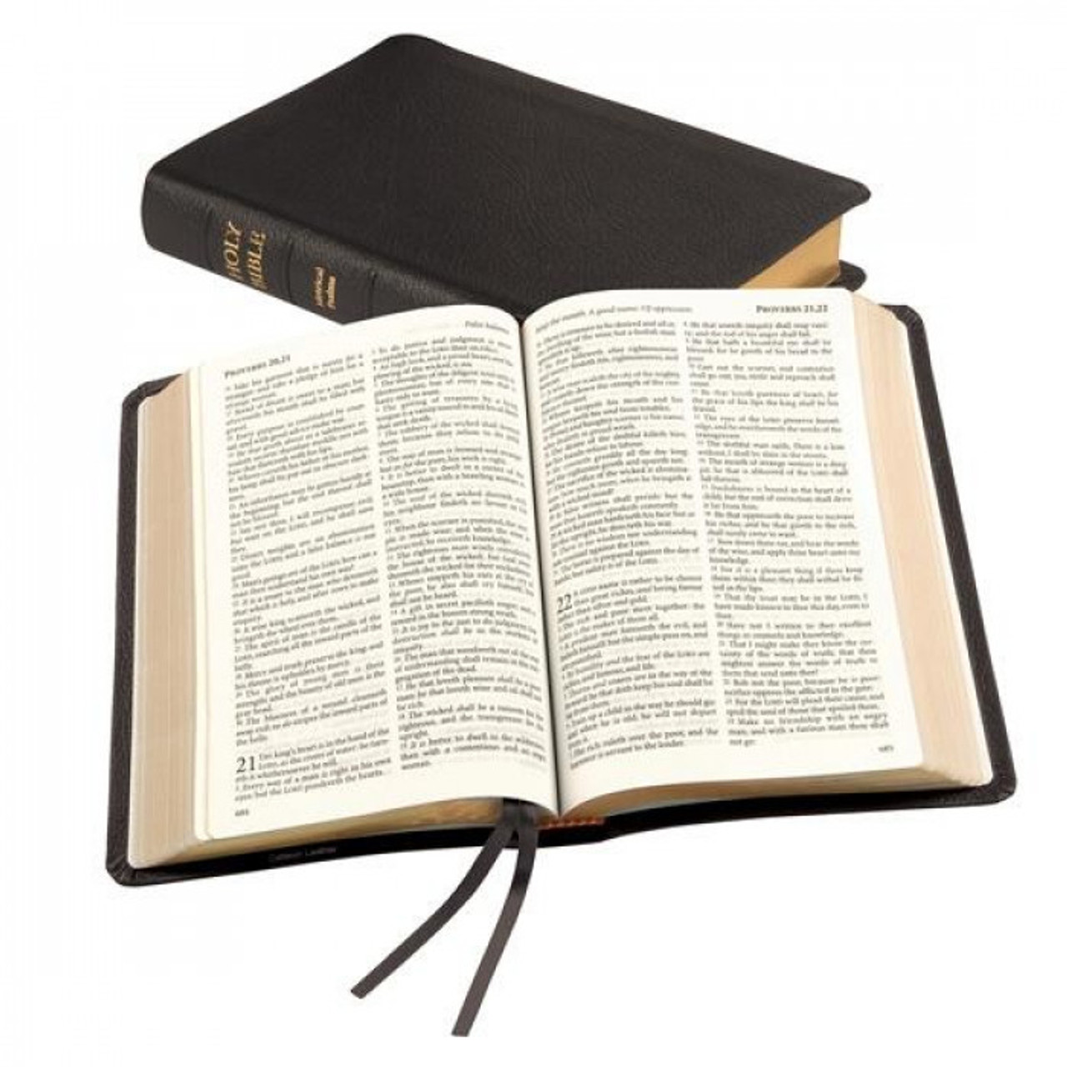

Slide 16
Jesus, God’s Word in breath,
is living, active, sharp, and discerning.
Everything in this world has been
tainted by the enemy’s weeds
1 We come to Jesus because He draws us to Himself!
2 We come to Jesus because He has planted the seed of His WORD! EAT IT!

