Slide 1
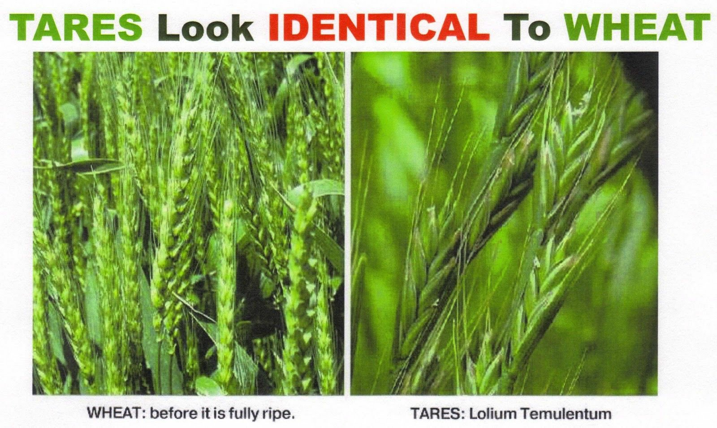
A Tare Revelation
Mt 13:36-43; Lk 3:16-17; Mk 3:11-12; Heb 1:7-14
11/3/24

Slide 2
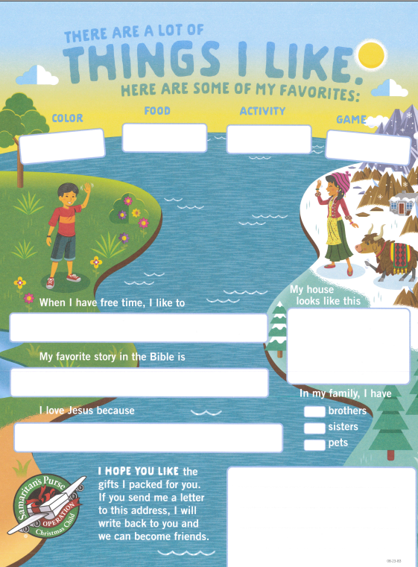
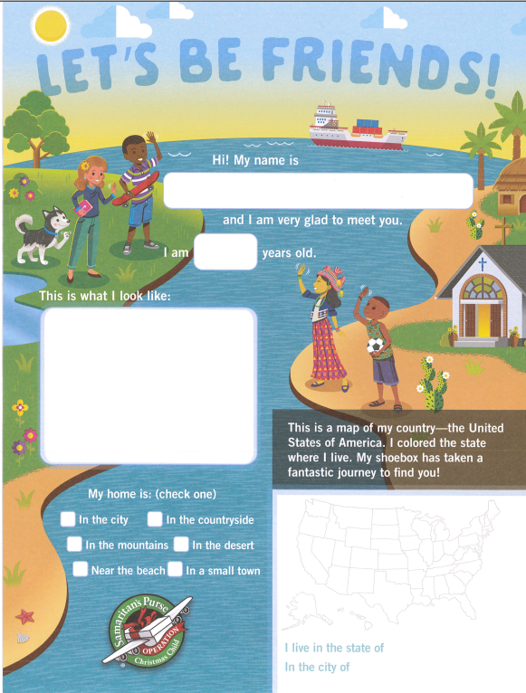
Picture of letter

Slide 3
Then he left the crowds and went into the house. And his disciples came to him, saying, “Explain to us the parable of the weeds of the field.” ³⁷ He answered, “The one who sows the good seed is the Son of Man. ³⁸ The field is the world, and the good seed is the sons of the kingdom. The weeds are the sons of the evil one, ³⁹ and the enemy who sowed them is the devil. The harvest is the end of the age, and the reapers are angels.
Mt 13:36-39

Slide 4
Just as the weeds are gathered and burned with fire, so will it be at the end of the age. ⁴¹ The Son of Man will send his angels, and they will gather out of his kingdom all causes of sin and all law-breakers, ⁴² and throw them into the fiery furnace. In that place there will be weeping and gnashing of teeth. ⁴³ Then the righteous will shine like the sun in the kingdom of their Father. He who has ears, let him hear. Mt 13:40-43

Slide 5
Worldview Paradigm
Son of Man (Jesus)
Angel “messenger”
Son of Man (Jesus)
Sower of Good
Devil (Satan)
Sower of evil
Children of
The Kingdom
Children of
the evil one

Slide 6
The Sower of the
good seed is Jesus,
the Son of Man.
³⁷ He answered, “The one who sows the good seed is the Son of Man. ³⁸ The field is the world, and the good seed is the sons of the kingdom. The weeds are the sons of the evil one, ³⁹ and the enemy who sowed them is the devil. Mt 13:37-39a

Slide 7
The Sower of the
“Tares” is the devil.
He answered, “The one who sows the good seed is the Son of Man. ³⁸ The field is the world, and the good seed is the sons of the kingdom. The weeds are the sons of the evil one, ³⁹ and the enemy who sowed them is the devil. Mt 13:37-39a

Slide 8
Worldview Paradigm
Son of Man (Jesus)
Angel “messenger”
[ Servants of The Son ]
Son of Man (Jesus)
Sower of Good
Devil (Satan)
Sower of evil
Children of
The Kingdom
Children of
the evil one

Slide 9
The angels observe the
evil & can root it out.
²⁸ He said to them, “‘An enemy has done this.’ So the servants (angels) said to him, ‘Then do you want us to go and gather them?’ ²⁹ But he said, ‘No, lest in gathering the weeds you root up the wheat along with them. ³⁰ Let both grow together until the harvest, and at harvest time I will tell the reapers, “Gather the weeds first and bind them in bundles to be burned, but gather the wheat into my barn.” ^{39b} The harvest is the end of the age, and the reapers are angels.
Mt 13:28-30, 39b

Slide 10
What would do Angels (messengers) do?
For to which of the angels did God ever say, “You are my Son, today I have begotten you”? Or again, “I will be to him a father, and he shall be to me a son”? ⁶ And again, when he brings the firstborn into the world, he says, “Let all God’s angels worship him.”
Heb 1:5-6

Slide 11
⁷ Of the angels he says, “He makes his angels winds, and his ministers a flame of fire.” … ¹³ And to which of the angels has he ever said, “Sit at my right hand until I make your enemies a footstool for your feet”? ¹⁴ Are they not all ministering spirits sent out to serve for the sake of those who are to inherit salvation? Heb 1:7, 13-14

Slide 12
Angels:
Worship Jesus (The Son) Heb 1:6
Are “Winds” Heb 1:6
Are “Ministers” Heb 1:7
Are “Flames of Fire” Heb 1:7
Are “Ministering Spirits” Heb 1:14
- sent out to “render service” for the sake of those who inherit salvation.

Slide 13
Angels:
Saw the Evil sowed Mt 13:27
Offered to root the evil tares Mt 13:28
Are the “Reapers” Mt 13:30, 39-40
Await the harvest when they will bundle the tares for burning Mt 13:40
Are “Kingdom Gatherers” of all STUMBLING BLOCKS & LAWLESS ACTIVISTS!
Mt 13:41

Slide 14
How should I think about these “last days?” Is 2:3b-4
How should I think about evil and God’s timing? Is 2:3b-4
How should I think about the current events in the 2024 Nation of Israel? Is 2:3b-4

Slide 15
How should I pray for family, friends, city, country, world?
How do I find PEACE that passes understanding in a world that is ANTI-PEACE? (anything but peaceful)

