Slide 1
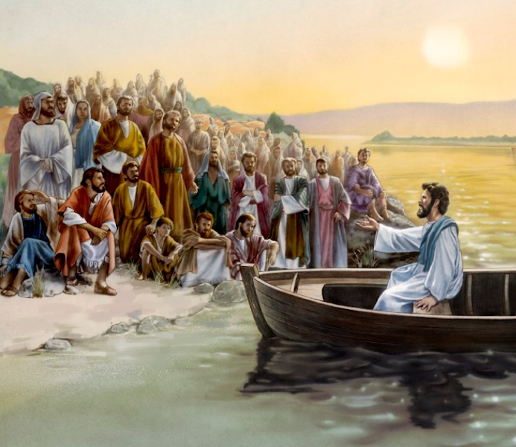
The Sower and His Seed
A Soil Test
Mt 13:1-9, 18-23
Mk 4:1-20
Lk 8:4-15
9/15/24

Slide 2
“Hear then the parable of the Sower: ¹⁹ When anyone hears the word of the kingdom and does not understand it, the evil one comes and snatches away what has been sown in his heart. This is what was sown along the path. ²⁰ As for what was sown on rocky ground, this is the one who hears the word and immediately receives it with joy, ²¹ yet he has no root in himself, but endures for a while, and when tribulation or persecution arises on account of the word, immediately he falls away.” Mt 13:18-21

Slide 3
As for what was sown among thorns, this is the one who hears the word, but the cares of the world and the deceitfulness of riches choke the word, and it proves unfruitful. ²³ As for what was sown on good soil, this is the one who hears the word and understands it. He indeed bears fruit and yields, in one case a hundredfold, in another sixty, and in another thirty.” Mt 13:22-23

Slide 4
Four Soils:
Unreceptive: Hardened Path - Soil
Receptive: Soil in Rocky Places
Soil among Thorns
Fruitful Soil

Slide 5
Wrong Thinking:
The Soils are a 20/20, Rear View Mirror, judgment on an individual’s response
to God

Slide 6
A Soil can be a Nation
- Israel
¹³ This is why I speak to them in parables, because seeing they do not see, and hearing they do not hear, nor do they understand… ¹⁴
“You will indeed hear but never understand, and you will indeed see but never perceive.”
¹⁹ When anyone hears the word of the kingdom and does not understand it, the evil one comes and snatches away what has been sown in his heart. This is what was sown along the path.
Mt 13:13a, 14a, 19a

Slide 7
A Soil can be a Nation
Biblical Examples: Israel, Babylon, USA
Israel could be every soil
Designed to be a Theocracy
Every other nation can only be soils 1-3
Human Design –
Impacted by God’s Seed in people

Slide 8
Babylon as a Soil
Nebuchadnezzar answered and said, “Blessed be the God of Shadrach, Meshach, and Abednego, who has sent his angel and delivered his servants, who trusted in him, and set aside the king’s command, and yielded up their bodies rather than serve and worship any god except their own God. 29 Therefore I make a decree: Any people, nation, or language that speaks anything against the God of Shadrach, Meshach, and Abednego shall be torn limb from limb, and their houses laid in ruins, for there is no other god who is able to rescue in this way.” Dan 3:28-29

Slide 9
Nineveh is a Soil
Jonah began to go into the city, going a day’s journey. And he called out, “Yet forty days, and Nineveh shall be overthrown!” ⁵ And the people of Nineveh believed God. They called for a fast & put on sackcloth, from the greatest of them to the least of them… ⁸ but let man and beast be covered with sackcloth & let them call out mightily to God. Let everyone turn from his evil way and from the violence that is in his hands...” ¹⁰ When God saw what they did, how they turned from their evil way, God relented of the disaster that he had said he would do to them, and he did not do it.

Slide 10
Mizpah is a Soil
⁴⁶ And Jacob said to his kinsmen, “Gather stones.” And they took stones and made a heap, and they ate there by the heap… ^{48b} Therefore he named it Galeed, ⁴⁹ and Mizpah, for he said, “The LORD watch between you and me, when we are out of one another’s sight. ⁵⁰ If you oppress my daughters, or if you take wives besides my daughters, although no one is with us, see, God is witness between you and me.” ⁵¹ Then Laban said to Jacob, “See this heap and the pillar, which I have set between you and me. Gen 31:46, 48b-51

Slide 11
A Soil can be a Nation
A Soil can be a City
A Soil can be a Human Relationship
A Soil can be a
Human Soul

Slide 12
The Seed for you!
But what does it say? “The word is near you, in your mouth and in your heart” (that is, the word of faith that we proclaim); ⁹ because, if you confess with your mouth that Jesus is Lord and believe in your heart that God raised him from the dead, you will be saved. ¹⁰ For with the heart one believes and is justified, and with the mouth one confesses and is saved. Rom 10:8-10

Slide 13
Since then we have a great high priest who has passed through the heavens, Jesus, the Son of God, let us hold fast our confession. ¹⁵ For we do not have a high priest who is unable to sympathize with our weaknesses, but one who in every respect has been tempted as we are, yet without sin. ¹⁶ Let us then with confidence draw near to the throne of grace, that we may receive mercy and find grace to help in time of need. Heb 4:14-16

Slide 14
Places where the Good Soil can be revealed!
Nation of Israel - Bird droppings
The Church - Jesus’ Body on Earth
Your Soul - Abide in Jesus
Marriages - Designed Unions
after the Godhead

Slide 15
Ethnicity is a Soil
^{Rev 5:9} And they sang a new song, saying, “Worthy are you to take the scroll and to open its seals, for you were slain, and by your blood you ransomed people for God from every tribe and language and people and nation, ¹⁰ and you have made them a kingdom and priests to our God, and they shall reign on the earth.”
^{Mt 24:14} And this gospel of the kingdom will be proclaimed throughout the whole world as a testimony to all nations, and then the end will come. Rev 5:9-10; Mt 24:14

Slide 16
Nations =“Ethnos”
8 Billion people on earth
- less than 200 million Believers
Unreached Ethnic Groups
2005 17,446
2015 1400
2019 300
Today 5-20

Slide 17
Praying for any Seed in any Soil is like praying for the Nations!

Slide 18
Recognizing SOIL is God’s way of helping us to direct our prayers according to His purposes!
For as the rain and the snow come down from heaven, And do not return there without watering the earth And making it bear and sprout, And furnishing seed to the Sower and bread to the eater; ¹¹ So will My word be which goes forth from My mouth; It will not return to Me empty, Without accomplishing what I desire, And without succeeding in the matter for which I sent it. Is 55:10-11

