Slide 1
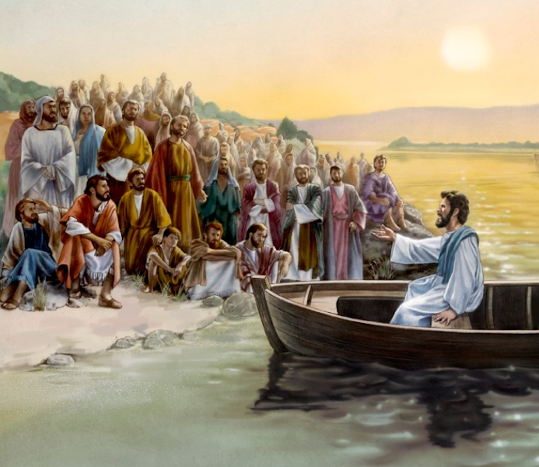
The Sower and His Seed
A Kingdom Call
Mt 13:1-9, 18-23
Heb 4:12-13
Is 55:8-12
Mk 4:1-20
Lk 8:4-15
9/8/24

Slide 2
The Sower and His Seed
That same day Jesus went out of the house and sat beside the sea. ² And great crowds gathered about him, so that he got into a boat and sat down. And the whole crowd stood on the beach. ³ And he told them many things in parables, saying… Mt 13:1-3a

Slide 3
“A Sower went out to sow. ⁴ And as he sowed, some seeds fell along the path, and the birds came and devoured them. ⁵ Other seeds fell on rocky ground, where they did not have much soil, and immediately they sprang up, since they had no depth of soil, ⁶ but when the sun rose they were scorched. And since they had no root, they withered away. ⁷ Other seeds fell among thorns, and the thorns grew up and choked them. ⁸ Other seeds fell on good soil and produced grain, some a hundredfold, some sixty, some thirty.” Mt 13:3b-8

Slide 4
The Sower is God.
“Hear then the parable of the Sower: ¹⁹ When anyone hears the word of the kingdom and does not understand it, the evil one comes and snatches away what has been sown in his heart. This is what was sown along the path.”
Mt 13:18-19

Slide 5
The seed is God’s Word.
When anyone hears the word of the kingdom and does not understand it, the evil one comes and snatches away what has been sown in his heart…
²⁰ As for the seed sown on rocky ground… ²² As for the seed sown among thorns… ²³ As for what was the seed sown on good soil, this is the one who hears the word and understands it. He indeed bears fruit and yields, in one case a hundredfold, in another sixty, and in another thirty.
Mt 13:19, 20, 22, 23

Slide 6
God’s Word is Activating, Invasive, & Illuminating!
For the Word of God is living and active, sharper than any two-edged sword, piercing to the division of soul and of spirit, of joints and of marrow, and discerning the thoughts and intentions of the heart. ¹³ And no creature is hidden from His sight, but all are naked and exposed to the eyes of him to whom we must give account. Heb 4:12-13

Slide 7
The disciples needed
help with their thinking.
For my thoughts are not your thoughts, neither are your ways my ways, declares the LORD. ⁹ For as the heavens are higher than the earth, so are my ways higher than your ways and my thoughts than your thoughts. ¹¹ so shall my word be that goes out from my mouth; it shall not return to me empty, but it shall accomplish… and shall succeed in the thing for which I sent it. Is 55:8, 9, 11 abv

Slide 8
For my thoughts are not your thoughts, neither are your ways my ways, declares the LORD. ⁹ For as the heavens are higher than the earth, so are my ways higher than your ways and my thoughts than your thoughts. ¹⁰ “For as the rain and the snow come down from heaven and do not return there but water the earth, making it bring forth and sprout, giving seed to the Sower and bread to the eater, ¹¹ so shall my word be that goes out from my mouth; it shall not return to me empty, but it shall accomplish that which I purpose, and shall succeed in the thing for which I sent it.
Is 55:8-11

Slide 9
Parables are invites to receive God’s thoughts!
Then the disciples came and said to him, “Why do you speak to them in parables?” ¹¹ And he answered them, “To you it has been given to know the secrets of the kingdom of heaven, but to them it has not been given. ¹² For to the one who has, more will be given, and he will have an abundance, but from the one who has not, even what he has will be taken away. Mt 13:10-12

