Slide 1
The Birth of a Spiritual Body
Acts 2:1-13 (49)
Agape Fellowship
June 9, 2024

Slide 2
Jesus Christ is present here
Jesus Christ is present here,
Jesus Christ is present here,
Jesus Christ is present here with us.
Alleluia, praise the Lord.
Yezu azali awa, Yezu azali awa,
Yezu azali awa na biso.
Alleluia, Alleluia, Alleluia na Yezu.
-- Lingala
From International Songbook, Mennonite World Conference, 1990

Slide 3
The Presence of Jesus
Earthly life and ministry – c. 33 years
Resurrection appearances
  Mary
  Road to Emmaus
  Upper room
  Galilee, etc.
  Mount of Olives – Ascension
What’s next?

Slide 4
Prophecy of Pentecost
⁴ While staying with them, he ordered them not to leave Jerusalem, but to wait there for the promise of the Father. “This,” he said, “is what you have heard from me; ⁵ for John baptized with water, but you will be baptized with the Holy Spirit not many days from now.” Acts 1:4-5

Slide 5
Pentecost – A Jewish holiday
A festival of weeks
First fruits of the harvest
²² You shall observe the festival of weeks, the first fruits of wheat harvest, and the festival of ingathering at the turn of the year. Exodus 34:22.

Slide 6
Old Testament Pentecost
¹⁵ And from the day after the sabbath [Passover]…you shall count off seven weeks; they shall be complete. ¹⁶ You shall count until the day after the seventh sabbath, fifty days; then you shall present an offering of new grain to the Lord…. ²¹ On that same day you shall make proclamation; you shall hold a holy convocation; you shall not work at your occupations. Leviticus 23:15–21

Slide 7
Passover to Pentecost timeline
Old Testament
Passover
Seven weeks
  Counting of omer
Shavuot – 50th day
  Feast of weeks
  Giving of Law
New Testament
Jesus’ passion
Seven weeks
  Easter season
Pentecost
  Coming of Holy Spirit

Slide 8
Salvation to Formation
Old Testament
Passover
  Salvation
Wilderness
Shavuot
  Giving of Law
  Israel formed
New Testament
Jesus’ passion
  Salvation
Waiting
Pentecost
  Giving of Holy Spirit
  The church formed

Slide 9
Wind and fire
Wind
Wind (Spirit) of God at creation
Wind = breath = spirit
Fire
Pillar of fire in the desert night
Fire on Sinai as Moses gets Law

Slide 10
Divided tongues of fire
³ Divided tongues, as of fire, appeared among them, and a tongue rested on each of them. ⁴ All of them were filled with the Holy Spirit and began to speak in other languages, as the Spirit gave them ability. Acts 2:3-4
Tongues of fire from God…
…blown by wind of God’s Spirit.

Slide 11
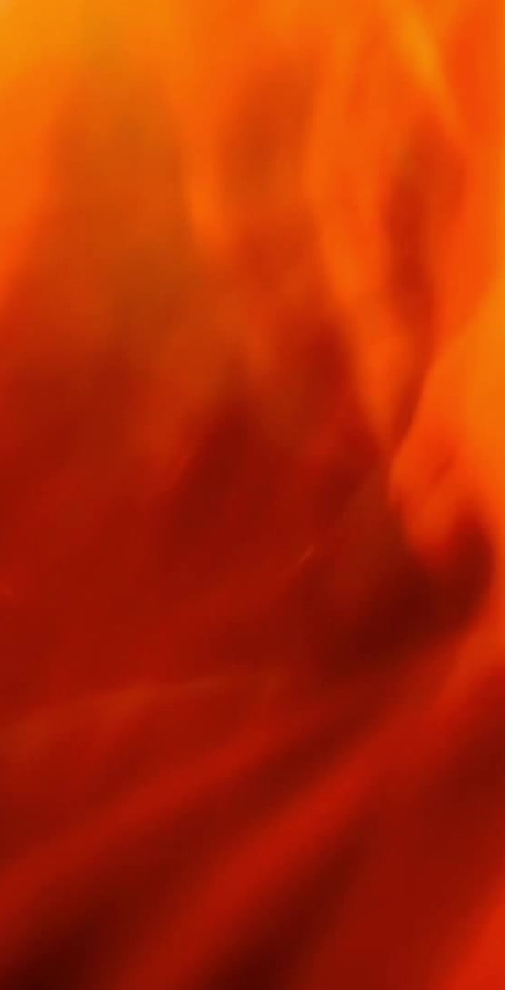
Tongues of fire
A part of our body in our mouth
Focus on the tip of tongue in fire
Language – one’s native tongue

Slide 12
In our own dialect
⁶ And at this sound the crowd gathered and was bewildered, because each one heard them speaking in the native language [διάλεκτος dialektos] of each. ⁷ Amazed and astonished, they asked, “Are not all these who are speaking Galileans? ⁸ And how is it that we hear, each of us, in our own native language [διάλεκτος dialektos]?”

Slide 13
In our own languages
⁹ Parthians, Medes, Elamites, and residents of Mesopotamia, Judea and Cappadocia, Pontus and Asia, ¹⁰ Phrygia and Pamphylia, Egypt and the parts of Libya belonging to Cyrene, and visitors from Rome, both Jews and proselytes, ¹¹ Cretans and Arabs—in our own languages [γλῶσσα glossa] we hear them speaking about God’s deeds of power.”

Slide 14
Missing the point
One-time event? Or tongues today?
Necessary for salvation? Or a gift for a few?
Understandable languages? Or ecstatic speech only the Spirit understands?
These questions miss the main point.

Slide 15
Babel – Genesis 11:1-4
11 Now the whole earth had one language and the same words. ² And as they migrated from the east, they came upon a plain in the land of Shinar and settled there. ³ And they said to one another, “Come, let us make bricks, and burn them thoroughly.” And they had brick for stone, and bitumen for mortar. ⁴ Then they said, “Come, let us build ourselves a city, and a tower with its top in the heavens, and let us make a name for ourselves; otherwise we shall be scattered abroad upon the face of the whole earth.”

Slide 16
Babel – Genesis 11:5-9
⁵ The Lord came down to see the city and the tower, which mortals had built. ⁶ And the Lord said, “Look, they are one people, and they have all one language; and this is only the beginning of what they will do; nothing that they propose to do will now be impossible for them. ⁷ Come, let us go down, and confuse their language there, so that they will not understand one another’s speech.” ⁸ So the Lord scattered them abroad from there over the face of all the earth, and they left off building the city. ⁹ Therefore it was called Babel, because there the Lord confused the language of all the earth; and from there the Lord scattered them abroad over the face of all the earth.

Slide 17
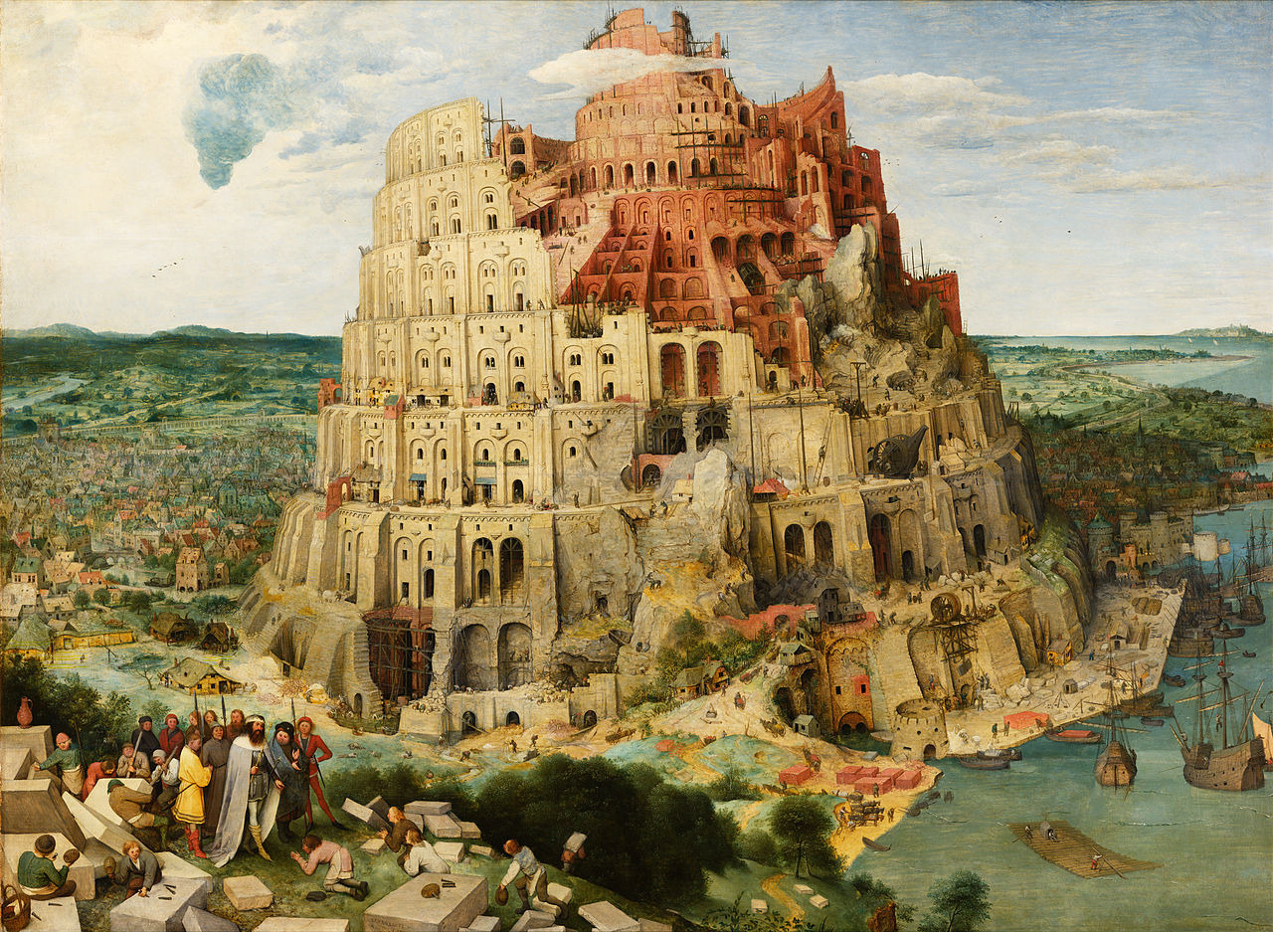
Babel – A tower and tongues

Slide 18
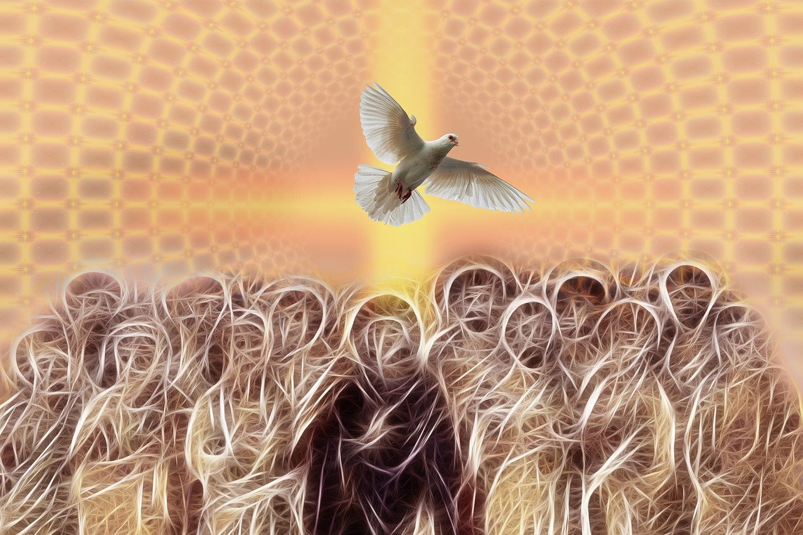
Pentecost – Spirit and tongues

Slide 19
Reversing Babel
Not the language of empire
  Not Greek
  Not Latin
  … in our own languages we hear them speaking about God’s deeds of power.” ¹² All were amazed and perplexed, saying to one another, “What does this mean?”

Slide 20
Community of the Spirit
Not by powerful human empire
Not from a political capital city
Not by trying harder to keep the Law.
But established in Jesus the Messiah
  Savior for all people
  From every tribe and tongue and nation.

Slide 21
Jesus’s birth in Luke
Luke 1:35
Physical body
³⁵ The angel said to her, “The Holy Spirit will come upon you, and the power of the Most High will overshadow you; therefore the child to be born will be holy; he will be called Son of God.
Acts 1:8
Spiritual body
⁸ But you will receive power when the Holy Spirit has come upon you; and you will be my witnesses in Jerusalem, in all Judea and Samaria, and to the ends of the earth.”

Slide 22
What happens at Pentecost
A new community is formed
Tongues of God’s fire on all people.
Kingdom of God moves forward.
The Body of Messiah moves forward
  Earthly ministry
  Resurrection appearances
  Community of Spirit in all times & places

Slide 23
The birth of Jesus
Christmas
A physical body
In time and space
Pentecost
A spiritual body
Universal
³⁸ Peter said to them, “Repent, and be baptized every one of you in the name of Jesus Christ so that your sins may be forgiven; and you will receive the gift of the Holy Spirit. ³⁹ For the promise is for you, for your children, and for all who are far away, everyone whom the Lord our God calls to him.” Acts 2:38-39

Slide 24
How do we become “church”?
How do we truly say, “Jesus Christ is present here?”
Not by building another empire.
But by God’s Spirit, the Spirit of Jesus.
By Pentecost: Christmas coming to our time and place.
Jesus Christ is present here! Alleluia!

Slide 25
Jesus Christ is present here.
Jesus Christ is present here,
Jesus Christ is present here,
Jesus Christ is present here with us.
Alleluia, praise the Lord.
Yezu azali awa, Yezu azali awa,
Yezu azali awa na biso.
Alleluia, Alleluia, Alleluia na Yezu.
-- Lingala
From International Songbook, Mennonite World Conference, 1990

