Slide 1
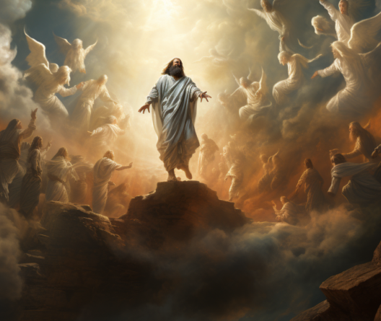
The Graduates
Acts 1:1-11
Lk 24:50-53
Mt 28:16-20
5/26/24

Slide 2
In the first book, O Theophilus, I have dealt with all that Jesus began to do and teach, ² until the day when he was taken up, after he had given commands through the Holy Spirit to the apostles whom he had chosen. ³ He presented himself alive to them after his suffering by many proofs, appearing to them during forty days and speaking about the kingdom of God. Acts 1:1-3

Slide 3
Jesus showed Himself to the disciples for 40 days after He suffered.
Acts 1:3

Slide 4
Surely he has borne our griefs and carried our sorrows; yet we esteemed him stricken, smitten by God, and afflicted. ⁵ But he was pierced for our transgressions; he was crushed for our iniquities; upon him was the chastisement that brought us peace, and with his wounds we are healed. ⁶ All we like sheep have gone astray; we have turned every one - to his own way; and the LORD has laid on him the iniquity of us all.
Is 53:4-6

Slide 5
In the first book, O Theophilus, I have dealt with all that Jesus began to do and teach, ² until the day when he was taken up, after he had given commands through the Holy Spirit to the apostles whom he had chosen. ³ He presented himself alive to them after his suffering by many convincing proofs, appearing to them during forty days and speaking about the kingdom of God. Acts 1:1-3

Slide 6
Jesus gave
convincing proofs.
Acts 1:3

Slide 7
Baptism by the Holy Spirit?
And while staying with them he ordered them not to depart from Jerusalem, but to wait for the promise of the Father, which, he said, “you heard from me; ⁵ for John baptized with water, but you will be baptized with the Holy Spirit not many days from now.”
Acts 1:4-5

Slide 8
So when they had come together, they asked him, “Lord, will you at this time restore the kingdom to Israel?” ⁷ He said to them, “It is not for you to know times or seasons that the Father has fixed by his own authority. ⁸ But you will receive power when the Holy Spirit has come upon you, and you will be my witnesses in Jerusalem and in all Judea and Samaria, and to the end of the earth.” ⁹ And when he had said these things, as they were looking on, he was lifted up, and a cloud took him out of their sight. Acts 1:6-9

Slide 9
Three Ascension Promises
You will Receive Power (Holy Spirit)
2 The Holy Spirit will come upon you
3 You will be my witnesses

Slide 10
And while they were gazing into heaven as he went, behold, two men stood by them in white robes, ¹¹ and said, “Men of Galilee, why do you stand looking into heaven? This Jesus, who was taken up from you into heaven, will come in the same way as you saw him go into heaven.” ¹² Then they returned to Jerusalem from the mount called Olivet, which is near Jerusalem, a Sabbath day’s journey away. ¹³ And when they had entered, they went up to the upper room… Acts 1:10-13a

Slide 11
Luke 24 Ascension Reveal
And he led them out as far as Bethany, and lifting up his hands he blessed them. ⁵¹ While he blessed them, he parted from them and was carried up into heaven. ⁵² And they worshiped him and returned to Jerusalem with great joy, ⁵³ and were continually in the temple blessing God. Lk 24:50-53

Slide 12
Take up your cross & follow me!
Then Jesus told his disciples, “If anyone would come after me, let him deny himself and take up his cross and follow me.” Mt 16:24
… but when you are old, you will stretch out your hands, and another will dress you and carry you where you do not want to go.” ¹⁹ (This he said to show by what kind of death he was to glorify God.) And after saying this he said to him, “Follow me.” Jn 21:18b-19

