Slide 1
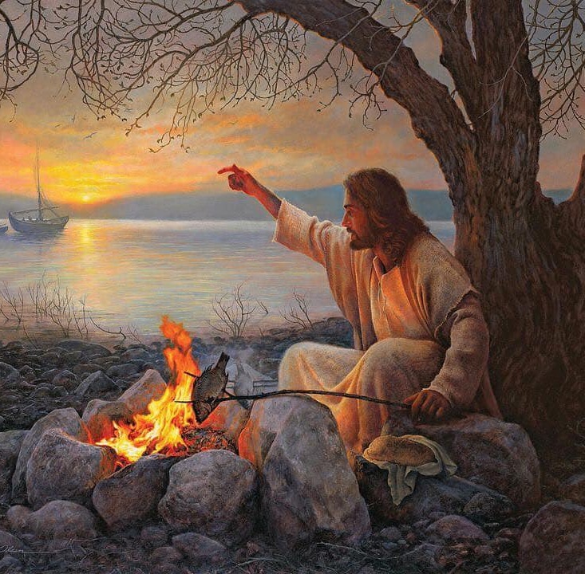
Peter Revival
Jn 21:1-19
Jn 18:12-27
Mt 15:32-16:28
5/12/24

Slide 2
Jesus said to them, “Come and have breakfast.” Now none of the disciples dared ask him, “Who are you?” They knew it was the Lord. ¹³ Jesus came and took the bread and gave it to them, and so with the fish. ¹⁴ This was now the third time that Jesus was revealed to the disciples after he was raised from the dead.
¹⁵ When they had finished breakfast, Jesus said to Simon Peter, “Simon, son of John, do you love me more than these?” Jn 21:12-15a

Slide 3
He said to him, “Yes, Lord; you know that I love you.” He said to him, “Feed my lambs.”
¹⁶ He said to him a second time, “Simon, son of John, do you love me?” He said to him, “Yes, Lord; you know that I love you.” He said to him, “Tend my sheep.” ¹⁷ He said to him the third time, “Simon, son of John, do you love me?” Peter was grieved because he said to him the third time, “Do you love me?” and he said to him, “Lord, you know everything; you know that I love you.” Jesus said to him, “Feed my sheep.” Jn 21:15b-17

Slide 4
“Truly, truly, I say to you, when you were young, you used to dress yourself and walk wherever you wanted, but when you are old, you will stretch out your hands, and another will dress you and carry you where you do not want to go.” ¹⁹ (This he said to show by what kind of death he was to glorify God.) And after saying this he said to him, “Follow me.” Jn 21:18-19

Slide 5
Jesus appeared before Annas, the high priest, when Peter was warming himself by the coal fire.
Jn 18:12

Slide 6
Jesus was arrested and bound -¹³ First they led him to Annas, for he was the father-in-law of Caiaphas, who was high priest that year… ¹⁵ Simon Peter followed Jesus, and so did John. John entered with Jesus into the courtyard of the high priest, ¹⁶ but Peter stood outside at the door. So, John, … went out and spoke to the servant girl who kept watch at the door, and brought Peter in. ¹⁷ The servant girl at the door said to Peter, “You also are not one of this man’s disciples, are you?” He said, “I am not.” Jn 18:12-17abv

Slide 7
Now the servants and officers had made a charcoal fire, because it was cold, and they were standing and warming themselves. Peter also was with them, standing and warming himself… ²⁵ Now Simon Peter was standing and warming himself. So they said to him, “You also are not one of his disciples, are you?” He denied it and said, “I am not.” ²⁶ One of the servants of the high priest, a relative of the man whose ear Peter had cut off, asked, “Did I not see you in the garden with him?” ²⁷ Peter again denied it, and at once a rooster crowed.
Jn 18:12-17abv

Slide 8
The 3rd time that Peter denied Jesus was to a witness (relative of Malchus whose ear was cut off by Peter).
Jn 18:26-27

Slide 9
When they had finished breakfast, Jesus said to Simon Peter, “Simon, son of John, do you love me more than these?” He said to him, “Yes, Lord; you know that I love you.” He said to him, “Feed my lambs.” ¹⁶ He said to him a second time, “Simon, son of John, do you love me?” He said to him, “Yes, Lord; you know that I love you.” He said to him, “Tend my sheep.” ¹⁷ He said to him the third time, “Simon, son of John, do you love me?” Peter was grieved because he said to him the third time, “Do you love me?” and he said to him, “Lord, you know everything; you know that I love you.” Jesus said to him, “Feed my sheep.” Jn 21:15-17

Slide 10
Love Action Sheep
Jesus - agape Feed my Lambs
Peter – phileo
Jesus - agape Shepherd my Sheep
Peter – phileo
Jesus - phileo Feed my Sheep
Peter – phileo

Slide 11
The 3rd time that Peter answered Jesus, after eating, Peter was grieved.
Jn 21:17

Slide 12
“Truly, truly, I say to you, when you were young, you used to dress yourself and walk wherever you wanted, but when you are old, you will stretch out your hands, and another will dress you and carry you where you do not want to go.” ¹⁹ (This he said to show by what kind of death he was to glorify God.) And after saying this he said to him, “Follow me.” Jn 21:18-19

Slide 13
Mt 15 - 16 Summary
Jesus Feeds the 4,000 after 3 days with no food Mt 15:32-39
Jesus lectures them on their lack of faith (God provided bread) Mt 16:5-12
Peter says, “You are the Christ, the Son of the Living God!” Mt 16:13-20
Peter says, “forbid it Lord,” Jesus, “Get behind me Satan!” Mt 16:21-23
Jesus says, “Follow me” Mt 16:24

Slide 14
From that time Jesus began to show his disciples that he must go to Jerusalem and suffer many things… and be killed, and on the third day be raised. ²² And Peter took him aside and began to rebuke him, saying, “Far be it from you, Lord! This shall never happen to you.” ²³ But he turned and said to Peter, “Get behind me, Satan! You are a hindrance to me. For you are not setting your mind on the things of God, but on the things of man.” Mt 16:21-23

Slide 15
Take up your cross and follow me!
Then Jesus told his disciples, “If anyone would come after me, let him deny himself and take up his cross and follow me.” Mt 16:24
… but when you are old, you will stretch out your hands, and another will dress you and carry you where you do not want to go.” ¹⁹ (This he said to show by what kind of death he was to glorify God.) And after saying this he said to him, “Follow me.”
Jn 21:18b-19

