Slide 1
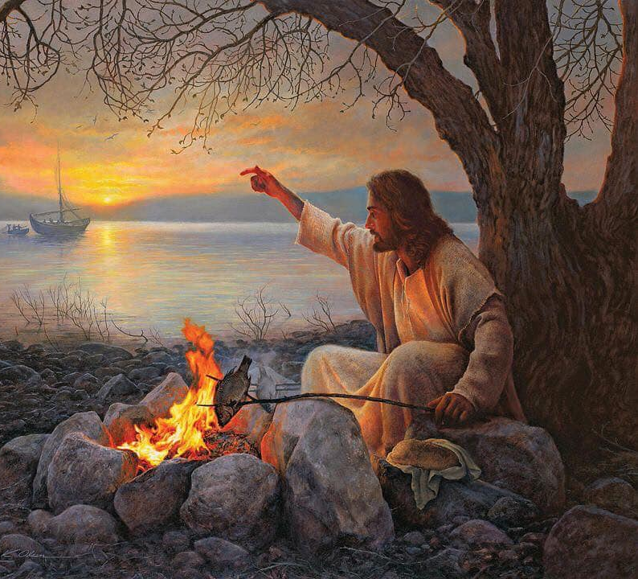
Fishing Disciples
Jn 21:1-14
Jn 18:18
Jn 11:14-17
Jn 14:5-7
Mt 14:17-21
Mt 16:9
4/28/24

Slide 2
After this Jesus revealed himself again to the disciples by the Sea of Tiberias, and he revealed himself in this way. ² Simon Peter, Thomas (called the Twin), Nathanael of Cana in Galilee, the sons of Zebedee, and two others of his disciples were together. ³ Simon Peter said to them, “I am going fishing.” They said to him, “We will go with you.” They went out and got into the boat, but that night they caught nothing. ⁴ Just as day was breaking, Jesus stood on the shore; yet the disciples did not know that it was Jesus. Jn 21:1-4

Slide 3
Jesus said to them, “Children, do you have any fish?” They answered him, “No.” ⁶ He said to them, “Cast the net on the right side of the boat, and you will find some.” So they cast it, and now they were not able to haul it in, because of the quantity of fish. ⁷ That disciple whom Jesus loved therefore said to Peter, “It is the Lord!” When Simon Peter heard that it was the Lord, he put on his outer garment, for he was stripped for work, and threw himself into the sea. Jn 21:5-7

Slide 4
The other disciples came in the boat, dragging the net full of fish, for they were not far from the land, but about a hundred yards off. ⁹ When they got out on land, they saw a charcoal fire in place, with fish laid out on it, and bread. ¹⁰ Jesus said to them, “Bring some of the fish that you have just caught.” ¹¹ So Simon Peter went aboard and hauled the net ashore, full of large fish, 153 of them. And although there were so many, the net was not torn. Jn 21:8-11

Slide 5
Jesus addressed
the Disciples’
futility.
Jn 21:5

Slide 6
Jesus appeared to
these disciples:
James Peter Matthew
John Judas Thomas
Philip Nathanael

Slide 7
Jesus appeared to
these disciples:
James Peter Matthew
John Judas Thomas
Philip Nathanael

Slide 8
Peter, James, John
And after six days Jesus took… Peter. James, and John… and led them up a high mountain by themselves. ² And he was transfigured before them, and his face shone like the sun, and his clothes became white as light. ³ And behold, there appeared to them Moses and Elijah, talking with him…. ^{5b} behold, a bright cloud overshadowed them, and a voice from the cloud said, “This is my beloved Son, with whom I am well pleased; listen to him,”

Slide 9
Peter, James, John
When the disciples heard this, they fell on their faces and were terrified. ⁷ But Jesus came and touched them, saying, “Rise, and have no fear.” ⁸ And when they lifted up their eyes, they saw no one but Jesus only.
⁹ And as they were coming down the mountain, Jesus commanded them, “Tell no one the vision, until the Son of Man is raised from the dead.” Mt 14:5-6; 11:15-16

Slide 10
Thomas: Let’s die with Jesus!
Thomas said to him, “Lord, we do not know where you are going. How can we know the way?” ⁶ Jesus said to him, “I am the way, and the truth, and the life. No one comes to the Father except through me… ¹⁵ and for your sake I am glad that I was not there, so that you may believe. But let us go to him.” ¹⁶ So Thomas, called the Twin, said to his fellow disciples, “Let us also go, that we may die with him.” Jn 14:5-6; 11:15-16

Slide 11
The next day again John was standing with two of his disciples, ³⁶ and he looked at Jesus as he walked by and said, “Behold, the Lamb of God!” ³⁷ The two disciples heard him say this, and they followed... ⁴¹ Andrew first found his own brother Simon and said to him, “We have found the Messiah” (which means Christ). ⁴² He brought him to Jesus. Jesus looked at him and said, “You are Simon the son of John. You shall be called Cephas” (which means Peter). Jn 1:35-42

Slide 12
Nathanael: No Good Thing
Nathanael said to him, “Can anything good come out of Nazareth?” Philip said to him, “Come and see.” ⁴⁷ Jesus saw Nathanael coming toward him and said of him, “Behold, an Israelite indeed, in whom there is no deceit!” ⁴⁸ Nathanael said to him, “How do you know me?” Jesus answered him, “Before Philip called you, when you were under the fig tree, I saw you.” Jn 1:46-48

Slide 13
Nathanael: Pure Israeli
Nathanael answered him, “Rabbi, you are the Son of God! You are the King of Israel!” ⁵⁰ Jesus answered him, “Because I said to you, ‘I saw you under the fig tree,’ do you believe? You will see greater things than these.” ⁵¹ And he said to him, “Truly, truly, I say to you, you will see heaven opened, and the angels of God ascending and descending on the Son of Man.” Jn 1:49-51

Slide 14
Four significant things in this passage are: fish, charcoal, bread, and a net.
Jn 18:18; 21:1-11

Slide 15
Fish: Zero to Too Full
Jesus said to them, “Children, do you have any fish?” They answered him, “No.” ⁶ He said to them, “Cast the net on the right side of the boat, and you will find some.” So they cast it, and now they were not able to haul it in, because of the quantity of fish… ⁹ When they got out on land, they saw a charcoal fire in place, with fish laid out on it, and bread. ¹⁰ Jesus said to them, “Bring some of the fish that you have just caught.” … ^{11b} And although there were so many, the net was not torn. Jn 21:5-6, 9-10, 11b

Slide 16
Charcoal: Coal from a mine
Jesus said to them, “Children, do you have any fish?” They answered him, “No.” ⁶ He said to them, “Cast the net on the right side of the boat, and you will find some.” So they cast it, and now they were not able to haul it in, because of the quantity of fish… ⁹ When they got out on land, they saw a charcoal fire in place, with fish laid out on it, and bread. ¹⁰ Jesus said to them, “Bring some of the fish that you have just caught.” … ^{11b} And although there were so many, the net was not torn.
Jn 21:5-6, 9-10, 11b

Slide 17
Bread: Communion & Feeding Miracles
⁹ When they got out on land, they saw a charcoal fire in place, with fish laid out on it, and bread.
But Jesus said, “They need not go away; you give them something to eat.” ¹⁷ They said to him, “We have only five loaves here and two fish.” ¹⁸ And he said, “Bring them here to me.” … ²¹ And those who ate were about five thousand men, besides women and children. Jn 21:9; Mt 14:17-18, 21

Slide 18
Net: Empty to Full
Jesus said to them, “Children, do you have any fish?” They answered him, “No.” ⁶ He said to them, “Cast the net on the right side of the boat, and you will find some.” So they cast it, and now they were not able to haul it in, because of the quantity of fish… ¹⁰ Jesus said to them, “Bring some of the fish that you have just caught.” ¹¹ So Simon Peter went aboard and hauled the net ashore, full of large fish, 153 of them. And although there were so many, the net was not torn. Jn 21:5-6, 9-10-11

