Slide 1
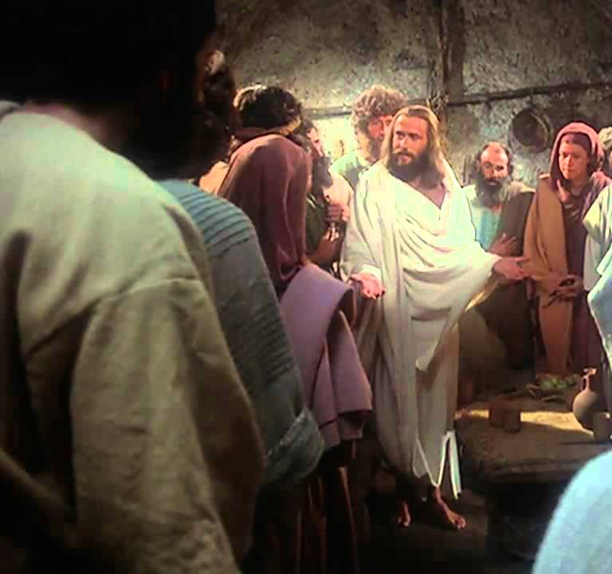
Thomas Alone
Jn 20:24-31
Lk 24:36-49
Jn 11:14-17
Jn 14:5-7
Jn 20:19-23
4/21/24

Slide 2
Thomas was willing to die with Jesus
Then Jesus told them plainly, “Lazarus has died, ¹⁵ and for your sake I am glad that I was not there, so that you may believe. But let us go to him.” ¹⁶ So Thomas, called the Twin, said to his fellow disciples, “Let us also go, that we may die with him.” ¹⁷ Now when Jesus came, he found that Lazarus had already been in the tomb four days. Jn 11:14-17

Slide 3
Thomas was Willing to go wherever Jesus went
Thomas said to him, “Lord, we do not know where you are going. How can we know the way?” ⁶ Jesus said to him, “I am the way, and the truth, and the life. No one comes to the Father except through me. ⁷ If you had known me, you would have known my Father also. From now on you do know him and have seen him.” Jn 14:5-7

Slide 4
Thomas missed out
Now Thomas, one of the twelve, called the Twin, was not with them when Jesus came.
²⁵ So the other disciples told him, “We have seen the Lord.” But he said to them, “Unless I see in his hands the mark of the nails, and place my finger into the mark of the nails, and place my hand into his side, I will never believe.” Jn 20:24-25

Slide 5
Thomas was
likely feeling:
Hurt
Ignored
Hopeful
Peaceful

Slide 6
Thomas was
likely feeling:
Hurt
Ignored
Hopeful
Peaceful

Slide 7
Eight days later, his disciples were inside again, and Thomas was with them. Although the doors were locked, Jesus came and stood among them and said, “Peace be with you.” ²⁷ Then he said to Thomas, “Put your finger here, and see my hands; and put out your hand, and place it in my side. Do not disbelieve, but believe.” ²⁸ Thomas answered him, “My Lord and my God!”
Jn 20:26-28

Slide 8
Jesus addressed Thomas’ feelings to reveal the peace that only He could bring.
Eight days later, his disciples were inside again, and Thomas was with them. Although the doors were locked, Jesus came and stood among them and said, “Peace be with you.” ²⁷ Then he said to Thomas, “Put your finger here, and see my hands; and put out your hand, and place it in my side. Do not disbelieve, but believe.” Jn 20:26-27

Slide 9
Jesus said to him, “Have you believed because you have seen me? Blessed are those who have not seen and yet have believed.” ³⁰ Now Jesus did many other signs in the presence of the disciples, which are not written in this book; ³¹ but these are written so that you may believe that Jesus is the Christ, the Son of God, and that by believing you may have life in his name.
Jn 20:29-31

Slide 10
My Lord and My God!

