Slide 1
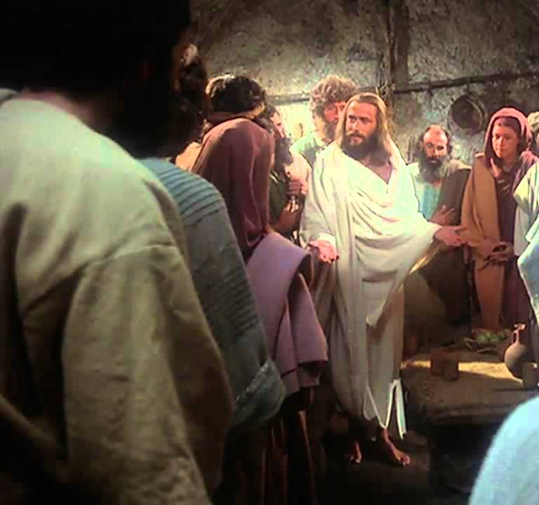
Touch Me
Jn 20:19-25
Lk 24:36-49
4/7/24

Slide 2
¹⁹ On the evening of that day, the first day of the week, the doors being locked where the disciples were for fear of the Jews, ³⁶ As they were talking about these things, Jesus himself stood among them, and said to them, “Peace to you!” ³⁷ But they were startled and frightened and thought they saw a spirit. ³⁸ And he said to them, “Why are you troubled, and why do doubts arise in your hearts? ³⁹ See my hands and my feet, that it is I myself. Touch me, and see. For a spirit does not have flesh and bones as you see that I have.” Jn 20:19; Lk 24:36-39

Slide 3
And while they still disbelieved for joy and were marveling, he said to them, “Have you anything here to eat?” ⁴² They gave him a piece of broiled fish, ⁴³ and he took it and ate before them. ²¹ Jesus said to them again, “Peace be with you. As the Father has sent me, even so I am sending you.” ²² And when he had said this, he breathed on them and said to them, “Receive the Holy Spirit. ²³ If you forgive the sins of any, they are forgiven them; if you withhold forgiveness from any, it is withheld.” Lk 24:40-43; Jn 20:21-23

Slide 4
On the evening of the
first day of the week the disciples were feeling:
Hopeful Confused
Abandoned Peaceful

Slide 5
On the evening of the
first day of the week the disciples were feeling:
Hopeful Confused
Abandoned Peaceful

Slide 6
Jesus addressed their senses to the peace that only He could bring.
As they were talking about these things, Jesus himself stood among them, and said to them, “Peace to you!” But they were startled and frightened and thought they saw a spirit. And he said to them, “Why are you troubled, and why do doubts arise in your hearts? Lk 24:36-38

Slide 7
¹⁹ On the evening of that day, the first day of the week, the doors being locked where the disciples were for fear of the Jews, ³⁶ As they were talking about these things, Jesus himself stood among them, and said to them, “Peace to you!” ³⁷ But they were startled and frightened and thought they saw a spirit. ³⁸ And he said to them, “Why are you troubled, and why do doubts arise in your hearts? ³⁹ See my hands and my feet, that it is I myself. Touch me, and see. For a spirit does not have flesh and bones as you see that I have.” Jn 20:19; Lk 24:36-39

Slide 8
And while they still disbelieved for joy and were marveling, he said to them, “Have you anything here to eat?” ⁴² They gave him a piece of broiled fish, ⁴³ and he took it and ate before them. ²¹ Jesus said to them again, “Peace be with you. As the Father has sent me, even so I am sending you.” ²² And when he had said this, he breathed on them and said to them, “Receive the Holy Spirit. ²³ If you forgive the sins of any, they are forgiven them; if you withhold forgiveness from any, it is withheld.” Lk 24:40-43; Jn 20:21-23

Slide 9
Reflections:
Jesus speaks “eternity” in face of pain:
“Peace to you!”
“Why are you troubled, and why do doubts arise in your hearts?
Jesus can be touched – He is human:
“Touch me, and see”
Jesus sends us what we need:
“Receive the Holy Spirit”
Receive forgiveness – “Give others forgiveness”

