Slide 1
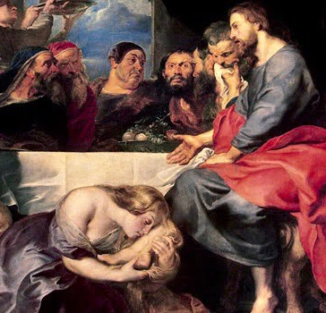
Perfume Anointing
Jn 12:1-8
Mt 26:6-13
Mk 14:3-11
Lk 10:38-42
Lk 7:36-50
3/3/24

Slide 2
Six days before the Passover, Jesus therefore came to Bethany, where Lazarus was, whom Jesus had raised from the dead. ² So they gave a dinner for him there. Martha served, and Lazarus was one of those reclining with him at table. ³ Mary therefore took a pound of expensive ointment made from pure nard, and anointed the feet of Jesus and wiped his feet with her hair. The house was filled with the fragrance of the perfume. ⁴ But Judas Iscariot, one of his disciples (he who was about to betray him), said, Jn 12:1-4

Slide 3
Bethany was an important stop
for Jesus.
Mt 21:17; 26:6; Mk 11:11, 12, 14:3;
Lk 19:29; 24:50; Jn 11:1, 18; 12:1

Slide 4
“Why was this ointment not sold for three hundred denarii and given to the poor?” ⁶ He said this, not because he cared about the poor, but because he was a thief, and having charge of the moneybag he used to help himself to what was put into it. ⁷ Jesus said, “Leave her alone, so that she may keep it for the day of my burial. ⁸ For the poor you always have with you, but you do not always have me.” Jn 12:5-8

Slide 5
Jesus defended Mary’s integrity. Lk 10:41-42; Jn 12:7-8; Mk 14:6-7
But Jesus said, “Leave her alone. Why do you trouble her? She has done a beautiful thing to me. ⁷ For you always have the poor with you, and whenever you want, you can do good for them. But you will not always have me. Mk 14:6-7

Slide 6
Now as they went on their way, Jesus entered a village. And a woman named Martha welcomed him into her house. ³⁹ And she had a sister called Mary, who sat at the Lord’s feet and listened to his teaching. ⁴⁰ But Martha was distracted with much serving. And she went up to him and said, “Lord, do you not care that my sister has left me to serve alone? Tell her then to help me.” ⁴¹ But the Lord answered her, “Martha, Martha, you are anxious and troubled about many things, ⁴² but one thing is necessary. Mary has chosen the good portion, which will not be taken away from her.” Lk 10:38-42

Slide 7
Notice:
Time:
  - Six days before Passover – Jesus’ death
Women’s Place (not at Table):
- Martha working at serving
- Mary acts UNSEEMINGLY
3 Jesus’ Silence:

Slide 8
Mary poured
perfume on Jesus’
Head Feet
Mt 26:7; Mk 14:3; Jn 12:1

Slide 9
And while he was at Bethany in the house of Simon the leper, as he was reclining at table, a woman came with an alabaster flask of ointment of pure nard, very costly, and she broke the flask and poured it over his head. ⁴ There were some who said to themselves indignantly, “Why was the ointment wasted like that? ⁵ For this ointment could have been sold for more than three hundred denarii and given to the poor.” And they scolded her.
Mk 15:3-5

Slide 10
Mary poured
perfume on Jesus’
Head Feet
Mt 26:7; Mk 14:3; Jn 12:1

Slide 11
Notice:
Time:
  - Six days before Passover – Jesus’ death
Women’s Place (not at Table):
- Martha working at serving
- Mary acts UNSEEMINGLY
3 Jesus’ Silence:
  - Jesus receives the anointing (saying 0)
  - Full scene is a complete anointing (Peter)

Slide 12
Lord, help me to process the depth of this Woman’s actions!
Am I ready to act out?

