Slide 1
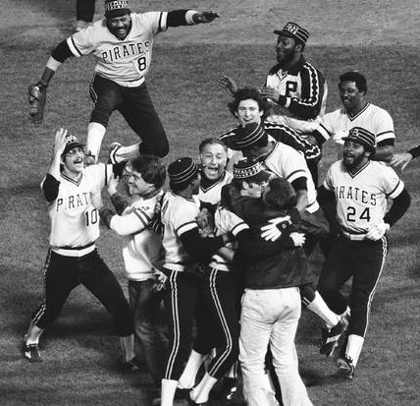
A House Principle - Jesus
Mt 13:1-9
Jn 6:59-7:10
Lk 2:41-53
Mt 12:46-50
Mk 3:19-4:1
2/18/24

Slide 2
While he was still speaking to the people, behold, his mother and his brothers stood outside, asking to speak to him. ⁴⁸ But he replied to the man who told him, “Who is my mother, and who are my brothers?” ⁴⁹ And stretching out his hand toward his disciples, he said, “Here are my mother and my brothers! ⁵⁰ For whoever does the will of my Father in heaven is my brother and sister and mother.” That same day Jesus went out of the house and sat beside the sea.
Mt 12:46-13:1

Slide 3
Jesus comes out of
the house.
Mt 13:1
Jesus values (uses)
house talk.
Mk 3:19-4:1… etc.

Slide 4
What was Jesus’ impact on his “house?”
Jesus in Jerusalem for Passover Lk 2:41-53
Jesus in house in Capernaum Mk 3:19-4:9
Jesus in house – Sūkkōt Mk 3:19-4:9
Several General references to Capernaum
FYI: Wedding in Cana – Jesus and his family return to Capernaum (taught in synagogue Jn 6:59)

Slide 5
Now his parents went to Jerusalem every year at the Feast of the Passover. ⁴² And when he was 12 years old, they went up according to custom. ⁴³ And when the feast was ended, as they were returning, the boy Jesus stayed behind in Jerusalem. His parents did not know it, ⁴⁴ but supposing him to be in the group they went a day’s journey, but then they began to search for him among their relatives and acquaintances, ⁴⁵ and when they did not find him, they returned to Jerusalem, searching for him. Lk 2:41-45

Slide 6
After three days they found him in the temple, sitting among the teachers, listening to them and asking them questions. ⁴⁷ And all who heard him were amazed at his understanding and his answers. ⁴⁸ And when his parents saw him, they were astonished. And his mother said to him, “Son, why have you treated us so? Behold, your father and I have been searching for you in great distress.” ⁴⁹ And he said to them, “Why were you looking for me? Did you not know that I must be in my Father’s house?” Lk 2:46-49

Slide 7
And they did not understand the saying that he spoke to them. ⁵¹ And he went down with them and came to Nazareth and was submissive to them. And his mother treasured up all these things in her heart.
Lk 2:50-51
1
Jesus fully expressed his relationship with his heavenly father in his house experience!

Slide 8
Then he went home, and the crowd gathered again, so that they could not even eat.
That same day Jesus went out of the house and sat beside the sea. Mk 3:20; Mt 13:1 (Mk 4:1)
2
Jesus retreated to “the house.”
This showed that he valued his relationship with his mother, brothers, and sisters. He gave priority to their thoughts.

Slide 9
After this Jesus went about in Galilee. He would not go about in Judea, because the Jews were seeking to kill him. ² Now the Jews’ Feast of Booths was at hand. ³ So his brothers said to him, “Leave here and go to Judea, that your disciples also may see the works you are doing. ⁴ For no one works in secret if he seeks to be known openly. If you do these things, show yourself to the world.” ⁵ For not even his brothers believed in him. Jn 7:1-5

Slide 10
Jesus said to them, “My time has not yet come, but your time is always here… ⁸ You go up to the feast. I am not going up to this feast, for my time has not yet fully come.” ⁹ After saying this, he remained in Galilee. Jn 7:6, 8-9
3
Jesus, in his house, revealed a discernment to be private and not public. Jesus was probably the one who changed the family’s “Feast” practice (going to Jerusalem 3x/yr.).

Slide 11


Mary and John
… behold your mother. Jn 19:25-27
Mary:
Heart
Treasure
Lk 2:19
Pentecost
Jesus
120 – including Mary and Jesus’ brothers

