Slide 1
When the Powers Take Over
Colossians 2:6–19; Exodus 32:1-14
Sermon at Agape Fellowship
February 11, 2024

Slide 2
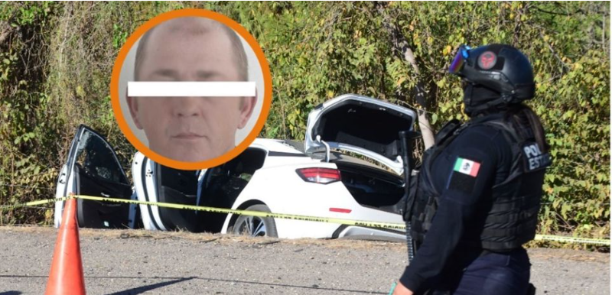
Franz Kauenhofen Wiebe
From La Silla Rota

Slide 3
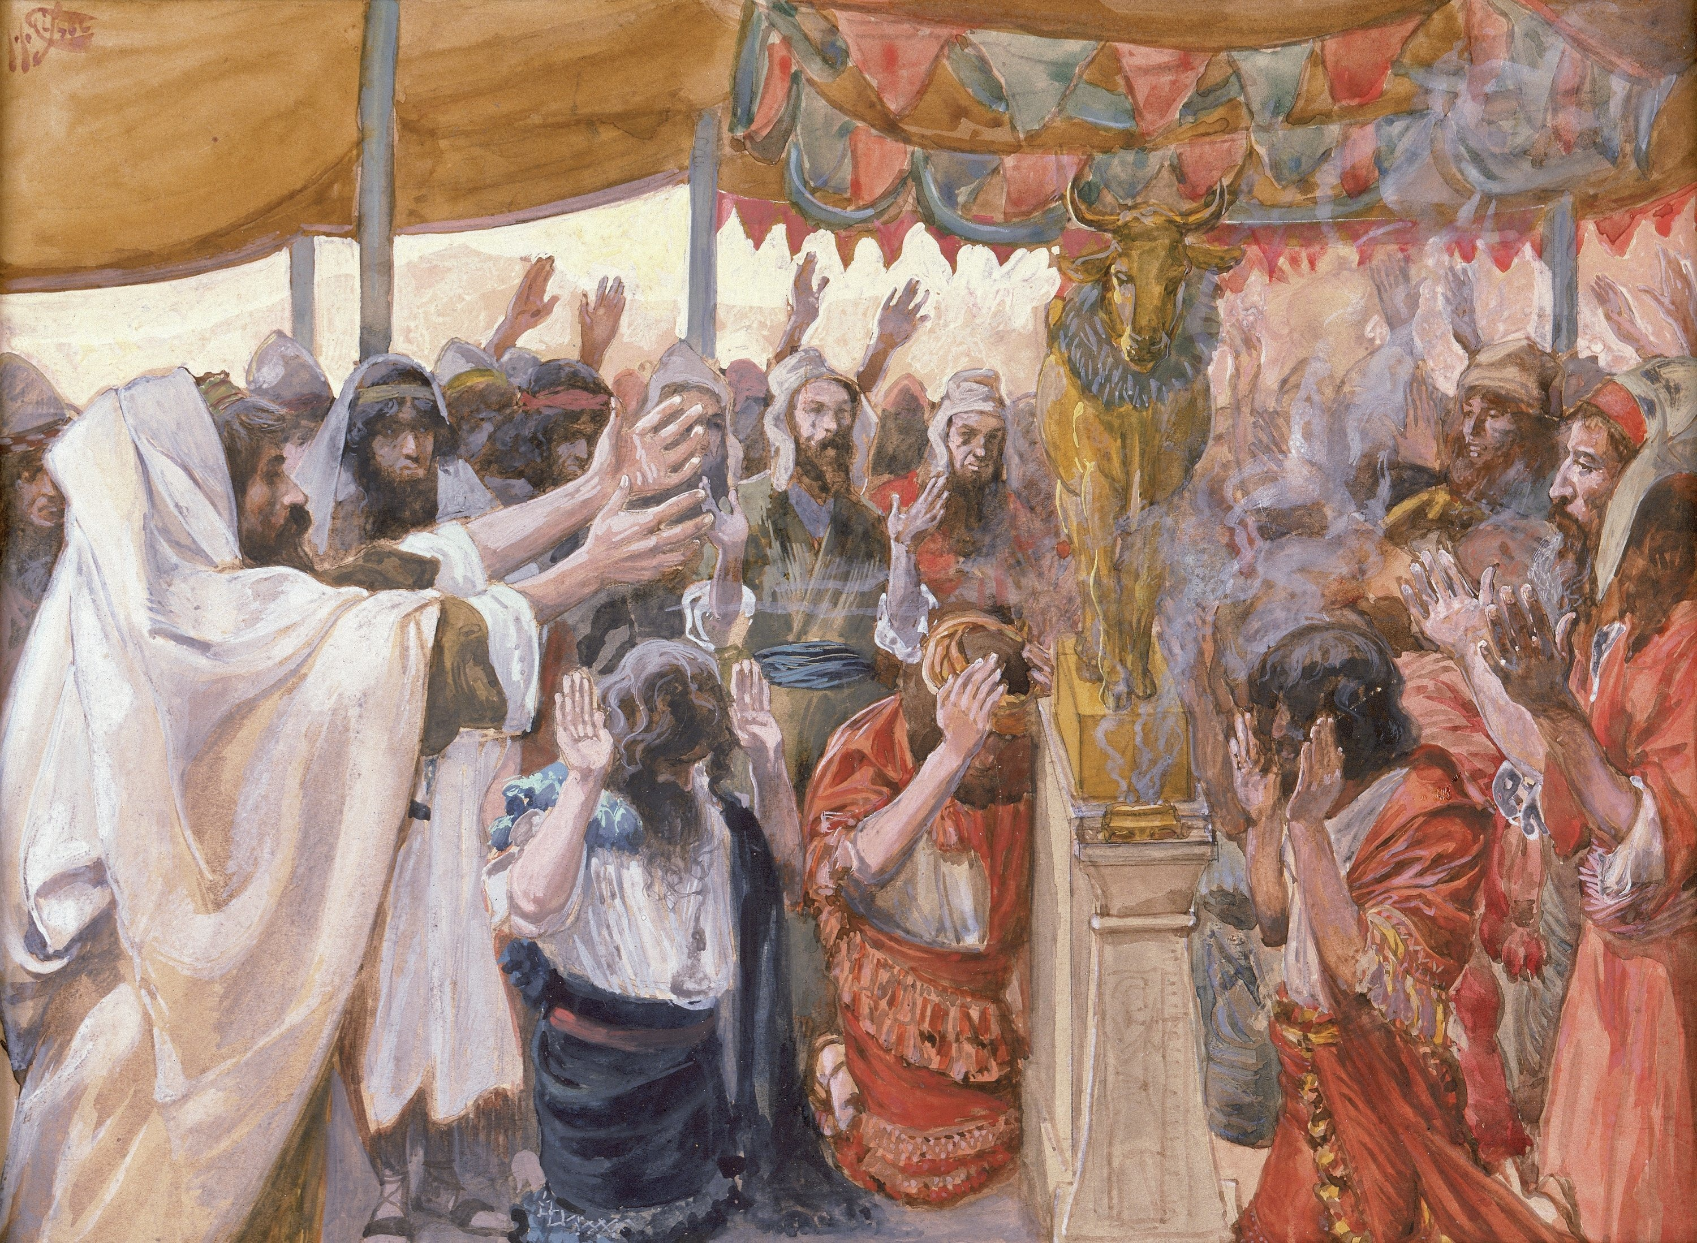
Exodus 32 – The Golden Calf
Picture from Logos Bible Software

Slide 4
Old Testament Story
(a cycle)
The people fall into sin and danger.
God sends a leader to rescue them.
God saves them; restores community.
The cycle repeats…
Eventually, they go into exile.

Slide 5
New Testament Story
God’s plan of salvation
Salvation is for both Jews and Gentiles
Saul / Paul becomes cross-cultural preacher
Paul writes to believers in Colossae.
  Saved from power of traditional religion.
  Saved from demonic forces.

Slide 6
Colossians chapter 2
The danger is the same.
Slipping back into old patterns.
Becoming enslaved again by the powers from which they were rescued.
Paul reminds them of their salvation.

Slide 7
The dangers – a closer look.
Colossians 2:8
⁸ Watch out that no one takes you captive through philosophy and empty deceit,
according to human tradition,
according to the elemental principles
of the world,
and not according to Christ.

Slide 8
Philosophy
Philosophy = love of wisdom
But whose wisdom?
What is the source of this wisdom?
God’s wisdom is distorted by sin and selfish human wisdom.
Such wisdom becomes…

Slide 9
Empty deceipt
Philosophy becomes distorted.
Disconnected from God.
Becomes empty; nothing to it.
Such “wisdom” is deceitful.
Separated from the truth; a lie.
It is simply empty deceit.

Slide 10
According to human tradition
Detached from God’s wisdom, it is simply human tradition.
Human tradition is selfish.
  It’s about Me
  My family
  My race
  My culture

Slide 11
The elemental principles
NRSV and ESV: elemental spirits
NIV: elemental spiritual forces or basic principles
NLT: spiritual powers
NCV: ruling spirits
NASB: elementary principles

Slide 12
Spiritual powers
Spiritual forces in the world
Become separated from God
Assert themselves against God
Serve the cause of human selfishness
Take the place of God in human lives

Slide 13
The modern isms
Materialism
Capitalism
Communism, Socialism
Federalism, Objectivism
Hedonism, Narcissism
Nationalism, Zionism

Slide 14
Isms become religious systems
Often an idea or ism starts with God.
But uses God for own purposes.
Expand the ism until it is greater than God.
Humans abandon the one true God for an idea, ism, a god in their own image

Slide 15
Exodus 32:1
When the people saw that Moses delayed to come down from the mountain, the people gathered around Aaron and said to him, “Come, make gods for us, who shall go before us; as for this Moses, the man who brought us up out of the land of Egypt, we do not know what has become of him.”

Slide 16
How “good people” become captive
Starts with anxiety, fear of unknown
Fear of the unknown, what is next
With no leader the presence and existence of God is in question.
People take matters into own hands.
Go back to a pagan religious system they can control.

Slide 17
Idolatry: Fear replacing trust
In crisis, back to old religious patterns
A religion of “add-ons”
  God and family
  God and country
Aaron: We can have it both ways.
  [32:5] Aaron…built an altar…and…made a proclamation and said, “Tomorrow shall be a festival to the LORD.”

Slide 18
The movement to idolatry
From trust in God to fear.
A compromise to address fear.
Compromise leads to commitment to a spiritual power.
Commitment leads to captivity by that power, slavery to the power.

Slide 19
Apostle Paul’s remedy
Colossians 2 -- ⁶ As you therefore have received Christ Jesus the Lord,
continue to walk in him…
⁷ rooted and built up in him and established in the faith,
just as you were taught…
From fear to abounding in thanksgiving.

Slide 20
The contrast
Colossians 2:8
⁸ Watch out that no one takes you captive through philosophy and empty deceit,
according to human tradition,
according to the elemental principles
of the world,
and not according to Christ.

Slide 21
Trust in Christ (Col. 2:9ff)
God himself (the whole fullness of deity) lives in Christ.
Christ is the head of every ruler and authority.
Proven through Christ’s death and resurrection.

Slide 22
No shadow god in worship
¹⁶ Therefore, do not let anyone condemn you in matters of food or drink or of observing festivals, new moons, or Sabbaths. ¹⁷ These are only a shadow of what is to come, but the body belongs to Christ.

Slide 23
Claiming our salvation
¹⁸ Do not let anyone disqualify you, insisting on self-abasement and worship of angels, initiatory visions, puffed up without cause by a human way of thinking, ¹⁹ and not holding fast to the head, from whom the whole body, nourished and held together by its ligaments and tendons, grows with a growth that is from God.

Slide 24
The powers take over
We may shake our heads…
But “watch out!”
The powers will take us away from the center.
The fullness of God’s character and salvation is in Jesus Christ.

