Slide 1
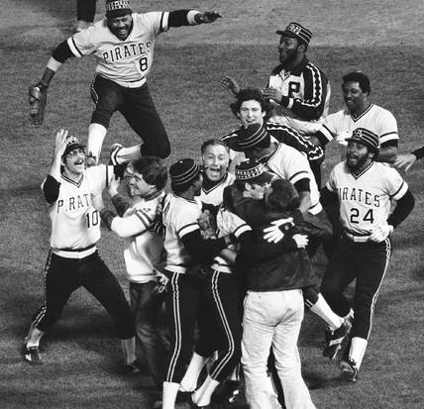
We are Family!
Mt 12:46-50
Lk 8:19-21
Mk 3:19-21
Mk 3:31-35
2/4/24

Slide 2
While he was still speaking to the people, behold, his mother and his brothers stood outside, asking to speak to him. ⁴⁸ But he replied to the man who told him, “Who is my mother, and who are my brothers?” ⁴⁹ And stretching out his hand toward his disciples, he said, “Here are my mother and my brothers! ⁵⁰ For whoever does the will of my Father in heaven is my brother and sister and mother.” Mt 12:46-50

Slide 3
… and Judas Iscariot, who betrayed him.
²⁰ Then he went home, and the crowd gathered again, so that they could not even eat. ²¹ And when his family heard it, they went out to seize him, for they were saying, “He is out of his mind. Mk 3:19-21
Judas, betrayer, Did not “family” Jesus
Jesus was hemmed in fasting: un-choice
Jesus was too “giving” –
  A Not looking out for himself
  B Sacrificing his health

Slide 4


Mary and Sons
… then his mother & brothers arrived… they sent word to him and called him. Mk 3:31
Mission:
Save
Jesus
Jesus
Town People

Slide 5
And Jesus answered them, “Go and tell John what you hear and see: the blind receive their sight and the lame walk, lepers are cleansed and the deaf hear, and the dead are raised up, and the poor have good news preached to them. And blessed is the one who is not offended by me.” Mt 11:4-6

Slide 6
I thank you, Father, Lord of heaven and earth, that you have hidden these things from the wise and understanding and revealed them to little children; ²⁶ yes, Father, for such was your gracious will. ²⁷ All things have been handed over to me by my Father, and no one knows the Son except the Father, and no one knows the Father except the Son and anyone to whom the Son chooses to reveal him. Mt 11:25-27

Slide 7
Come to me, all you who labor and are heavy laden, and I will give you rest. ²⁹ Take my yoke upon you, and learn from me, for I am gentle and lowly in heart, and you will find rest for your souls. ³⁰ For my yoke is easy, and my burden is light. Mt 11:28-30
I tell you, something greater than the temple is here. ⁷ And if you had known what this means, ‘I desire mercy, and not sacrifice,’ you would not have condemned the guiltless.⁸ For the Son of Man is lord of the Sabbath.
Mt 12:7-8

Slide 8
While he was still speaking to the people, behold, his mother and his brothers stood outside, asking to speak to him. ⁴⁸ But he replied to the man who told him, “Who is my mother, and who are my brothers?” ⁴⁹ And stretching out his hand toward his disciples, he said, “Here are my mother and my brothers! ⁵⁰ For whoever does the will of my Father in heaven is my brother and sister and mother.” Mt 12:46-50

Slide 9
Jesus uses this
occasion to point out the healthy is the relationships found in the house (of God)!
Mt 9:28; 10:6, 12, 13, 25; 12:4, 25, 29, 44; 13:1

Slide 10
For all who are led by the Spirit of God are sons of God. ¹⁵ For you did not receive the spirit of slavery to fall back into fear, but you have received the Spirit of adoption as sons, by whom we cry, “Abba! Father!” ¹⁶ The Spirit himself bears witness with our spirit that we are children of God, ¹⁷ and if children, then heirs—heirs of God and fellow heirs with Christ, provided we suffer with him in order that we may also be glorified with him.
Rom 8:14-17

