Slide 1
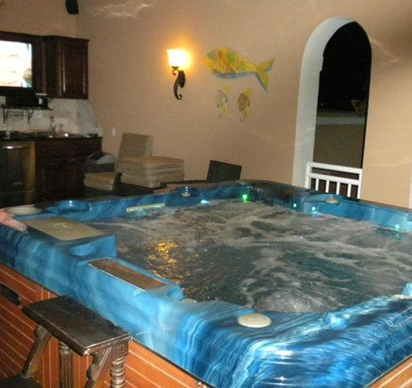
God’s Memory
Ps 102:18-20
Ps 103:1-22
Lk 11:1-2
Is 55:6-8
1/14/24

Slide 2
God is Hallowed.
Hallowed means Holy.
It happened that while Jesus was praying in a certain place, after He had finished, one of His disciples said to Him, “Lord, teach us to pray just as John also taught his disciples.” ² And He said to them, “When you pray, say:
‘Father, hallowed be Your name. Your kingdom come. Lk 11:1-2

Slide 3
God is (Hallowed)
a “world apart!”
“Seek the LORD while he may be found; call upon him while he is near; ⁷ let the wicked forsake his way, and the unrighteous man his thoughts; let him return to the LORD, that he may have compassion on him, and to our God, for he will abundantly pardon. ⁸ For my thoughts are not your thoughts, neither are your ways my ways, declares the LORD.
Is 55:6-8

Slide 4
How does God
change my status?
Let this be recorded for a generation to come, so that a people yet to be created may praise the LORD: ¹⁹ that he looked down from his holy height; from heaven the LORD looked at the earth, ²⁰ to hear the groans of the prisoners, to set free those who were doomed to die… Ps 102:18-20

Slide 5
GOD WANTS IT TO BE DOCUMENTED!
God sees our BAD SITUATION
God hears our LONGING (groans)
God sees our BONDAGE
God knows our END
God makes a new creation

Slide 6
Why does God desire to change our state?
The LORD works righteousness and justice for all who are oppressed. ⁷ He made known his ways to Moses, his acts to the people of Israel. ⁸ The LORD is merciful and gracious, slow to anger and abounding in steadfast love. Ps 103:6-8

Slide 7
God “compassions” us!
He does not deal with us according to our sins, nor repay us according to our iniquities. ¹¹ For as high as the heavens are above the earth, so great is his steadfast love toward those who fear him; ¹² as far as the east is from the west, so far does he remove our transgressions from us. ¹³ As a father shows compassion to his children, so the LORD shows compassion to those who fear him. ¹⁴ For he knows our frame; he remembers that we are dust.
. Ps 103:10-14

Slide 8
God gives us Memory
But, as it is written, “What no eye has seen, nor ear heard, nor the heart of man imagined, what God has prepared for those who love him” - knows our frame; he remembers that we are dust. 1 Cor 2:9
From of old no one has heard or perceived by the ear, no eye has seen a God besides you, who acts for those who wait for him. ⁵ You meet him who joyfully works righteousness, those who remember you in your ways. Is 64:4-5a

Slide 9
God’s removes our “POVERTY” to make a way for us to BE with Him.
He does not deal with us according to our sins, nor repay us according to our iniquities… ¹² as far as the east is from the west, so far does he remove our transgressions from us. ¹³ As a father shows compassion to his children, so the LORD shows compassion to those who fear him. ¹⁴ For he knows our frame; he remembers that we are dust.
. Ps 103:10, 12-14

Slide 10
What God does with me
He enables me to do with others because He made me in His image.
So God created man in his own image, in the image of God he created him; male and female he created them. ²⁸ And God blessed them. And God said to them, “Be fruitful and multiply and fill the earth and subdue it… ” Gen 1:27-28a

