Slide 1
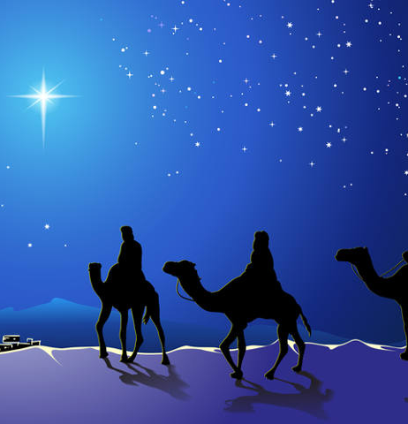
Hope, Peace, & Joy
Matt 2:1-2, 16-18
1 Sam 16:1-22
Jn 1:1-5
1 Samuel:
12:12-25
13:5-15
14:24-36
15:1-35
Josh 3:7; 5:13-15
12/17/23

Slide 2
God’s Story regarding His creation is not humanly predictable, not boring, and not with an unsatisfactory ending!

Slide 3
The Town of Bethlehem is a centerpiece of God’s mysterious way of centering Joy!

Slide 4
The word that characterized Saul’s relationship with Samuel was drama.
Saul said to Samuel, “I have sinned, for I have transgressed the commandment of the LORD and your words, because I feared the people and obeyed their voice. Now therefore, please pardon my sin and return with me that I may bow before the LORD.” 1 Sam 15:24-25

Slide 5
King chosen out of fear:
Fear of the Lord precedent 1 Sam 12:2-10; 12-25
Offering a priestly offering out of fear 1 Sam 13:5-15
Fasting Curse over Jonathan 1 Sam 14:24-36
Selfish wealth grabbing
following the Lord’s war 1 Sam 15:1-23

Slide 6
Samuel was
emotionally hooked.
And also the Glory of Israel will not lie or have regret, for he is not a man, that he should have regret.” Then he said, “I have sinned; yet honor me now before the elders of my people and before Israel, and return with me, that I may bow before the LORD your God.” So, Samuel turned back after Saul, and Saul bowed before the LORD.
1 Sam 15:29-31

Slide 7
The Lord responds to the desperate hearts of ______________ by shaking Samuel to go to Bethlehem.

Slide 8
The LORD said to Samuel, “How long will you grieve over Saul, since I have rejected him from being king over Israel? Fill your horn with oil, and go. I will send you to Jesse the Bethlehemite, for I have provided for myself a king among his sons.” …
Then Samuel said to Jesse, “Are all your sons here?” And he said, “There remains yet the youngest, but behold, he is keeping the sheep.” And Samuel said to Jesse, “Send and get him, for we will not sit down till he comes here.” 1 Sam 16:1, 11

Slide 9
Now after Jesus was born in Bethlehem of Judea in the days of Herod the king, behold, wise men from the east came to Jerusalem, ² saying, “Where is he who has been born king of the Jews? For we saw his star when it rose and have come to worship him.” ³ When Herod the king heard this, he was troubled, and all Jerusalem with him;
Mt 2:1-3

Slide 10
… an angel of the Lord appeared to Joseph in a dream and said, “Rise, take the child and his mother, and flee to Egypt, and remain there until I tell you, for Herod is about to search for the child, to destroy him.” … ¹⁶ Then Herod, when he saw that he had been tricked by the wise men, became furious, and he sent and killed all the male children in Bethlehem and in all that region who were two years old or under, according to the time that he had ascertained from the wise men. Mt 2:13b, 16

