Slide 1
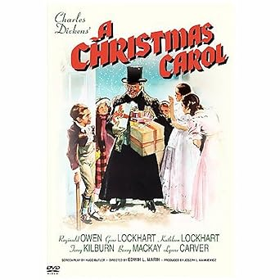
God Rest Ye Merry Gentlemen
2 Cor 1:3-7
Mt 1-2
Lk 1-2
2 Cor 1:3-5
Heb 12:1-3
Jn 16:31-33
11/26/23

Slide 2
Christmas Carol Sharing
Pick a Christmas Hymn/Carol.
Share a story relating to why you chose this Christmas Hymn/Carol.
Share something from the history of the song (we have resources for you).
Share the verses that are especially meaningful to you. Including any word changes and your preferences.
Give us your favorite audio or visual rendition of the song to play during your sharing time.

Slide 3
Sharing Schedule
Dates: Sunday 12/3 Sunday 12/10 Sunday 12/17
Moderator: Dale Rintelman Paul Leichty Junior Herlocher
Song #
1 Betty Sprout; O Little Town Tim Mello; Silent Night?/O Holy Night? Holger Schult; Silent Night
2
3

Slide 4
God Rest ye Merry Gentlemen
God rest ye merry gentlemen 1
Let nothing you dismay
Remember Christ our Saviour
Was born on Christmas Day
To save us all from Satan's pow’r
When we were gone astray
Chorus
O tidings of comfort and joy; Comfort and joy; O tidings of comfort and joy

Slide 5
Charles Dicken’s
A Christmas Carol
1938 MGM Cinema Release
Starring Reginald Owen as Scrooge
God Rest Ye Merry Gentlemen
Bob Cratchit – Happy w/ Family
- No talk of Mr. Scrooge
- Just fired for ruining Scrooge’s hat

Slide 6
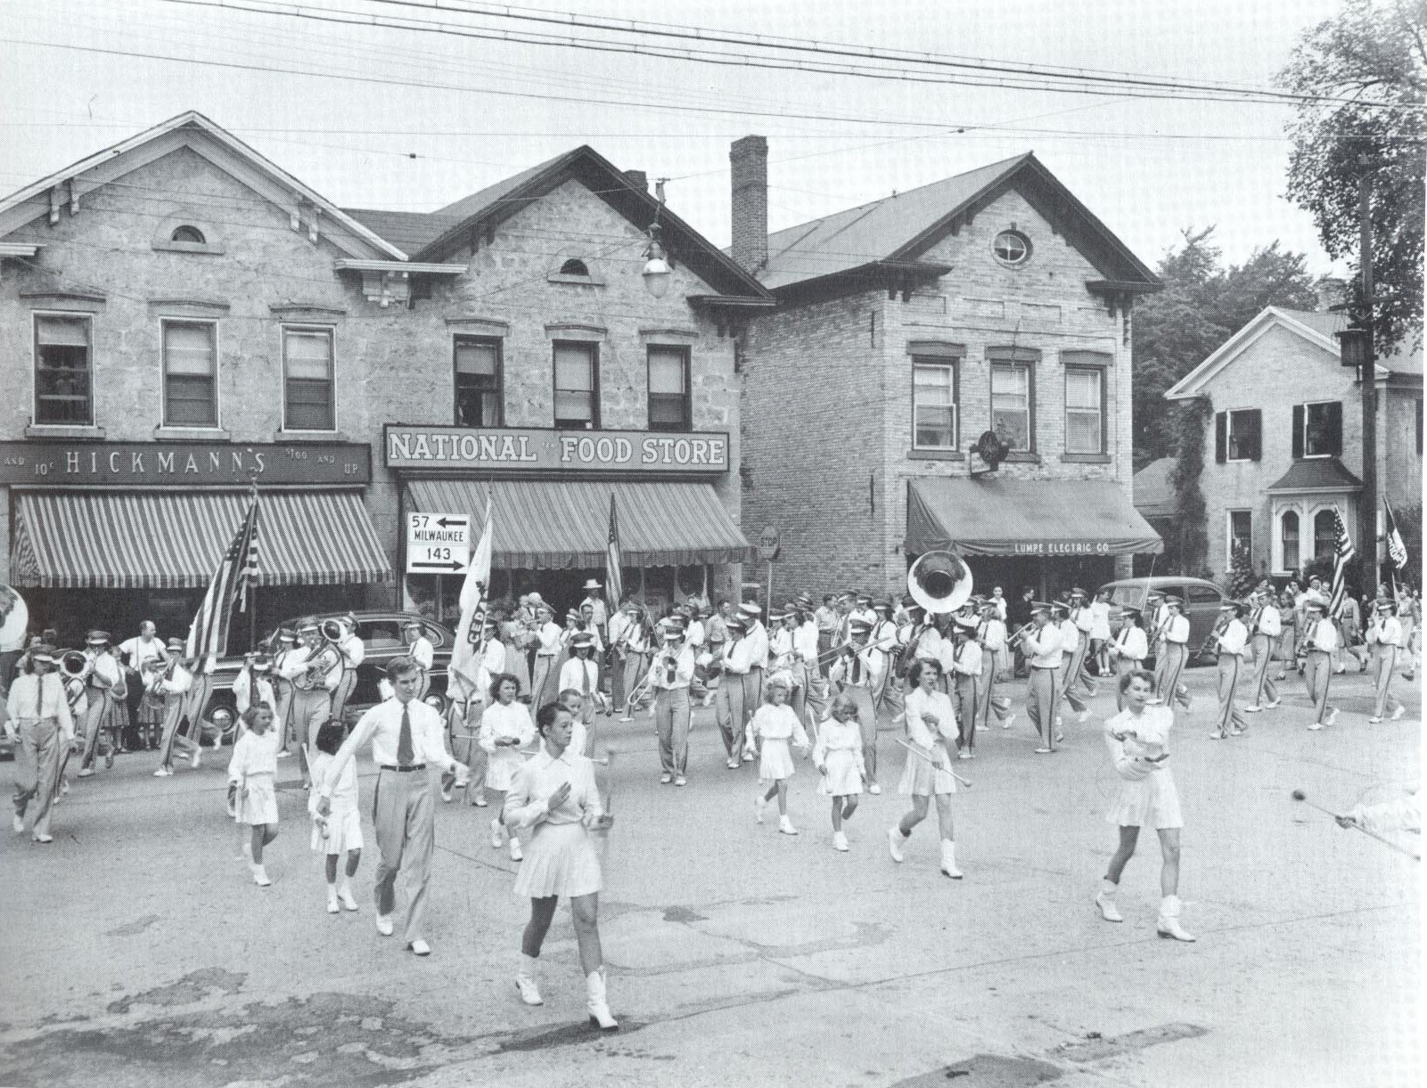

Slide 8
God Rest ye Merry Gentlemen
God rest ye merry gentlemen 1
Let nothing you dismay
Remember Christ our Saviour
Was born on Christmas Day
To save us all from Satan's pow’r
When we were gone astray
Chorus
O tidings of comfort and joy; Comfort and joy; O tidings of comfort and joy

Slide 9
In Bethlehem in Israel 2
This blessed Babe was born
And laid within a manger
Upon this blessed morn
The which His mother Mary
Did nothing take in scorn
From God our heavenly Father 3
A blessed angel came
And unto certain shepherds
Brought tidings of the same
How that in Bethlehem was born
The Son of God by name

Slide 10
Fear not then said the angel 4
Let nothing you affright
This day is born a Saviour,
Of a pure virgin bright
To free all those who trust in Him
From Satan's pow'r and might
The shepherds at those tidings 5
Rejoiced much in mind
And left their flocks afeeding
In tempest storm and wind
And went to Bethlehem straightway
The blessed Babe to find

Slide 11
when they came to Bethlehem 6
Where our dear Saviour lay
They found Him in a manger
Where oxen feed on hay
His mother Mary kneeling down
Unto the Lord did pray
Now to the Lord sing praises 7
All you within this place
And with true love and brotherhood
Each other now embrace
This holy tide of Christmas
All others doth deface

Slide 12
God Rest ye Merry Gentlemen
Over 500 years old – completely unknown
Queen Victoria published it for the first time in the 1800’s – popularity in the Anglican church
O tidings of comfort and joy; Comfort and joy; O tidings of comfort and joy

Slide 13
God Rest ye Merry Gentlemen
Merry: Not happy; Great & Mighty (victory)
Rest: Not sleep; keep or make (fortify)
God make you mighty Gentlemen
God will fortify you as Overcomers you people of Christ our savior and freedom giver
O tidings of comfort and joy;
Tidings: Coming news with informative implications, THIS WILL BRING CHANGE!

Slide 14
Scripture Connections
Blessed be the God and Father of our Lord Jesus Christ, the Father of mercies and God of all comfort, ⁴ who comforts us in all our affliction, so that we may be able to comfort those who are in any affliction, with the comfort with which we ourselves are comforted by God. ⁵ For as we share abundantly in Christ’s sufferings, so through Christ we share abundantly in comfort too. 2 Cor 1:3-5

Slide 15
Therefore, since we have been justified by faith, we have peace with God through our Lord Jesus Christ. ² Through him we have also obtained access by faith into this grace in which we stand, and we rejoice in hope of the glory of God. ³ Not only that, but we rejoice in our sufferings, knowing that suffering produces endurance, ⁴ and endurance produces character, and character produces hope, ⁵ and hope does not put us to shame, because God’s love has been poured into our hearts through the Holy Spirit who has been given to us. Rom 5:1-5

Slide 16
Therefore, since we are surrounded by so great a cloud of witnesses, let us also lay aside every weight, and sin which clings so closely, and let us run with endurance the race that is set before us, looking to Jesus, the founder and perfecter of our faith, who for the joy that was set before him endured the cross, despising the shame, and is seated at the right hand of the throne of God. Consider him who endured from sinners such hostility against himself, so that you may not grow weary or fainthearted.
Heb 12:1-3

Slide 17
God make you overcomers, you people of faith in Jesus Christ!
Jesus answered them, “Do you now believe? ³² Behold, the hour is coming, indeed it has come, when you will be scattered, each to his own home, and will leave me alone. Yet I am not alone, for the Father is with me. ³³ I have said these things to you, that in me you may have peace. In the world you will have tribulation. But take heart; I have overcome the world.”
Jn 16:31-33

