Slide 1
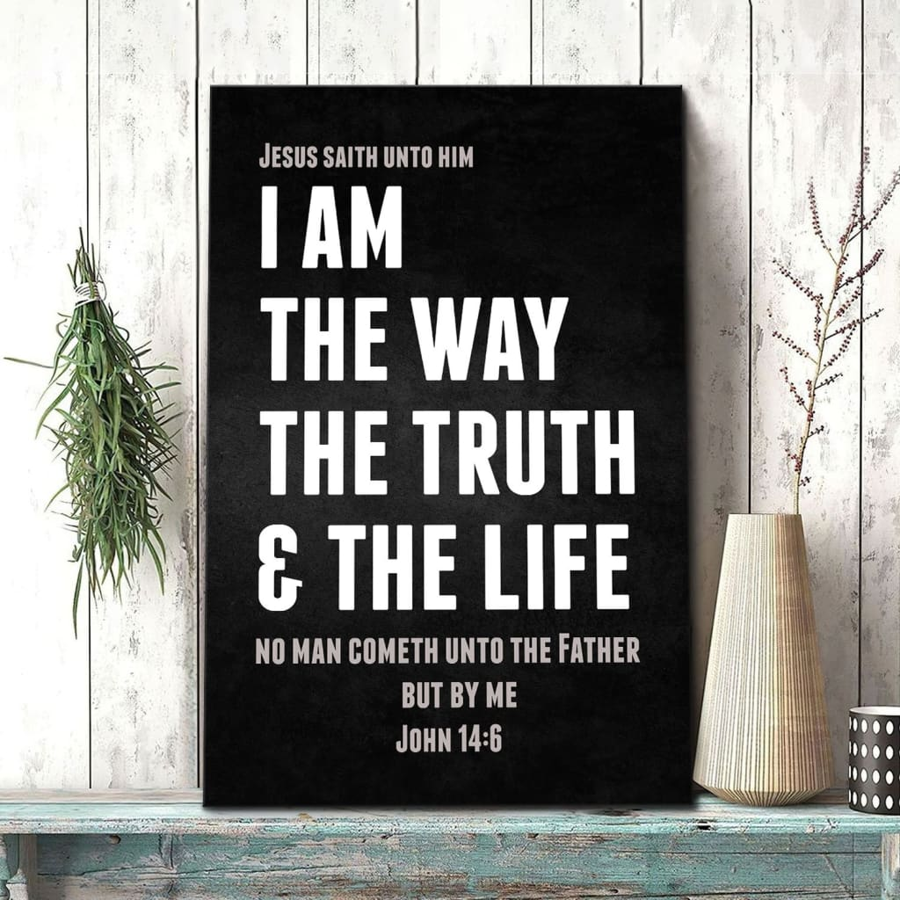
Jesus’ Spirit of Oneness
Jn 14:1-6
Jn 14:7-15
Rom 8:28-30
10/1/23

Slide 2
How much are you
like your father?
How well do you
know your father?

Slide 3
“Let not your hearts be troubled. Believe in God; believe also in me. ² In my Father’s house are many rooms. If it were not so, would I have told you that I go to prepare a place for you?” …
⁶ Jesus said to him, “I am the way, and the truth, and the life. No one comes to the Father except through me. ⁷ If you had known me, you would have known my Father also. From now on you do know him and have seen him.” Jn 14:1-2, 6-7

Slide 4
Jesus, The Placeholder:
And we know that for those who love God all things work together for good, for those who are called according to his purpose. ²⁹ For those whom he foreknew he also predestined to be conformed to the image of his Son, so that he might be the firstborn among many brothers. ³⁰ And those whom he predestined he also called, and those whom he called he also justified, and those whom he justified he also glorified. Rom 8:28-30

Slide 5
Jesus, The Revealer
Philip said to him, “Lord, show us the Father, and it is enough for us.”
⁹ Jesus said to him, “Have I been with you so long, and you still do not know me, Philip? Whoever has seen me has seen the Father. How can you say, ‘Show us the Father’?
Jn 14:8-9
Philip should have known that Jesus and His Father were ONE!

Slide 6
When Jesus said that He was in the Father and the Father was in Him He was saying that there are absolutely NO difference between them. (All of their words, actions, thoughts, and purposes were absolutely unified)

Slide 7
Do you not believe that I am in the Father and the Father is in me? The words that I say to you I do not speak on my own authority, but the Father who dwells in me does his works.
¹¹ Believe me that I am in the Father and the Father is in me, or else believe on account of the works themselves.
¹² “Truly, truly, I say to you, whoever believes in me will also do the works that I do; and greater works than these will he do, because I am going to the Father.
Jn 14:8-9

Slide 8
Whatever you ask in my name, this I will do, that the Father may be glorified in the Son. ¹⁴ If you ask me anything in my name, I will do it. ¹⁵ “If you love me, you will keep my commandments. Jn 14:13-15
A LOVE relationship with Jesus results in the activation of His words, actions, thoughts, and works through us.

Slide 9
I am created to be so
married to God that I flow His love and His mighty works.
Whatever you ask in my name, this I will do, that the Father may be glorified in the Son. ¹⁴ If you ask me anything in my name, I will do it. ¹⁵ “If you love me, you will keep my commandments. Jn 14:13-15

