Slide 1
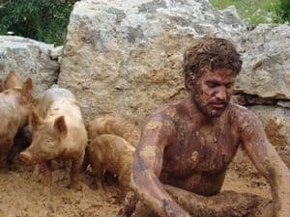
A Wondering Son
and a Forgiving Father
Lk 15:1-2
Lk 15:11-32
Rom 3:21-25
9/17/23

Slide 2
Jesus,
the “Sinner” Magnet
Now the tax collectors and sinners were all drawing near to hear him. ² And the Pharisees and the scribes grumbled, saying, “This man receives sinners and eats with them.” Lk 15:1-2

Slide 3
Joy in Heaven
The Lost Sheep
… And when he has found it, he lays it on his shoulders, rejoicing. ⁶ And when he comes home, he calls together his friends and his neighbors, saying to them, ‘Rejoice with me, for I have found my sheep that was lost.’ ⁷ Just so, I tell you, there will be exceeding joy in heaven over one sinner who repents above ninety-nine righteous persons who need no repentance. Lk 15:5-7

Slide 4
Joy in Heaven
The Lost Coin
… And when she has found it, she calls together her friends and neighbors, saying, ‘Rejoice with me, for I have found the coin that I had lost.’ ¹⁰ Just so, I tell you, there is joy before the angels of God over one sinner who repents.” Lk 15:9-10

Slide 5
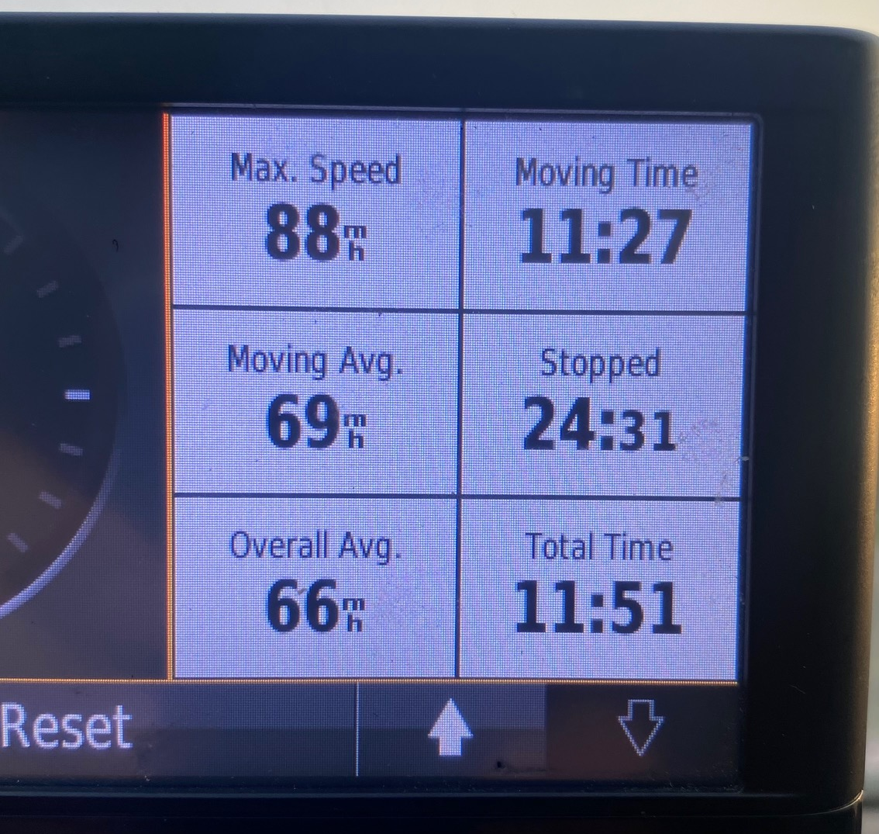
J
o
u
r
n
e
y

Slide 6
Jesus said, “There was a man who had two sons. ¹² And the younger of them said to his father, ‘Father, give me the share of property that is coming to me.’ And he divided his property between them. ¹³ Not many days later, the younger son gathered all he had and took a journey into a far country, and there he squandered his property in reckless living. ¹⁴ And when he had spent everything, a severe famine arose in that country, and he began to be in need. Lk 15:11-14

Slide 7
So he went and hired himself out to one of the citizens of that country, who sent him into his fields to feed pigs. ¹⁶ And he was longing to be fed with the pods that the pigs ate, and no one gave him anything. Lk 15:15-16
Desperation
kicks in…

Slide 8
Shame kept the younger son from a relationship with his father. Lk 15:14-17
And when he had spent everything, a severe famine arose in that country, and he began to be desperate… He ended up in the country feeding pigs… ¹⁶ And he was longing to be fed with the pods that the pigs ate… he came to himself, and said, ‘How many of my father’s hired servants have more than enough bread, but I perish here with hunger! Lk 15:14-17 abv

Slide 9
So he went and hired himself out to one of the citizens of that country, who sent him into his fields to feed pigs. ¹⁶ And he was longing to be fed with the pods that the pigs ate, and no one gave him anything.
¹⁷ “But when he came to himself, he said, ‘How many of my father’s hired servants have more than enough bread, but I perish here with hunger! ¹⁸ I will arise and go to my father, and I will say to him, “Father, I have sinned against heaven and before you.
Lk 15:15-18

Slide 10
Relational sin is also heavenly sin. Lk 15:18
I will arise and go to my father, and I will say to him, “Father, I have sinned against heaven and before you. ¹⁹ I am no longer worthy to be called your son. Treat me as one of your hired servants.” ’ ²⁰ And he arose and came to his father. But while he was still a long way off, his father saw him and felt compassion, and ran and embraced him and kissed him. Lk 15:18-20

Slide 11
And the son said to him, ‘Father, I have sinned against heaven and before you. I am no longer worthy to be called your son.’ ²² But the father said to his servants, ‘Bring quickly the best robe, and put it on him, and put a ring on his hand, and shoes on his feet. ²³ And bring the fattened calf and kill it, and let us eat and celebrate. ²⁴ For this my son was dead, and is alive again; he was lost, and is found.’ And they began to celebrate.
Lk 15:21-24

Slide 12
But now the righteousness of God has been manifested… through faith in Jesus Christ for all who believe. For there is no distinction: ²³ for all have sinned and fall short of the glory of God, ²⁴ and are justified by his grace as a gift, through the redemption that is in Christ Jesus, ²⁵ whom God put forward as a propitiation by his blood, to be received by faith. This was to show God’s righteousness, because in his divine forbearance he had passed over former sins. Rom 3:21-25abv

Slide 13
God’s Glory
(riches in righteousness)
is our inheritance!

Slide 14
Joy must follow repentance!
And he said to him, ‘Son, you are always with me, and all that is mine is yours. ³² It was fitting to celebrate and be glad, for this your brother was dead, and is alive; he was lost, and is found.’ ”
Lk 15:31-32

Slide 15
Jesus, enjoys spending
time with you!
You will feel welcome & comfortable around Jesus!
Jesus will always invite you rather than refuse you.

