Slide 1
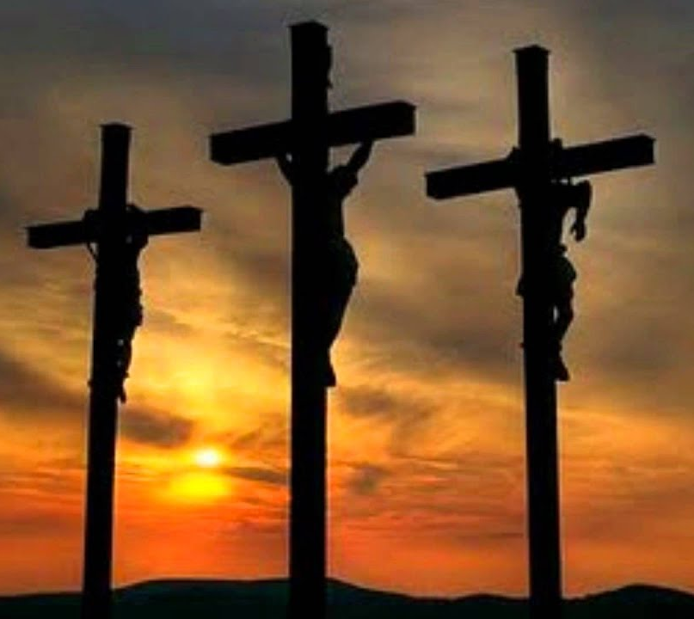
Jesus, A Tender Friend
Mt 11:18-19
Lk 15:1-10
Lk 23:39-43
Mt 11:28-30
Heb 12:2
9/10/23

Slide 2
Jesus and You
Friend or Foe
“For John came neither eating nor drinking, and they say, ‘He has a demon.’ ¹⁹ The Son of Man came eating and drinking, and they say, ‘Look at him! A glutton and a drunkard, a friend of tax collectors and sinners!’ Yet wisdom is justified by her deeds.” Mt 11:18-19
Now the tax collectors and sinners were all drawing near to hear him. Lk 15:1

Slide 3
He enjoys spending
time with them. Ortlund p114
“The Son of Man came eating and drinking, and they say, ‘Look at him! A glutton and a drunkard, a friend of tax collectors and sinners!’” Mt 11:19
Now the tax collectors and sinners were all drawing near to hear him. Lk 15:1
Jesus, a friend of sinners?

Slide 4
They feel welcome & comfortable around Jesus. Ortlund p114
“The Son of Man came eating and drinking, and they say, ‘Look at him! A glutton and a drunkard, a friend of tax collectors and sinners!’” Mt 11:19
Now the tax collectors and sinners were all drawing near to hear him. Lk 15:1
Jesus, a friend of sinners?

Slide 5
Here is the promise of
the gospel and the message of the whole Bible: In Jesus Christ we are given a friend who will always enjoy rather than refuse us. Ortlund p115

Slide 6
Now the tax collectors and sinners were all drawing near to hear him. ² And the Pharisees and the scribes grumbled, saying, “This man receives sinners and eats with them.”
³ So he told them this parable: ⁴ “What man of you, having a hundred sheep, if he has lost one of them, does not leave the ninety-nine in the open country, and go after the one that is lost, until he finds it? ⁵ And when he has found it, he lays it on his shoulders, rejoicing. Lk 15:1-5

Slide 7
Immediate Unity… JOY!
- embracing confession -
And when he comes home, he calls together his friends and his neighbors, saying to them, ‘Rejoice with me, for I have found my sheep that was lost.’ ⁷ Just so, I tell you, there will be more joy in heaven over one sinner who repents than over ninety-nine righteous persons who need no repentance. Lk 15:6-7

Slide 8
Lost and Found
“Or what woman, having ten silver coins, if she loses one coin, does not light a lamp and sweep the house and seek diligently until she finds it? ⁹ And when she has found it, she calls together her friends and neighbors, saying, ‘Rejoice with me, for I have found the coin that I had lost.’ ¹⁰ Just so, I tell you, there is joy before the angels of God over one sinner who repents.” Lk 15:8-10

Slide 9
Jesus, enjoys spending
time with you!
You will feel welcome & comfortable around Jesus!
Jesus will always invite you rather than refuse you.

Slide 10
Jesus’ Inviting nature
One of the criminals who were hanged railed at him, saying, “Are you not the Christ? Save yourself and us!” ⁴⁰ But the other rebuked him, saying, “Do you not fear God, since you are under the same sentence of condemnation? ⁴¹ And we indeed justly, for we are receiving the due reward of our deeds; but this man has done nothing wrong.” ⁴² And he said, “Jesus, remember me when you come into your kingdom.” ⁴³ And he said to him, “Truly, I say to you, today you will be with me in paradise.” Lk 23:39-43

Slide 11
Are you including Jesus in your daily (moment by moment [Ortlund]) life?

