Slide 1
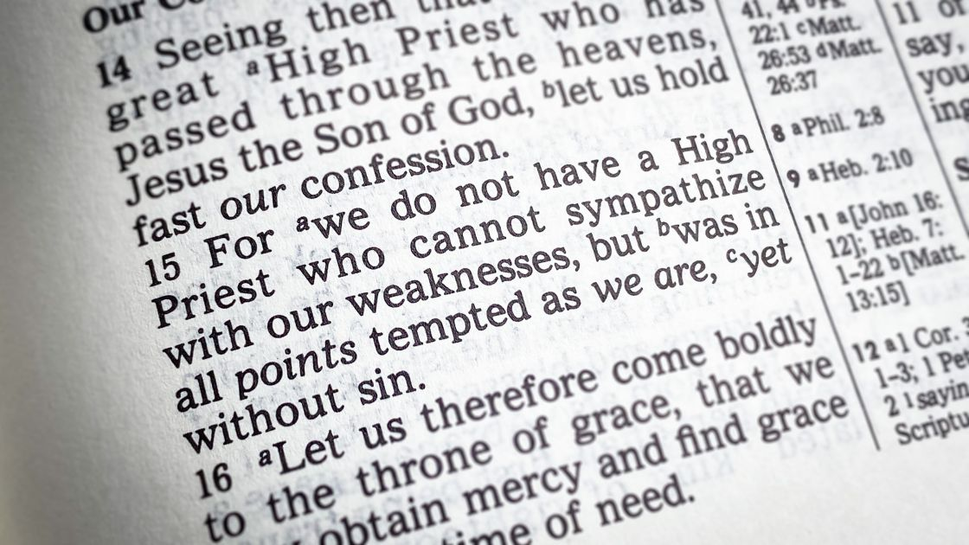
Jesus, Interceding Advocate
Heb 7:25
Heb 12:1-3
Mt 11:28-30
1 Jn 2:1-6
8/20/23

Slide 2
Jesus does this…
My little children, I am writing these things to you so that you may not sin. But if anyone does sin, we have an advocate with the Father, Jesus Christ the righteous. ² He is the propitiation for our sins, and not for ours only but also for the sins of the whole world.
1 Jn 2:1-2

Slide 3
Three concepts…
Propitiation: My sin World’s sin
Advocate: My sinful actions
Intercession: My continual broken experiential need due to sin

Slide 4
Propitiation means to appease …
Propitiation: My sin World’s sin
There needs to be an answer to all of the damage that humanity has done… all creatures…
that includes me

Slide 5
And by this we know that we have come to know him, if we keep his commandments. ⁴ Whoever says “I know him” but does not keep his commandments is a liar, and the truth is not in him, ⁵ but whoever keeps his word, in him truly the love of God is perfected. By this we may know that we are in him: ⁶ whoever says he abides in him ought to walk in the same way in which he walked. 1 Jn 1:3-6

Slide 6
What does it mean for Christ to Intercede?
Who are the two
parties involved?
The two parties are: God and believers.

Slide 7
“Intercession applies
what the atonement
accomplished.”
“The atonement accomplished our salvation; intercession is the moment-by-moment application of our atoning work.”
Dane Ortlund, Gentle and Lowly, page 79

Slide 8
Hosanna in the Highest
The former priests were many in number, because they were prevented by death from continuing in office, ²⁴ but he holds his priesthood permanently, because he continues forever. ²⁵ Consequently,
He is able to save to the uttermost those who draw near to God through him, since he always lives to make intercession for them.
Heb 7:23-25

Slide 9
Therefore, since we are surrounded by so great a cloud of witnesses, let us also lay aside every weight, and sin which clings so closely, and let us run with endurance the race that is set before us, ² looking to Jesus, the founder and perfecter of our faith, who for the joy that was set before him endured the cross, despising the shame, and is seated at the right hand of the throne of God. ³ Consider Jesus the one who endured from sinners such hostility… so that you may not grow weary or fainthearted. Heb 12:1-3

Slide 10
Jesus Invites us into His Work for…
All of the World and…
You as a Broken Human
Come to me, all who labor and are heavy laden, and I will give you rest. ²⁹ Take my yoke upon you, and learn from me, for I am gentle and lowly in heart, and you will find rest for your souls. ³⁰ For my yoke is easy, and my burden is light.” Mt 11:28-30

Slide 11
Are you including Jesus in your daily (moment by moment [Ortlund]) life?

