Slide 1
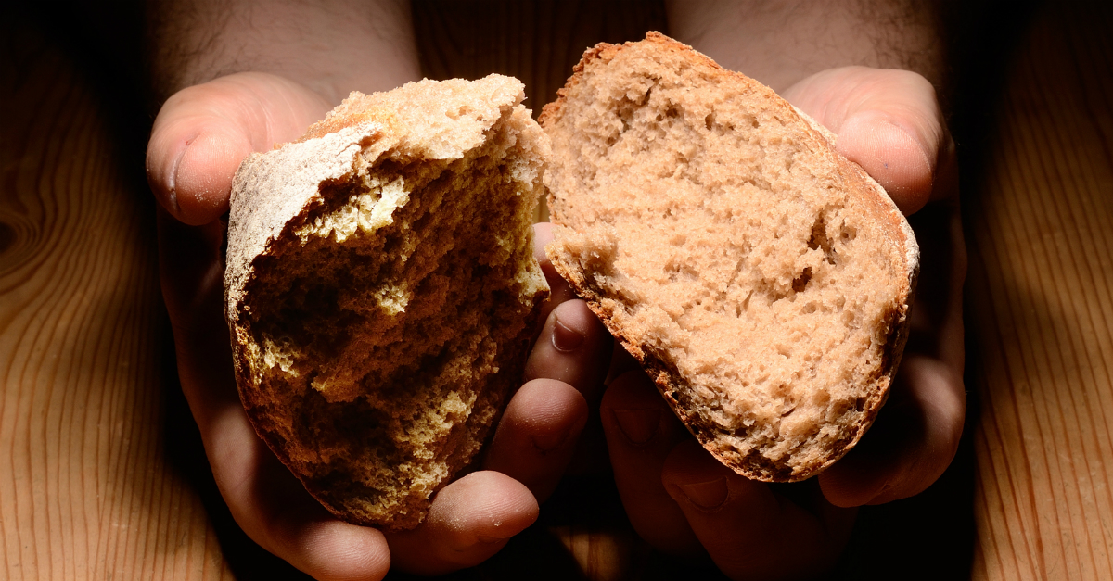
Jesus’ Grip
I will in no wise cast out
Jn 6:26-40
Mt 11:25-30
Jn 6:41-44
8/13/23

Slide 2
Jesus’ Invites us out of our Worn-Out-Ness!
Come to Me, all you who labor & are heavy-laden and overburdened, and I will cause you to rest. ²⁹ Take My yoke upon you and learn of Me, for I am gentle (meek) and humble (lowly) in heart, and you will find rest (relief and ease and refreshment and recreation and blessed quiet) for your souls. ³⁰ For My yoke is wholesome (useful, good—not harsh, hard, sharp, or pressing, but comfortable, gracious, and pleasant) , and My burden is light and easy to be borne. Mt 11:28-30

Slide 3
Jesus said to them, “I am the bread of life; whoever comes to me shall not hunger, and whoever believes in me shall never thirst… and whoever comes to me I will never cast out. Jn 6:35, 37b

Slide 4


Slide 5
What does your faith journey look like?
Is the “Bread of Life” (Jesus) your food?

Slide 6
“All” means:
Circle the correct answer
Some a few all most
Jesus said to them, “I am the bread of life; whoever comes to me shall not hunger, and whoever believes in me shall never thirst… ³⁷ All that the Father gives me will come to me, and whoever comes to me I will never cast out.
Jn 6:35-37

Slide 7
“All” means:
Circle the correct answer
Some a few all most
Jesus said to them, “I am the bread of life; whoever comes to me shall not hunger, and whoever believes in me shall never thirst… ³⁷ All that the Father gives me will come to me, and whoever comes to me I will never cast out.
Jn 6:35-37

Slide 8
“the Father gives” indicates:
Circle the correct answer
A delightful exchange a debate
a bidding war a compromise
Jesus said to them, “I am the bread of life; whoever comes to me shall not hunger, and whoever believes in me shall never thirst… ³⁷ All that
the Father gives me will come to me, and whoever comes to me I will never cast out. Jn 6:35, 37

Slide 9
“the Father gives” indicates:
Circle the correct answer
A delightful exchange a debate
a bidding war a compromise
Jesus said to them, “I am the bread of life; whoever comes to me shall not hunger, and whoever believes in me shall never thirst… ³⁷ All that
the Father gives me will come to me, and whoever comes to me I will never cast out. Jn 6:35, 37

Slide 10
“will come to Me” indicates:
Circle the correct answer
A possibility an unwilful action
a hypothesis a joint collaboration
Jesus said to them, “I am the bread of life; whoever comes to me shall not hunger, and whoever believes in me shall never thirst… ³⁷ All that
the Father gives me will come to me, and whoever comes to me I will never cast out. Jn 6:35, 37

Slide 11
“will come to Me” indicates:
Circle the correct answer
A possibility an unwilful action
a hypothesis a joint collaboration
Jesus said to them, “I am the bread of life; whoever comes to me shall not hunger, and whoever believes in me shall never thirst… ³⁷ All that
the Father gives me will come to me, and whoever comes to me I will never cast out. Jn 6:35, 37

Slide 12
God the Father draws us to Jesus…
The Great Collaboration
So the Jews grumbled about him, because he said, “I am the bread that came down from heaven.” … ⁴³ Jesus answered them, “Do not grumble among yourselves. ⁴⁴ No one can come to me unless the Father who sent me draws him. And I will raise him up on the last day. Jn 6:42, 43-44

Slide 13
Are you being “Kept” by Jesus today?
“Whoever comes to me I will “HOLD!”
Jn 6:37 abv
All that the Father gives me will come to me, and whoever comes to me I will never cast out. Jn 6:37

Slide 14
Jesus said to them, “I am the bread of life; whoever comes to me shall not hunger, and whoever believes in me shall never thirst… and whoever comes to me I will never cast out. Jn 6:35, 37b

