Slide 1
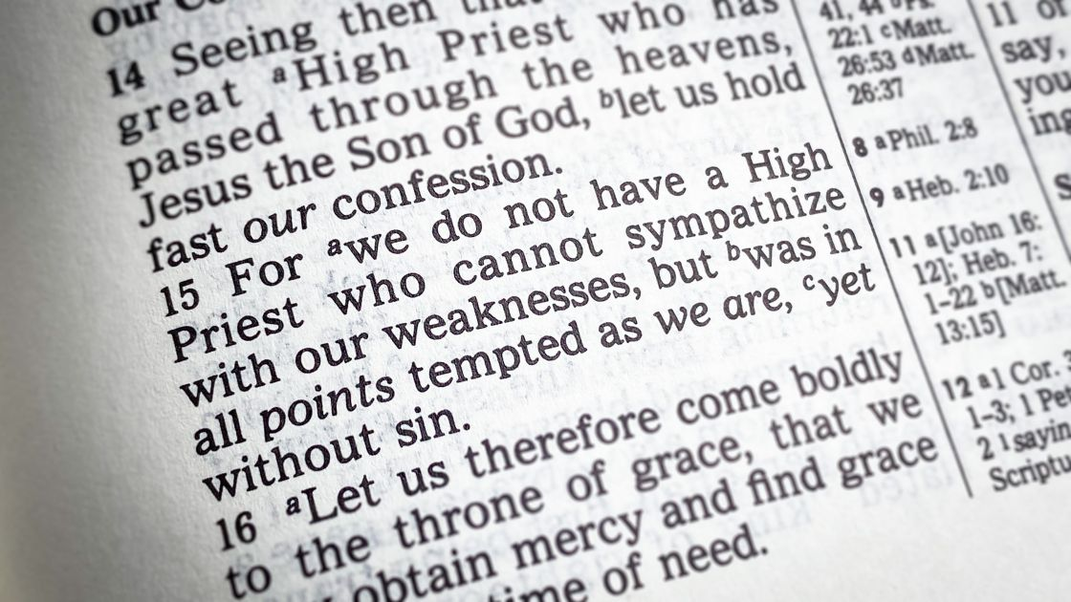
Able To Deal Gently
Heb 5:1-10
Mt 11:25-30
Phil 2:1-15
Mt 7:1-5
8/6/23

Slide 2
Jesus’ Invites us out of our Worn-Out-Ness!
Come to Me, all you who labor & are heavy-laden and overburdened, and I will cause you to rest. ²⁹ Take My yoke upon you and learn of Me, for I am gentle (meek) and humble (lowly) in heart, and you will find rest (relief and ease and refreshment and recreation and blessed quiet) for your souls. ³⁰ For My yoke is wholesome (useful, good—not harsh, hard, sharp, or pressing, but comfortable, gracious, and pleasant) , and My burden is light and easy to be borne. Mt 11:28-30

Slide 3
A Human High Priest intercedes for us regarding things pertaining to God’s requirements for sin; and able to do so with gentleness due to his own sin. Heb 5:1-3

Slide 4
For every high priest chosen from among men is appointed to act on behalf of men in relation to God, to offer gifts and sacrifices for sins. ² He can deal gently with the ignorant and wayward, since he himself is beset with weakness. ³ Because of this he is obligated to offer sacrifice for his own sins just as he does for those of the people. ⁴ And no one takes this honor for himself, but only when called by God, just as Aaron was.
Heb 5:1-4

Slide 5
Jesus, ALSO, can do
this because of His humanity and His obedience through suffering. Heb 5:5-8

Slide 6
Father and Son in Complete Unity
So also, Christ did not exalt himself to be made a high priest, but was appointed by him who said to him, “You are my Son, today I have begotten you;” Heb 5:5

Slide 7
Jesus our Eternal Life-Source
In the days of his flesh, Jesus offered up prayers and supplications, with loud cries and tears, to him who was able to save him from death, and he was heard because of his reverence. ⁸ Although he was a son, he learned obedience through what he suffered. ⁹ And being made perfect, he became the source of eternal salvation to all who obey him… Heb 5:7-9

Slide 8
Jesus took on our death
Have this mind among yourselves, which is yours in Christ Jesus, ⁶ who, though he was in the form of God, did not count equality with God a thing to be grasped, ⁷ but emptied himself, by taking the form of a servant, being born in the likeness of men. ⁸ And being found in human form, he humbled himself by becoming obedient to the point of death, even death on a cross. Phil 2:5-8

Slide 9
Jesus is to be exalted
Therefore God has highly exalted him and bestowed on him the name that is above every name, ¹⁰ so that at the name of Jesus every knee should bow, in heaven and on earth and under the earth, ¹¹ and every tongue confess that Jesus Christ is Lord, to the glory of God the Father. Phil 2:9-11

Slide 10
Therefore, my beloved, as you have always obeyed, so now, not only as in my presence but much more in my absence, work out your own salvation with fear and trembling, ¹³ for it is God who works in you, both to will and to work for his good pleasure. ¹⁴ Do all things without grumbling or disputing, ¹⁵ that you may be blameless and innocent, children of God without blemish in the midst of a crooked and twisted generation, among whom you shine as lights in the world,
Phil 2:12-15

Slide 11
I must Humble Myself
Complete my joy by being of the same mind, having the same love, being in full accord and of one mind. ³ Do nothing from selfish ambition or conceit, but in humility count others more significant than yourselves. ⁴ Let each of you look not only to his own interests, but also to the interests of others.
Phil 2:1-4

Slide 12
Judge not, that you be not judged. For with the judgment you pronounce you will be judged, and with the measure you use it will be measured to you. Why do you see the speck that is in your brother’s eye, but do not notice the log that is in your own eye? Or how can you say to your brother, ‘Let me take the speck out of your eye,’ when there is the log in your own eye? You hypocrite, first take the log out of your own eye, and then you will see clearly to take the speck out of your brother’s eye. Mt 7:1-5

Slide 13
Jesus,
by Your grace and mercy, Help me to treat others according to Your Heart and Your Mind.

