Slide 1
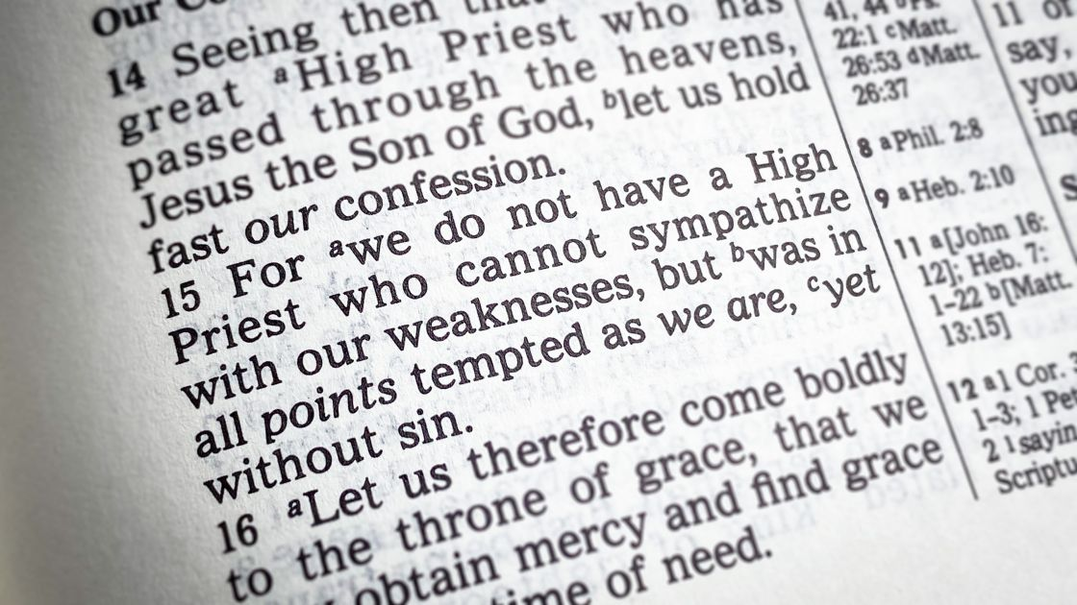
Able To Sympathize
Heb 4:14-16
Heb 7:26-27
Mt 11:28-30
7/16/23

Slide 2
Jesus’ Invites us into His rest
Come to me, all who labor and are heavy laden, and I will give you rest. ²⁹ Take my yoke upon you, and learn from me, for I am gentle and lowly in heart, and you will find rest for your souls. ³⁰ For my yoke is easy, and my burden is light.” Mt 11:28-30

Slide 3
Jesus our Eternal Life-Source
In the days of his flesh, Jesus offered up prayers and supplications, with loud cries and tears, to him who was able to save him from death, and he was heard because of his reverence. ⁸ Although he was a son, he learned obedience through what he suffered. ⁹ And being made perfect, he became the source of eternal salvation to all who obey him… Heb 5:7-9

Slide 4
Jesus answered them, “Do you now believe?
³² Behold, the hour is coming, indeed it has come, when you will be scattered, each to his own home, and will leave me alone. Yet I am not alone, for the Father is with me. ³³ I have said these things to you, that in me you may have peace!
In the world you will have tribulation. But take heart; I have overcome the world.”
Jn 16:31-33

Slide 5
Jesus faces abandonment by His disciples as a victory declaration for those who will soon abandon him

Slide 6
Jesus was tempted
in the deepest places.
For we do not have a high priest who is unable to sympathize with our weaknesses, but one who in every respect has been tempted as we are, yet without sin. Heb 4:15

Slide 7
Since then we have a great high priest who has passed through the heavens, Jesus, the Son of God, let us hold fast our confession. ¹⁵ For we do not have a high priest who is unable to sympathize with our weaknesses, but one who in every respect has been tempted as we are, yet without sin. ¹⁶ Let us then with confidence draw near to the throne of grace, that we may receive mercy and find grace to help in time of need.
Heb 4:14-16

Slide 8
Draw near to Jesus
Let us then with confidence draw near to the throne of grace, that we may receive mercy and find grace to help in time of need.
Heb 4:16

Slide 9
Jesus’ Sacrificial Life
Peace – Rest for your soul (pain)
Come to me, all who labor and are heavy laden, and I will give you rest. ²⁹ Take my yoke upon you, and learn from me, for I am gentle and lowly in heart, and you will find rest for your souls. ³⁰ For my yoke is easy, and my burden is light.” Mt 11:28-30

