Slide 1
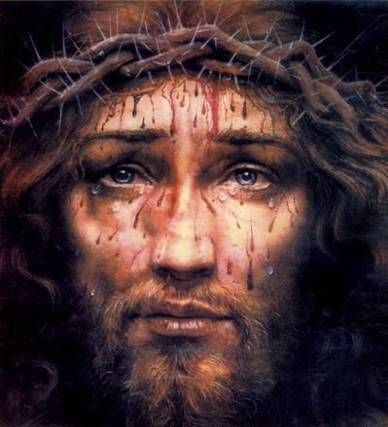
Jesus’ Fight for Joy
Heb 12:1-3, 4-11
Heb 5:7-9
Mt 11:28-30
Is 57:15
7/2/23

Slide 2
Jesus’ Invites us into His rest
Come to me, all who labor and are heavy laden, and I will give you rest. ²⁹ Take my yoke upon you, and learn from me, for I am gentle and lowly in heart, and you will find rest for your souls. ³⁰ For my yoke is easy, and my burden is light.” Mt 11:28-30

Slide 3
Therefore, since we are surrounded by so great a cloud of witnesses, let us also lay aside every weight, and sin which clings so closely, and let us run with endurance the race that is set before us, ² looking to Jesus, the founder and perfecter of our faith, who for the joy that was set before him endured the cross, despising the shame, and is seated at the right hand of the throne of God. ³ Consider him who endured from sinners such hostility against himself, so that you may not grow weary or fainthearted.
Heb 12:1-3

Slide 4
Jesus:
endured the cross.
despised the shame.
looking to Jesus, the founder and perfecter of our faith, who for the joy that was set before him endured the cross, despising the shame, and is seated at the right hand of the throne of God. Heb 12:2

Slide 5
Jesus endured
our hostility.
looking to Jesus, the founder and perfecter of our faith, who for the joy that was set before him endured the cross, despising the shame, and is seated at the right hand of the throne of God. Heb 12:2

Slide 6
Jesus’ joy and
sacrifice is founded in
His upholding you.
He is holding you up!
Consider him who endured from sinners such hostility against himself, so that
you may not grow weary or fainthearted.
Heb 12:2

Slide 7
Jesus’ Obedience was learned through suffering
In the days of his flesh, Jesus offered up prayers and supplications, with loud cries and tears, to him who was able to save him from death, and he was heard because of his reverence. ⁸ Although he was a son, he learned obedience through what he suffered. ⁹ And being made perfect, he became the source of eternal salvation to all who obey him Heb 5:7-9

Slide 8
Jesus brings a new definition (relationship) to suffering
In your struggle against sin you have not yet resisted to the point of shedding your blood. ⁵ And have you forgotten the exhortation that addresses you as sons? “My son, do not regard lightly the discipline of the Lord, nor be weary when reproved by him. ⁶ For the Lord disciplines the one he loves and chastises every son whom he receives.”
Heb 5:4-6

Slide 9
Discipline (παιδεία) denotes the upbringing and handling of the child which is growing up to maturity and which thus needs direction, teaching, instruction and a certain measure of compulsion in the form of discipline or even chastisement. παιδεία is both the way of education and cultivation which has to be traversed and also the goal which is to be attained.

Slide 10


Grown
Baby
Father
Mother
Alignment
via Suffering
Friends
Teachers

Slide 11
It is for discipline that you have to endure. God is treating you as sons. For what son is there whom his father does not discipline? ⁸ If you are left without discipline, in which all have participated, then you are illegitimate children and not sons. ⁹ Besides this, we have had earthly fathers who disciplined us, and we respected them. Shall we not much more be subject to the Father of spirits and live? Heb 12:7-9

Slide 12
¹⁰ For they disciplined us for a short time as it seemed best to them, but he disciplines us for our good, that we may share his holiness. ¹¹ For the moment all discipline seems painful rather than pleasant, but later it yields the peaceful fruit of righteousness to those who have been trained by it.
Heb 12:10-11

Slide 13
Fullness of
Design
Baby
Father of
LIFE
Life Forming Instruction
His Holiness
Spirit
Jesus

Slide 14
Jesus’ sacrificial life
Peaceable fruit of righteousness
Come to me, all who labor and are heavy laden, and I will give you rest. ²⁹ Take my yoke upon you, and learn from me, for I am gentle and lowly in heart, and you will find rest for your souls. ³⁰ For my yoke is easy, and my burden is light.” Mt 11:28-30

