Slide 1
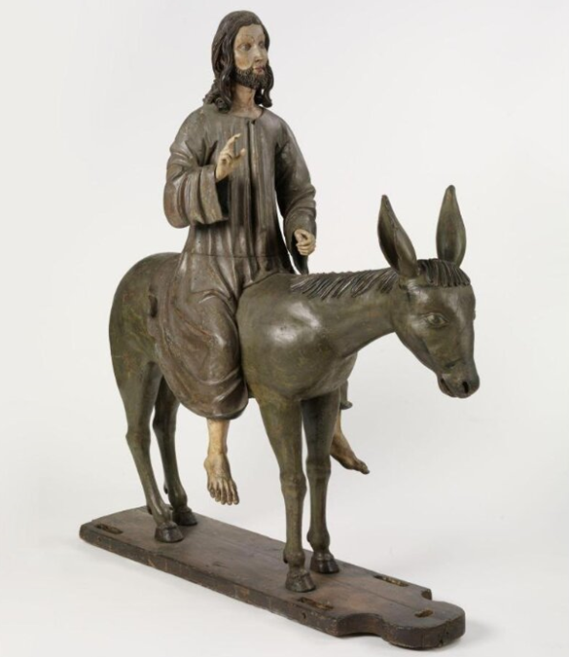
Gentle and Lowly
A Memorial Day Weekend Building Block
Mt 11:28-30
Jn 15:12-15
Mt 21:4-5
5/28/23

Slide 2
Greater love has no one than this, that someone lay down his life for his friends.
Jn 15:13
Come to me, all who labor and are heavy laden, and I will give you rest. ²⁹ Take my yoke upon you, and learn from me, for I am gentle (meek) and lowly in heart, and you will find rest for your souls. ³⁰ For my yoke is easy, and my burden is light. Mt 11:28-30

Slide 3
This is my commandment, that you love one another as I have loved you. ¹³ Greater love has no one than this, that someone lay down his life for his friends. ¹⁴ You are my friends if you do what I command you. ¹⁵ No longer do I call you servants, for the servant does not know what his master is doing; but I have called you friends, for all that I have heard from my Father I have made known to you. Jn 15:12-15

Slide 4
Jesus’ Heart
Come to me, all who labor and are heavy laden, and I will give you rest. ²⁹ Take my yoke upon you, and learn from me, for I am gentle (meek) and lowly in heart, and you will find rest for your souls. ³⁰ For my yoke is easy, and my burden is light.” Mt 11:28-30
Greater love has no one than this, that someone lay down his life for his friends.
Jn 15:13

Slide 5
Jesus’ heart is
inviting. Mt 11:28
Come to me, all who labor and are heavy laden, and I will give you rest. Mt 11:28

Slide 6
Jesus’ heart is
gentle (meek) and lowly.
Mt 11:29
Take my yoke upon you, and learn from me, for I am gentle (meek) and lowly in heart, and you will find rest for your souls. Mt 11:29

Slide 7
Jesus’ heart is restful.
Mt 11:28, 29
Come to me, all who labor and are heavy laden, and I will give you rest. ²⁹ Take my yoke upon you, and learn from me, for I am gentle (meek) and lowly in heart, and you will find rest for your souls. ³⁰ For my yoke is easy, and my burden is light. Mt 11:28-30

Slide 8
In these 3 verses Jesus gives an invitation and an application. Mt 11:28, 29
Come to me, all who labor and are heavy laden, and I will give you rest. ²⁹ Take my yoke upon you, and learn from me, for I am gentle (meek) and lowly in heart, and you will find rest for your souls. ³⁰ For my yoke is easy, and my burden is light. Mt 11:28-30

Slide 9
Jesus, the humble one
This took place to fulfill what was spoken by the prophet, saying, ⁵ “Say to the daughter of Zion, ‘Behold, your king is coming to you, humble, and mounted on a donkey, on a colt, the foal of a beast of burden.’ ” Mt 21:4-5

