Slide 1
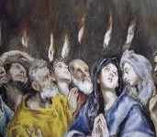
A Prophesy the Spirit
Fire & Repentance
Acts 2:1-5, 14-21
Joel 1:1-14;
Joel 2:1-5, 11-13,
25-32
Mt 3:1-2, 11
6/19/22

Slide 2
And suddenly there came from heaven a sound like a mighty rushing wind, and it filled the entire house where they were sitting. ³ And divided tongues as of fire appeared to them and rested on each one of them. ⁴ And they were all filled with the Holy Spirit and began to speak in other tongues as the Spirit gave them utterance. ⁵ Now there were dwelling in Jerusalem Jews, devout men from every nation under heaven. Acts 2:2-5

Slide 3
And at this sound the multitude came together, and they were bewildered, because each one was hearing them speak in his own language. ⁷ And they were amazed and astonished, saying, “Are not all these who are speaking Galileans? ⁸ And how is it that we hear, each of us in his own native language?
Acts 2:6-8

Slide 4
But Peter, standing with the eleven, lifted up his voice and addressed them: “Men of Judea and all who dwell in Jerusalem, let this be known to you, and give ear to my words. ¹⁵ For these people are not drunk, as you suppose, since it is only the third hour of the day. ¹⁶ But this is what was uttered through the prophet Joel: ¹⁷ “ ‘And in the last days it shall be, God declares, that I will pour out my Spirit on all flesh, & your sons & your daughters shall prophesy,
Acts 2:14-17a

Slide 5
your young men shall see visions, & your old men shall dream dreams; ¹⁸ even on my male & female servants in those days I will pour out my Spirit, & they shall prophesy. ¹⁹ I will show wonders in the heavens above & signs on the earth below, blood, & fire, & vapor of smoke; ²⁰ the sun shall be turned to darkness & the moon to blood, before the day of the Lord comes, the great & magnificent day. ²¹ & it shall come to pass that everyone who calls upon the name of the Lord shall be saved.’ Acts 2:17b-21

Slide 6
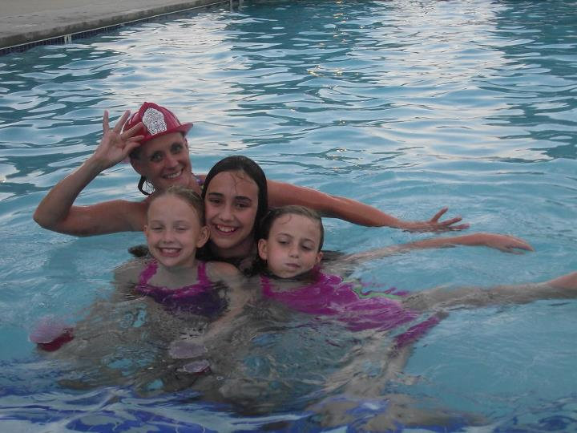

Slide 7
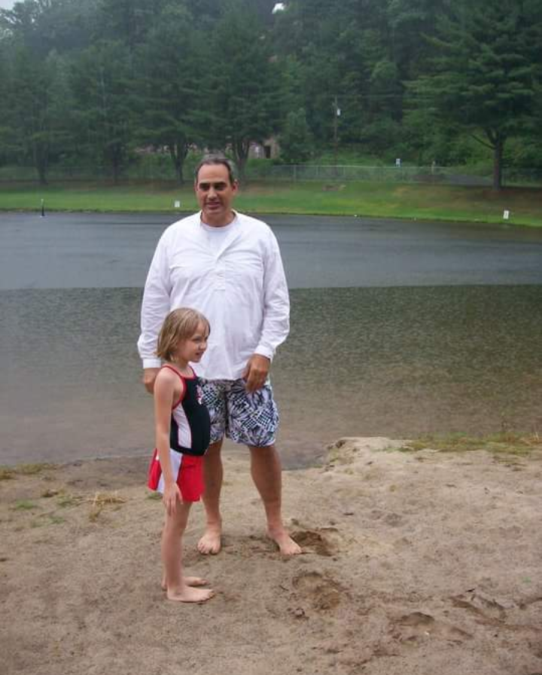
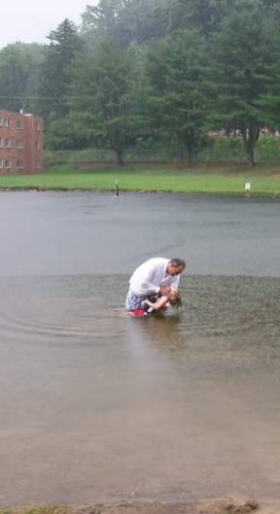

Slide 8
In those days John the Baptist came preaching in the wilderness of Judea, ² “Repent, for the kingdom of heaven is at hand.” Mt 3:1-2
“I baptize you with water for repentance, but he who is coming after me is mightier than I (JESUS), whose sandals I am not worthy to carry; He will baptize you with the Holy Spirit and fire.” Mt 3:11

Slide 9
Joel characterizes the day of the Lord with fire.
Joel 2:3

Slide 10
Blow a trumpet in Zion; sound an alarm on my holy mountain! Let all the people of the land tremble, for the day of the LORD is coming; it is near... ³ Fire devours before them, and behind them a flame burns. The land is like the garden of Eden before them, but behind them a desolate wilderness, and nothing escapes them. Joel 2:1, 3

Slide 11
Their appearance is like the appearance of horses, and like war horses they run.
⁵ As with the rumbling of chariots, they leap on the tops of the mountains, like the crackling of a flame of fire devouring the stubble, like a powerful army drawn up for battle. Joel 2:4-5

Slide 12
Hear this, you elders; give ear, all inhabitants of the land! Has such a thing happened in your days, or in the days of your fathers? ³ Tell your children of it, and let your children tell their children, and their children to another generation. ⁴ What the cutting locust left, the swarming locust has eaten. What the swarming locust left, the hopping locust has eaten, and what the hopping locust left, the destroying locust has eaten. Joel 1:2-4

Slide 13
Group repentance comes through hearing God (spiritual sight) & by talking.
Joel 1:2-3

Slide 14
Put on sackcloth and lament, O priests; wail, O ministers of the altar. Go in, pass the night in sackcloth, O ministers of my God! Because grain offering and drink offering are withheld from the house of your God.
¹⁴ Consecrate a fast; call a solemn assembly. Gather the elders and all the inhabitants of the land to the house of the LORD your God, and cry out to the LORD.
Joel 1:13-14

Slide 15
The turning point comes through repentance.
Joel 1:8, 13-14; Acts 1:14; Mt 3:2; Is 40:3

Slide 16
For Israel, this was called a Solemn Assembly.
Joel 1:14

Slide 17
The LORD utters his voice before his army, for his camp is exceedingly great; he who executes his word is powerful. For the day of the LORD is great and very awesome; who can endure it? ¹² “Yet even now,” declares the LORD, “return to me with all your heart, with fasting, with weeping, and with mourning; ¹³ & rend your hearts & not your garments.” Return to the LORD your God, for he is gracious & merciful, slow to anger, & abounding in steadfast love; and He relents over disaster! Joel 2:11-13

Slide 18
I will restore to you the years that the swarming locust has eaten, the hopper, the destroyer, and the cutter, my great army, which I sent among you. ²⁶ “You shall eat in plenty and be satisfied, and praise the name of the LORD your God, who has dealt wondrously with you. And my people shall never again be put to shame. ²⁷ You shall know that I am in the midst of Israel, and that I am the LORD your God and there is none else. And my people shall never again be put to shame. Joel 2:25-27

Slide 19
God releases
a new dynamic!
“And it shall come to pass afterward, that I will pour out my Spirit on all flesh; your sons and your daughters shall prophesy, Your old men shall dream dreams, and your young men shall see visions. ²⁹ Even on the male and female servants in those days I will pour out my Spirit… Joel 2:28-29

