Slide 1
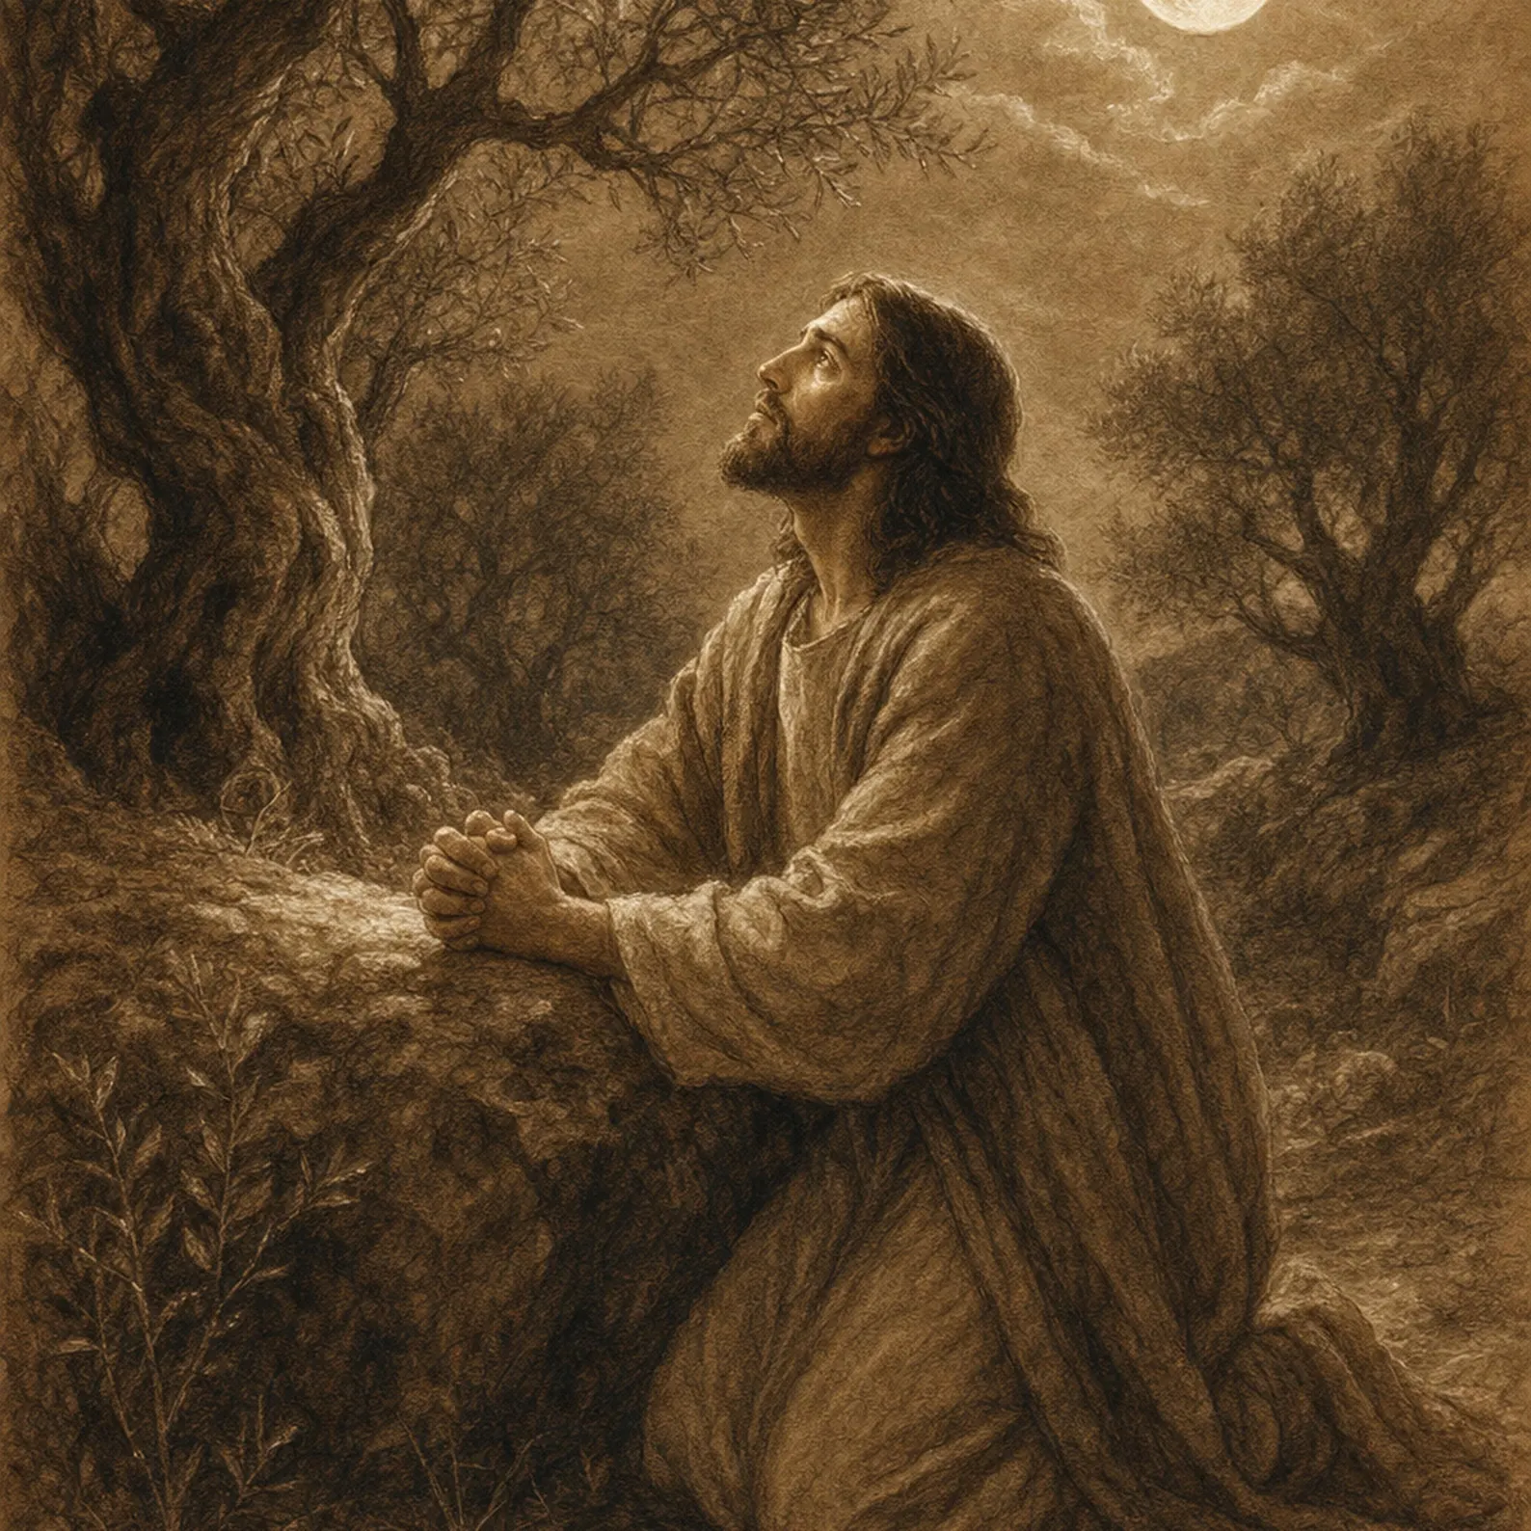
When You Pray
Matthew 6:5-15 Luke 11:1-13
John 3:16-17 Romans 5:8
Ps 110:1
10/18/26

Slide 2
Now Jesus was praying in a certain place, and when he finished, one of his disciples said to him, “Lord, teach us to pray, as John taught his disciples.” ² And he said to them, “When you pray, say: “Father, hallowed be your name. Your kingdom come. ³ Give us each day our daily bread, ⁴ and forgive us our sins, for we ourselves forgive everyone who is indebted to us. And lead us not into temptation.” Lk 11:1-4

Slide 3
One Verse about the
One Activity of Heaven
for the One Earth
The Lord says to my Lord: “Sit at My right hand Until I make Your enemies a foot-stool for Your feet.” ² The Lord will stretch forth Your strong scepter from Zion, saying, “Rule in the midst of Your enemies.” Ps 110:1

Slide 4
1
“And when you pray, YOU MUST NOT be like the hypocrites. For they love to stand and pray in the synagogues and at the street corners, that they may be seen by others. Truly, I say to you, they have received their reward. ⁶ But when you pray, go into your room and shut the door and pray to your Father who is in secret. And your Father who sees in secret will reward you. Mt 6:5-6

Slide 5
2
“And when you pray, DO NOT heap up empty phrases as the Gentiles do, for they think that they will be heard for their many words. ⁸ Do not be like them, for your Father knows what you need before you ask him.” Mt 6:7-8

Slide 6
3
“Pray, then, in this way: ‘Our Father who is in heaven, Hallowed be Your name. ¹⁰ ‘Your kingdom come. Your will be done, On earth as it is in heaven. ¹¹ ‘Give us this day our daily bread. ¹² ‘And forgive us our debts, as we also have forgiven our debtors. ¹³ ‘And do not lead us into temptation, but deliver us from evil. For Yours is the kingdom and the power and the glory forever. Amen.’
Mt 6:9-13

Slide 7
Hypocrites prayed authoritatively sounding, feel good prayers.
“And when you pray, YOU MUST NOT be like the hypocrites. For they love to stand and pray in the synagogues and at the street corners, that they may be seen by others. Truly, I say to you, they have received their reward. ⁷ “And when you are praying, do not use meaningless repetition as the Gentiles do, for they suppose that they will be heard for their many words. Mt 6:5, 7

Slide 8
For You:
Prayer begins in your closet.
But when you pray, go into your room and shut the door and pray to your Father who is in secret. And your Father who sees in secret will reward you. Mt 6:6

Slide 9
For You:
Asking begins with your forgiving heart.
For if you forgive others their trespasses, your heavenly Father will also forgive you, ¹⁵ but if you do not forgive others their trespasses, neither will your Father forgive your trespasses.
Mt 6:14-15

Slide 10
For Earth:
Prayer begins in heaven.
Pray then like this: “Our Father in heaven, hallowed be your name. ¹⁰ Your kingdom come, your will be done, on earth as it is in heaven.
Mt 6:9-10

Slide 11
Asking exudes from
God’s loving nature!
For God so loved the world, that he gave his only Son, that whoever believes in him should not perish but have eternal life. ¹⁷ For God did not send his Son into the world to condemn the world, but in order that the world might be saved through him.
⁶ For while we were still weak, at the right time Christ died for the ungodly… ⁸ but God shows his love for us in that while we were still sinners, Christ died for us. Jn 3:16-17; Rom 5:6, 8

Slide 12
Jesus reveals the glory of
Our Father in Heaven!
… in these last days he has spoken to us by his Son, whom he appointed the heir of all things, through whom also he created the world. ³ He is the radiance of the glory of God and the exact imprint of his nature, and he upholds the universe by the word of his power. After making purification for sins, he sat down at the right hand of the Majesty on high, ⁴ having become as much superior to angels as the name he has inherited is more excellent than theirs. Heb 1:2-4

Slide 13
Would you like to
pray like Jesus?

