Slide 1
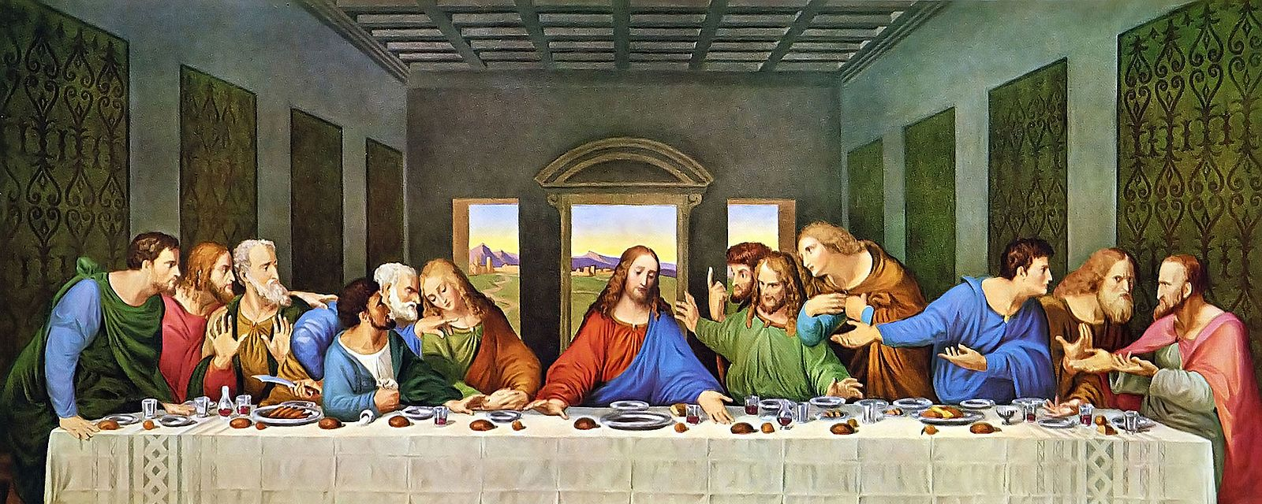
Ultimate Community
Communion: Discerning your unity
10/4/26
1 Cor 11:16-34

Slide 2
You have divisions and
cliques.
Groups
revealing unity
For, in the first place, when you come together as a church, I hear that there are divisions among you. And I believe it in part, ¹⁹ for there must be factions among you in order that those who are genuine among you may be recognized.
1 Cor 11:18-19

Slide 3
The divisions manifested among the Corinthians when they gather for worship are probably those that Paul has mentioned in ch. 1. Theissen is probably right in saying that these divisions are between the relatively well-to-do and the poor. Some are going hungry at the communal meal, while others are gorging themselves and getting drunk (v. 21). Ben Witherington
Conflict and Community in Corinth

Slide 4
Here is more evidence that the main troublemakers for Paul in Corinth are the more well-to-do Gentiles who continue to follow the social conventions of the larger pagan culture, here in regard to dining and drinking. Hairesis, from which we get our word “heresy,” did not have that later technical sense. It referred, rather, to sociological divisions. The Corinthians were assuming that, as at a pagan feast, it was proper in celebrating the Lord’s Supper to separate or distinguish between wealthier and poorer Christians. Ben Witherington
Conflict and Community in Corinth

Slide 5
Heresy in the First Century church had a lot to do with the infiltration of Pagan Rites and Rituals into the unity of the body of Christ Jesus!

Slide 6
For you, the Lord’s Supper
is about satisfying yourself!
When you come together,
it is not the Lord’s supper that you eat.
²¹ For in eating, each one goes ahead with his own meal. One goes hungry, another gets drunk. 1 Cor 11:20-21

Slide 7
Communion has become
nothing!
When you come together, it is not the Lord’s supper that you eat. ²¹ For in eating, each one goes ahead with his own meal. One goes hungry, another gets drunk. ²² What! Do you not have houses to eat and drink in? Or do you despise the church of God and humiliate those who have nothing? What shall I say to you? Shall I commend you in this? No, I will not. 1 Cor 11:20-22

Slide 8
For I received from the Lord what I also delivered to you, that the Lord Jesus on the night when he was betrayed took bread, ²⁴ and when he had given thanks, he broke it, and said, “This is my body, which is for you. Do this in remembrance of me.” ²⁵ In the same way also he took the cup, after supper, saying, “This cup is the new covenant in my blood. Do this, as often as you drink it, in remembrance of me.” ²⁶ For as often as you eat this bread and drink the cup, you proclaim the Lord’s death until he comes. 1 Cor 11:23-26

Slide 9
Whoever, therefore, eats the bread or drinks the cup of the Lord in an unworthy manner will be guilty concerning the body and blood of the Lord. ²⁸ Let a person examine himself, then, and so eat of the bread and drink of the cup. ²⁹ For anyone who eats and drinks without discerning the body eats and drinks judgment on himself. ³⁰ That is why many of you are weak and ill, and some have died. ³¹ But if we judged ourselves truly, we would not be judged. 1 Cor 11:27-31

Slide 10
But when we are judged by the Lord, we are disciplined so that we may not be condemned along with the world.
³³ So then, my brothers, when you come together to eat, wait for one another— ³⁴ if anyone is hungry, let him eat at home—so that when you come together it will not be for judgment. About the other things I will give directions when I come. 1 Cor 11:32-34

Slide 11
The Lord’s Supper should be an act:
Sourced in Jesus!
For I received from the Lord what I also delivered to you, that the Lord Jesus on the night when he was betrayed took bread, ²⁴ and when he had given thanks, he broke it, and said, “This is my body, which is for you. Do this in remembrance of me.”
1 Cor 11:23-24

Slide 12
The Lord’s Supper should be an act:
Received with
Thanksgiving!
For I received from the Lord what I also delivered to you, that the Lord Jesus on the night when he was betrayed took bread, ²⁴ and when he had given thanks, he broke it, and said, “This is my body, which is for you. Do this in remembrance of me.”
1 Cor 11:23-24

Slide 13
The Lord’s Supper should be an act:
Recognizing
Brokenness!
He broke it, and said, “This is my body, which is for you. Do this in remembrance of me.” ²⁵ In the same way also he took the cup, after supper, saying, “This cup is the new covenant in my blood. Do this, as often as you drink it, in remembrance of me.” ²⁶ For as often as you eat this bread and drink the cup, you proclaim the Lord’s death until he comes.
1 Cor 11:24-26

Slide 14
The Lord’s Supper should be an act:
Remembering Jesus’
Sacrifice.
He broke it, and said, “This is my body, which is for you. Do this in remembrance of me.” ²⁵ In the same way also he took the cup, after supper, saying, “This cup is the new covenant in my blood. Do this, as often as you drink it, in remembrance of me.” ²⁶ For as often as you eat this bread and drink the cup, you proclaim the Lord’s death until he comes.
1 Cor 11:24-26

Slide 15
The Lord’s Supper should be an act:
Proclaiming Jesus’
Death.
He broke it, and said, “This is my body, which is for you. Do this in remembrance of me.” ²⁵ In the same way also he took the cup, after supper, saying, “This cup is the new covenant in my blood. Do this, as often as you drink it, in remembrance of me.” ²⁶ For as often as you eat this bread and drink the cup, you proclaim the Lord’s death until he comes.
1 Cor 11:24-26

Slide 16
The Lord’s Supper should be an act:
Examining Oneself.
Whoever, therefore, eats the bread or drinks the cup of the Lord in an unworthy manner will be guilty concerning the body and blood of the Lord. ²⁸ Let a person examine himself, then, and so eat of the bread and drink of the cup. ²⁹ For anyone who eats and drinks without discerning the body eats and drinks judgment on himself. 1 Cor 11:27-29

