Slide 1
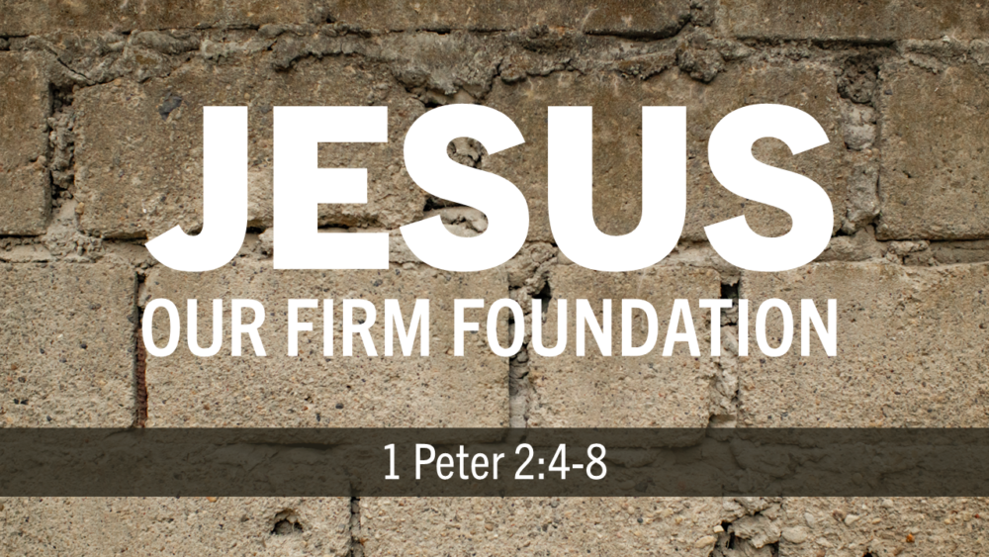
Ultimate Build
Jesus Christ: Firm Foundation
1 Cor 3:1-15
1 Pet 2:4-6
Rev 1:12-20
Dan 3:23-25
9/20/26

Slide 2
Does God need me?

Slide 3
Jesus is the LIVING and CHIEF CORNERSTONE!
As you come to him, a living stone rejected by men but in the sight of God chosen and precious, ⁵ you yourselves like living stones are being built up as a spiritual house, to be a holy priesthood, to offer spiritual sacrifices acceptable to God through Jesus Christ. ⁶ For it stands in Scripture: “Behold, I am laying in Zion a stone, a cornerstone chosen and precious, and whoever believes in him will not be put to shame.” 1 Pet 2:4-6

Slide 4
Jesus is the LIVING and CHIEF CORNERSTONE!
As you come to him, a living stone rejected by men but in the sight of God chosen and precious, ⁵ you yourselves like living stones are being built up as a spiritual house, to be a holy priesthood, to offer spiritual sacrifices acceptable to God through Jesus Christ. ⁶ For it stands in Scripture: “Behold, I am laying in Zion a stone, a cornerstone chosen and precious, and whoever believes in him will not be put to shame.” 1 Pet 2:4-6

Slide 5
Paul laid a foundation on which he expects others to build on.
For we are God’s fellow workers. You are God’s field, God’s building. ¹⁰ According to the grace of God given to me, like a skilled master builder I laid a foundation, and someone else is building upon it. Let each one take care how he builds upon it.
1 Cor 3:9-10

Slide 6
There are two “BUILD” perspectives:
1 Of Man, resulting in jealousy and strife.
I fed you with milk, not solid food, for you were not ready for it. And even now you are not yet ready, ³ for you are still of the flesh. For while there is jealousy and strife among you, are you not of the flesh and behaving only in a human way? 1 Cor 3:2-3

Slide 7
There are two “BUILD” perspectives:
2 Of God, revealing grace and wisdom.
According to the grace of God which was given to me, like a wise master builder I laid a foundation, and another is building on it. But each man must be careful how he builds on it. 1 Cor 3:10

Slide 8
Each individual work will reveal their (the work’s) quality.
Now if anyone builds on the foundation with gold, silver, precious stones, wood, hay, straw - ¹³ each one’s work will become manifest, for the Day will disclose it, because it will be revealed by fire, and the fire will test what sort of work each one has done. ¹⁴ If the work that anyone has built on the foundation survives, he will receive a reward.
1 Cor 3:13-15

Slide 9
The quality is determined (revealed) by fire.
Now if anyone builds on the foundation with gold, silver, precious stones, wood, hay, straw - ¹³ each one’s work will become manifest, for the Day will disclose it, because it will be revealed by fire, and the fire will test what sort of work each one has done. ¹⁴ If the work that anyone has built on the foundation survives, he will receive a reward.
1 Cor 3:13-15

Slide 10
Does God need me?

Slide 11
How am I handling the precious living GRACE and WISDOM that I have received?

