Slide 1
The Meaning of Love
Mark 12:28–31; John 13:34–35; 1 John 4:7–11
Agape Fellowship
August 23, 2026

Slide 2

Love love love

Slide 3
Objects of love
Food - I love pizza.
Pets - She loves her dog.
Activities - They love to play pickle ball.
Natural wonders
  We love the sunsets over Lake Erie.
People
  Romantic
  Family and close friends

Slide 4
Love in the Bible -- words
ַהֲבָה, ahavah – affectionate, caring love
חֶסֶד khesed -- loyal love
φιλέω, philéō̇ -- family love
ἀγάπη, agape – divine love

Slide 5
Ahavah
Central to salvation history
Shema - Deuteronomy 6:4–5 (NRSVue):
⁴ “Hear, O Israel: The LORD is our God, the LORD alone., ⁵ You shall love the LORD your God with all your heart and with all your soul and with all your might.

Slide 6
Chosen in love
⁷ “It was not because you were more numerous than any other people that the LORD set his heart on you and chose you, for you were the fewest of all peoples. ⁸ It was because the LORD loved you and kept the oath that he swore to your ancestors that the LORD has brought you out with a mighty hand and redeemed you from the house of slavery… Deuteronomy 7:7–8 (NRSVue)

Slide 7
Avoiding another golden calf
Q: ¹² “So now, O Israel, what does the LORD your God require of you?
A: Only to fear the Lord your God, to walk in all his ways, to love him, to serve the Lord your God with all your heart and with all your soul, ¹³ and to keep the commandments of the Lord and his decrees that I am commanding you today, for your own well-being. Deuteronomy 10:12–13 (NRSVue)

Slide 8
Action verbs define love
…fear the LORD your God…
…walk in all his ways…
…love (ahavah) him…
…serve...with all your heart and soul
…keep the commandments…

Slide 9
God’s heart set
¹⁴ Although heaven and the heaven of heavens belong to the Lord your God, the earth with all that is in it, ¹⁵ yet the LORD set his heart in love on your ancestors alone and chose you, their descendants after them, out of all the peoples, as it is today.
Deuteronomy 10:14-15 (NRSVue)

Slide 10
An impartial choice to bless all
¹⁷ For the LORD your God is God of gods and Lord of lords, the great God, mighty and awesome, who is not partial and takes no bribe, ¹⁸ who executes justice for the orphan and the widow, and who loves the strangers, providing them food and clothing. ¹⁹ You shall also love the stranger, for you were strangers in the land of Egypt. Deuteronomy 10:17-19 (NRSVue)

Slide 11
Khesed – Loyal love
חֶסֶד
  Hesed
  Chesed
  Khesed
חֶסֶד
  Mercy
  Kindness
  Love
  Lovingkindness
  Steadfast love
  Unfailing love
  Loyalty
  Loyal love
  Faithfulness
  Goodness

Slide 12
Khesed – God’s character
God’s response to Israel’s betrayal
The Lord said to Moses, “Cut two tablets of stone like the former ones, and I will write on the tablets the words that were on the former tablets, which you broke. Exodus 34:1

Slide 13
God reveals himself to Israel
⁵ The LORD descended in the cloud and stood with him there and proclaimed the name, “The LORD.” [“Yahweh”] ⁶ The LORD passed before him and proclaimed, “The LORD, the LORD, a God merciful and gracious, slow to anger, and abounding in steadfast love and faithfulness…
⁷ …keeping steadfast love for the thousandth generation, forgiving iniquity and transgression and sin… Exodus 34:5–7 (NRSVue)

Slide 14
Khesed – Meaning
חֶסֶד
  Hesed
  Chesed
  khesed
חֶסֶד (from BibleProject)
  Unconditional love
  Generosity
  Enduring commitment
חֶסֶד
  Mercy
  Kindness
  Love; grace
  Lovingkindness
  Steadfast love
  Unfailing love
  Loyalty
  Loyal love
  Faithfulness
  Goodness

Slide 15
Agape – unconditional love
φιλέω, philéō̇ -- family love
ἀγάπη, agape – divine love
Jewish translators often used agape to translate ahavah and khesed from Hebrew to Greek.
Early Christians picked up this usage to talk about God’s act in Jesus.

Slide 16
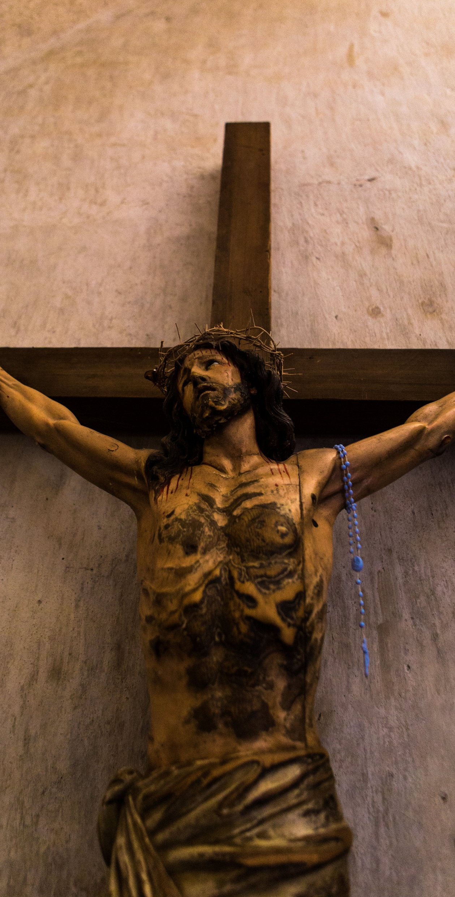
Jesus defines “agape”
What is love for a Christian?
The love of Jesus defines agape.
The defining image is the cross.

Slide 17
Agape – layers of meaning
Ahavah – attractive, caring love
  God does not just feel love, but chooses to act in love.
Khesed – loyal love
  Generous, unconditional, relational
  Grows out of who God is.
  Results in covenant.

Slide 18
Agape love declares…
God is love as shown in the cross.
1 John 4:8
God’s purpose in choosing a particular people is to bless all people.
God’s “new” covenant is always an updated expression of God’s original intent.

Slide 19
Love extended
²⁷ “But I say to you who are listening: Love your enemies; do good to those who hate you; ²⁸ bless those who curse you; pray for those who mistreat you. ²⁹ If anyone strikes you on the cheek, offer the other also, and from anyone who takes away your coat do not withhold even your shirt. ³⁰ Give to everyone who asks of you, and if anyone takes away what is yours, do not ask for it back again. ³¹ Do to others as you would have them do to you. Luke 6:27–31 (NRSVue)

Slide 20
The core of the Gospel
⁸ But God proves his love for us in that while we still were sinners Christ died for us.
Romans 5:7–8 (NRSVue)
⁹ God’s love was revealed among us in this way: God sent his only Son into the world so that we might live through him. ¹⁰ In this is love, not that we loved God but that he loved us and sent his Son to be the atoning sacrifice for our sins. ¹¹ Beloved, since God loved us so much, we also ought to love one another. 1 John 4:9–11 (NRSVue)

