Slide 1
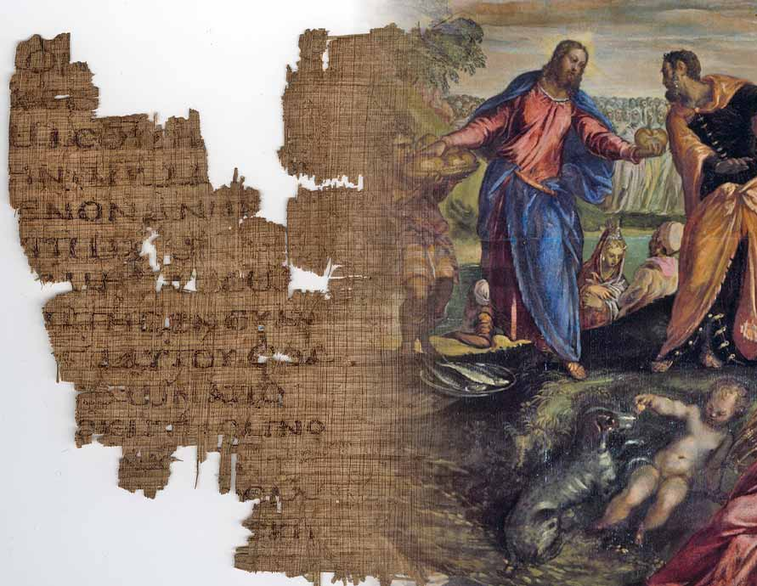
Ultimate Evidence
Personal Submission One to Another
1 Cor 1:10
Phil 2:1-4
Rom 12:1-16
Jn 5:19-20
Is 55:8-9
8/2/26

Slide 2
The name of Jesus requires absolute oneness to the church.
I appeal to you, brothers, by the name of our Lord Jesus Christ, that all of you agree, and that there be no divisions among you, but that you be united in the same mind and the same judgment. ¹¹ For it has been reported to me by Chloe’s people that there is quarreling among you, my brothers. 1 Cor 1:10-11

Slide 3
Oneness Requires:
Unified Communication
I appeal to you, brothers, by the name of our Lord Jesus Christ, that all of you agree, and that there be no divisions among you, but that you be united in the same mind and the same judgment. ¹¹ For it has been reported to me by Chloe’s people that there is quarreling among you, my brothers. 1 Cor 1:10-11

Slide 4
Oneness Requires:
Unified Communication
No Cliques or Sides.
I appeal to you, brothers, by the name of our Lord Jesus Christ, that all of you agree, and that there be no divisions among you, but that you be united in the same mind and the same judgment. ¹¹ For it has been reported to me by Chloe’s people that there is quarreling among you, my brothers. 1 Cor 1:10-11

Slide 5
Oneness Requires:
Unified Communication
Perfect (Healthy) Greetings
No Cliques or Sides
I appeal to you, brothers, by the name of our Lord Jesus Christ, that all of you agree, and that there be no divisions among you, but that you be united in the same mind and the same judgment. 1 Cor 1:10-11

Slide 6
Oneness Requires:
Unified Communication
Perfect (Healthy) Greetings
No Cliques or Sides
Unified Reflection = Thoughts
Unified Judgment = Speaking
I appeal to you, brothers, by the name of our Lord Jesus Christ, that all of you agree, and that there be no divisions among you, but that you be united in the same mind and the same judgment. 1 Cor 1:10-11

Slide 7
The mind of Jesus
should be in to us!!!
Do nothing from selfish ambition or conceit, but in humility of mind count others more significant than yourselves. ⁴ Let each of you look not only to his own interests, but also to the interests of others. ⁵ Have this mind among yourselves, which is yours in Christ Jesus, ⁶ who, though he was in the form of God, did not count equality with God a thing to be grasped, ⁷ but emptied himself, by taking the form of a servant, being born in the likeness of men.
Phil 2:3-7

Slide 8
Our minds are also to be one, and in complete submission to one another!
² complete my joy by being of the same mind, having the same love, being in full accord and of one mind. ³ Do nothing from selfish ambition or conceit,
but in humility count others more significant than yourselves. ⁴ Let each of you look not only to his own interests, but also to the interests of others.
Phil 2:1-4

Slide 9
Lord Jesus Christ, Who am I not putting their interests above my own?

Slide 10
Lord Jesus Christ, Who am I not putting their interests above my own?
Lord Jesus Christ, Who am I overpowering with my selfishness?

