Slide 1
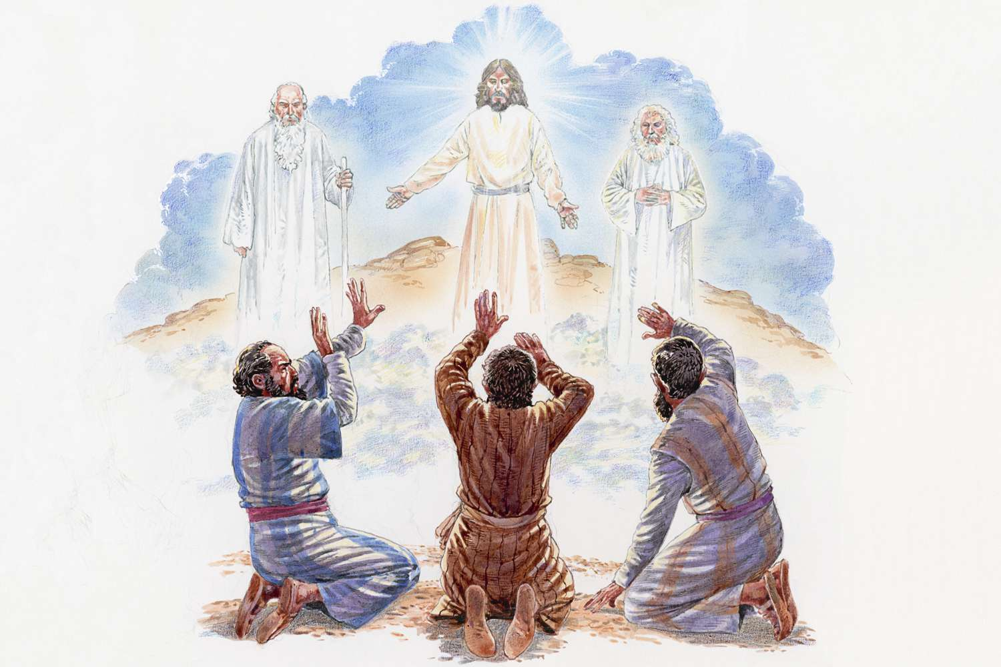
Ultimate Evidence
Jesus’ Test of Presence
1 Cor 1:10-17
1 Cor 2:1-16
1 Cor 3:1-15
Mt 18:10-20
1 Cor 12:1-13:13
7/5/26

Slide 2
Paul writes the Corinthians to correct their relationship with God’s Spirit.
I appeal to you, brothers, by the name of our Lord Jesus Christ, that all of you agree, and that there be no divisions among you, but that you be united in the same mind and the same judgment. ¹¹ For it has been reported to me by Chloe’s people that there is quarreling among you, my brothers. 1 Cor 1:10-11

Slide 3
Quarreling reflects
“Un-Spirit” led people
But I, brothers, could not address you as spiritual people, but as people of the flesh, as infants in Christ. ² I fed you with milk, not solid food, for you were not ready for it. And even now you are not yet ready, ³ for you are still of the flesh. For while there is jealousy and strife among you, are you not of the flesh and behaving only in a human way? 1 Cor 3:1-3

Slide 4
But, as it is written, “What no eye has seen, nor ear heard, nor the heart of man imagined, what God has prepared for those who love him” - ¹⁰ these things God has revealed to us through the Spirit. For the Spirit searches everything, even the depths of God. ¹¹ For who knows a person’s thoughts except the spirit of that person, which is in him? So also no one comprehends the thoughts of God except the Spirit of God. 1 Cor 2:9-11

Slide 5
And we are writing these things so that our joy may be complete. AND…
⁵ This is the message we have heard from him and proclaim to you, that God is light, and in him is no darkness at all. ⁶ If we say we have fellowship with him while we walk in darkness, we lie and do not practice the truth. ⁷ But if we walk in the light, as he is in the light, we have fellowship with one another, and the blood of Jesus his Son cleanses us from all sin. 1 Jn 1:4-7

Slide 6
God’s relational standard is personal intimacy.
“See that you do not despise one of these little ones. For I tell you that in heaven their angels always see the face of my Father who is in heaven.
¹⁵ “If your brother sins against you, go and tell him his fault, between you and him alone. If he listens to you, you have gained your brother. ¹⁸ Truly, I say to you, whatever you bind on earth shall be bound in heaven, and whatever you loose on earth shall be loosed in heaven. Mt 18:10, 15, 18
Mt 18:10, 15, 18

Slide 7
“If your brother sins against you, go and tell him his fault, between you and him alone. If he listens to you, you have gained your brother.” Mt 18:15

Slide 8
¹⁵ “If your brother sins against you, go and tell him his fault, between you and him alone. If he listens to you, you have gained your brother.”
¹² What do you think? If a man has a hundred sheep, and one of them has gone astray, does he not leave the ninety-nine on the mountains and go in search of the one that went astray? ¹³ And if he finds it, truly, I say to you, he rejoices over it more than over the ninety-nine that never went astray. ¹⁴ So it is not the will of my Father who is in heaven that one of these little ones should perish. Mt 18:12-14, 15

Slide 9
Talking to others requires the heart of the Good Shepherd who doesn’t focus on the sin but on the separation.
And if he finds it, truly, I say to you, he rejoices over it more than over the ninety-nine that never went astray. ¹⁴ So it is not the will of my Father who is in heaven that one of these little ones should perish.
Mt 18:13-14

