Slide 1
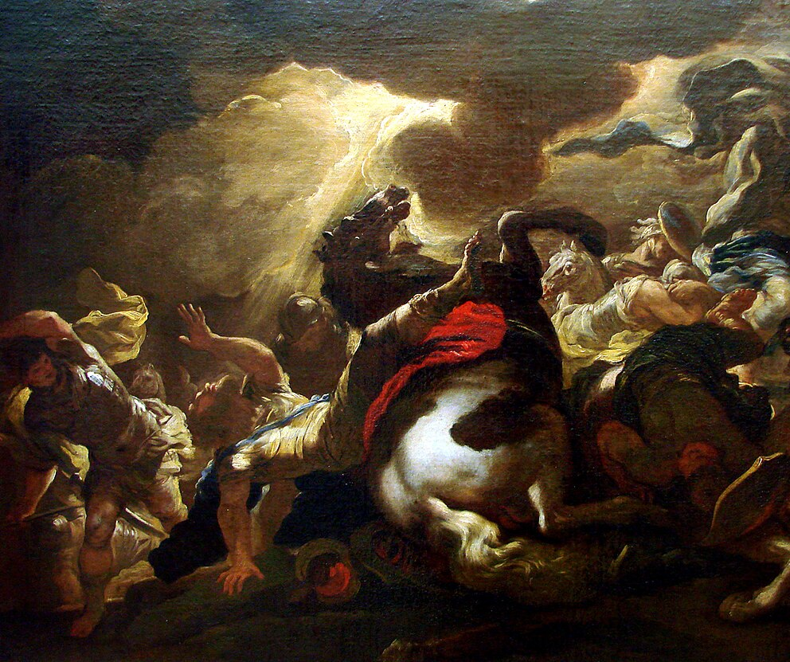
Ultimate Evidence
Jesus’ Test of Fire
1 Cor 1:10-17
1 Cor 2:1-16
1 Cor 3:1-15
Mt 18:15-20
1 Cor 12:1-13:13
6/28/26

Slide 2
The one who is spiritual discerns all things.
The natural person does not accept the things of the Spirit of God, for they are folly to him, and he is not able to understand them because they are spiritually discerned. ¹⁵ The spiritual person
discerns (judges) all things, but is himself to be judged by no one. 1 Cor 2:14-15

Slide 3
The spiritual person is discerned by no one.
The natural person does not accept the things of the Spirit of God, for they are folly to him, and he is not able to understand them because they are spiritually discerned. ¹⁵ The spiritual person
discerns (judges) all things, but is himself to be discerned (judged) by no one. 1 Cor 2:14-15

Slide 4
The Lord is instructed
by no one.
The spiritual person judges all things, but is himself to be judged by no one. ¹⁶ “For who has understood the mind of the Lord so as to instruct him?” But we have the mind of Christ.
1 Cor 2:15-16

Slide 5
We have the
mind of Christ.
The spiritual person judges all things, but is himself to be judged by no one. ¹⁶ “For who has understood the mind of the Lord so as to instruct him?” But we have the mind of Christ.
1 Cor 2:15-16

Slide 6
You are babies (infants), unable to receive any Spirit teaching at all.
And I, brethren, could not speak to you as to spiritual men, but as to men of flesh, as to infants in Christ. ² I gave you milk to drink, not solid food; for you were not yet able
to receive it. Indeed, even now you are not yet able, 1 Cor 3:1-2

Slide 7
The sole source and final test of all things is Jesus and His Spirit.

Slide 8
According to the grace of God given to me, like a skilled master builder I laid a foundation, and someone else is building upon it. Let each one take care how he builds upon it. ¹¹ For no one can lay a foundation other than that which is laid, which is Jesus Christ. ¹² Now if anyone builds on the foundation with gold, silver, precious stones, wood, hay, straw— ¹³ each one’s work will become manifest, for the Day will disclose it, because it will be revealed by fire, and the fire will test what sort of work each one has done. 1 Cor 5:10-13

Slide 9
The sole source and final test of all things is Jesus and His Spirit.
If the work that anyone has built on the foundation survives, he will receive a reward. ¹⁵ If anyone’s work is burned up, he will suffer loss, though he himself will be saved, but only as through fire… ¹⁶ Do you not know that you are God’s temple and that God’s Spirit dwells in you? 1 Cor 3:14-15

