Slide 1
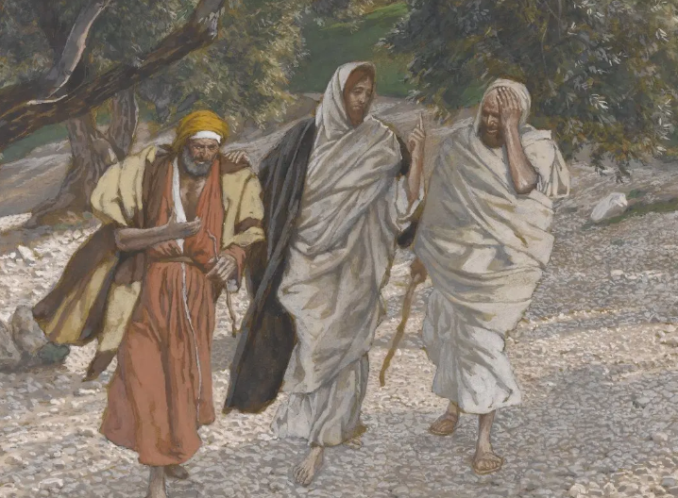
Emmaus Easter
Lk 24:13-35
4/5/26

Slide 2
That very day two of them were going to a village named Emmaus, about seven miles from Jerusalem, ¹⁴ and they were talking with each other about all these things that had happened. ¹⁵ While they were talking and discussing together, Jesus himself drew near and went with them. ¹⁶ But their eyes were kept from recognizing him. ¹⁷ And he said to them, “What is this conversation that you are holding with each other as you walk?” And they stood still, looking sad. Lk 24:13-17

Slide 3
Then one of them, named Cleopas, answered him, “Are you the only visitor to Jerusalem who does not know the things that have happened there in these days?” ¹⁹ And he said to them, “What things?” And they said to him, “Concerning Jesus of Nazareth, a man who was a prophet mighty in deed and word before God and all the people, ²⁰ and how our chief priests and rulers delivered him up to be condemned to death, and crucified him. ²¹ But we had hoped that he was the one to redeem Israel.
Lk 24:18-21a

Slide 4
…Yes, and besides all this, it is now the third day since these things happened. ²² Moreover, some women of our company amazed us. They were at the tomb early in the morning, ²³ and when they did not find his body, they came back saying that they had even seen a vision of angels, who said that he was alive. ²⁴ Some of those who were with us went to the tomb and found it just as the women had said, but him they did not see.” Lk 24:21b-24

Slide 5
And He said to them, “O foolish ones, and slow of heart to believe all that the prophets have spoken! ²⁶ Was it not necessary that the Christ should suffer these things and enter into his glory?” ²⁷ And beginning with Moses and all the Prophets, he interpreted to them in all the Scriptures the things concerning himself. ²⁸ So they drew near to the village to which they were going. He acted as if he were going farther, ²⁹ but they urged him strongly, saying, “Stay with us, for it is toward evening and the day is now far spent.” So he went in to stay with them. Lk 24:25-29

Slide 6
When he was at table with them, he took the bread and blessed and broke it and gave it to them. ³¹ And their eyes were opened, and they recognized him. And he vanished from their sight. ³² They said to each other, “Did not our hearts burn within us while he talked to us on the road, while he opened to us the Scriptures?” ³³ And they rose that same hour and returned to Jerusalem. Lk 24:30-33a

Slide 7
The first testimonies
were from women.
Some of those who were with us went to the tomb and found it just as the women had said, but him they did not see.” ²⁵ And he said to them, “O foolish ones, and slow of heart to believe all that the prophets have spoken! ²⁶ Was it not necessary that the Christ should suffer these things and enter into his glory?” Lk 24:24-26

Slide 8
These testimonies
were confirmed by men.
Some of those who were with us went to the tomb and found it just as the women had said, but him they did not see.” ²⁵ And he said to them, “O foolish ones, and slow of heart to believe all that the prophets have spoken! ²⁶ Was it not necessary that the Christ should suffer these things and enter into his glory?” Lk 24:24-26

Slide 9
Jesus was
free and alive.
Some of those who were with us went to the tomb and found it just as the women had said, but him they did not see.” ²⁵ And he said to them, “O foolish ones, and slow of heart to believe all that the prophets have spoken! ²⁶ Was it not necessary that the Christ should suffer these things and enter into his glory?” Lk 24:24-26

Slide 10
Cleopus and his friend
were observers.
?
Some of those who were with us went to the tomb and found it just as the women had said, but him they did not see.” ²⁵ And he said to them, “O foolish ones, and slow of heart to believe all that the prophets have spoken! ²⁶ Was it not necessary that the Christ should suffer these things and enter into his glory?” Lk 24:24-26

Slide 11
Then one of them, named Cleopas, answered him, “Are you the only visitor to Jerusalem who does not know the things that have happened there in these days?” ¹⁹ And he said to them, “What things?” And they said to him, “Concerning Jesus of Nazareth, a man who was a prophet mighty in deed and word before God and all the people, ²⁰ and how our chief priests and rulers delivered him up to be condemned to death, and crucified him. ²¹ But we had hoped that he was the one to redeem Israel.
Lk 24:18-21a

Slide 12
…Yes, and besides all this, it is now the third day since these things happened. ²² Moreover, some women of our company amazed us. They were at the tomb early in the morning, ²³ and when they did not find his body, they came back saying that they had even seen a vision of angels, who said that He was alive! ²⁴ Some of those who were with us went to the tomb and found it just as the women had said, but him they did not see.” Lk 24:21b-24

Slide 13
And He said to them, “O foolish ones, and slow of heart to believe all that the prophets have spoken! ²⁶ Was it not necessary that the Christ should suffer these things and enter into his glory?” ²⁷ And beginning with Moses and all the Prophets, he interpreted to them in all the Scriptures the things concerning himself. ²⁸ So they drew near to the village to which they were going. He acted as if he were going farther, ²⁹ but they urged him strongly, saying, “Stay with us, for it is toward evening and the day is now far spent.” So he went in to stay with them. Lk 24:25-29

Slide 14
There was a second
second set (of testimonies).
1
2
And they rose that same hour and returned to Jerusalem. And they found the eleven and those who were with them gathered together, ³⁴ saying, “The Lord has risen indeed, and has appeared to Simon!”
³⁵ Then they told what had happened on the road, and how he was known to them in the breaking of the bread. Lk 24:33-35

Slide 15
When Jesus was at table with them, he took the bread and blessed and broke it and gave it to them. ³¹ And their eyes were opened, and they recognized him. And he vanished from their sight. ³² They said to each other, “Did not our hearts burn within us while he talked to us on the road, while he opened to us the Scriptures?” ³³ And they rose that same hour and returned to Jerusalem. Lk 24:30-33a

Slide 16
Meeting Jesus will forever mark your heart!

Slide 17
Cleopus and his
companion were
were included in
the second set.
When Jesus was at table with them, he took the bread and blessed and broke it and gave it to them. ³¹ And their eyes were opened, and they recognized him. And he vanished from their sight.
Lk 24:30-31

Slide 18
Will you let Jesus
mark your heart today?

