Slide 1
Judgment or Testimony?
Matthew 7:1–5; John 8:12–20
Paul Leichty
Agape Fellowship
March 1, 2026

Slide 2

Labels

Slide 3
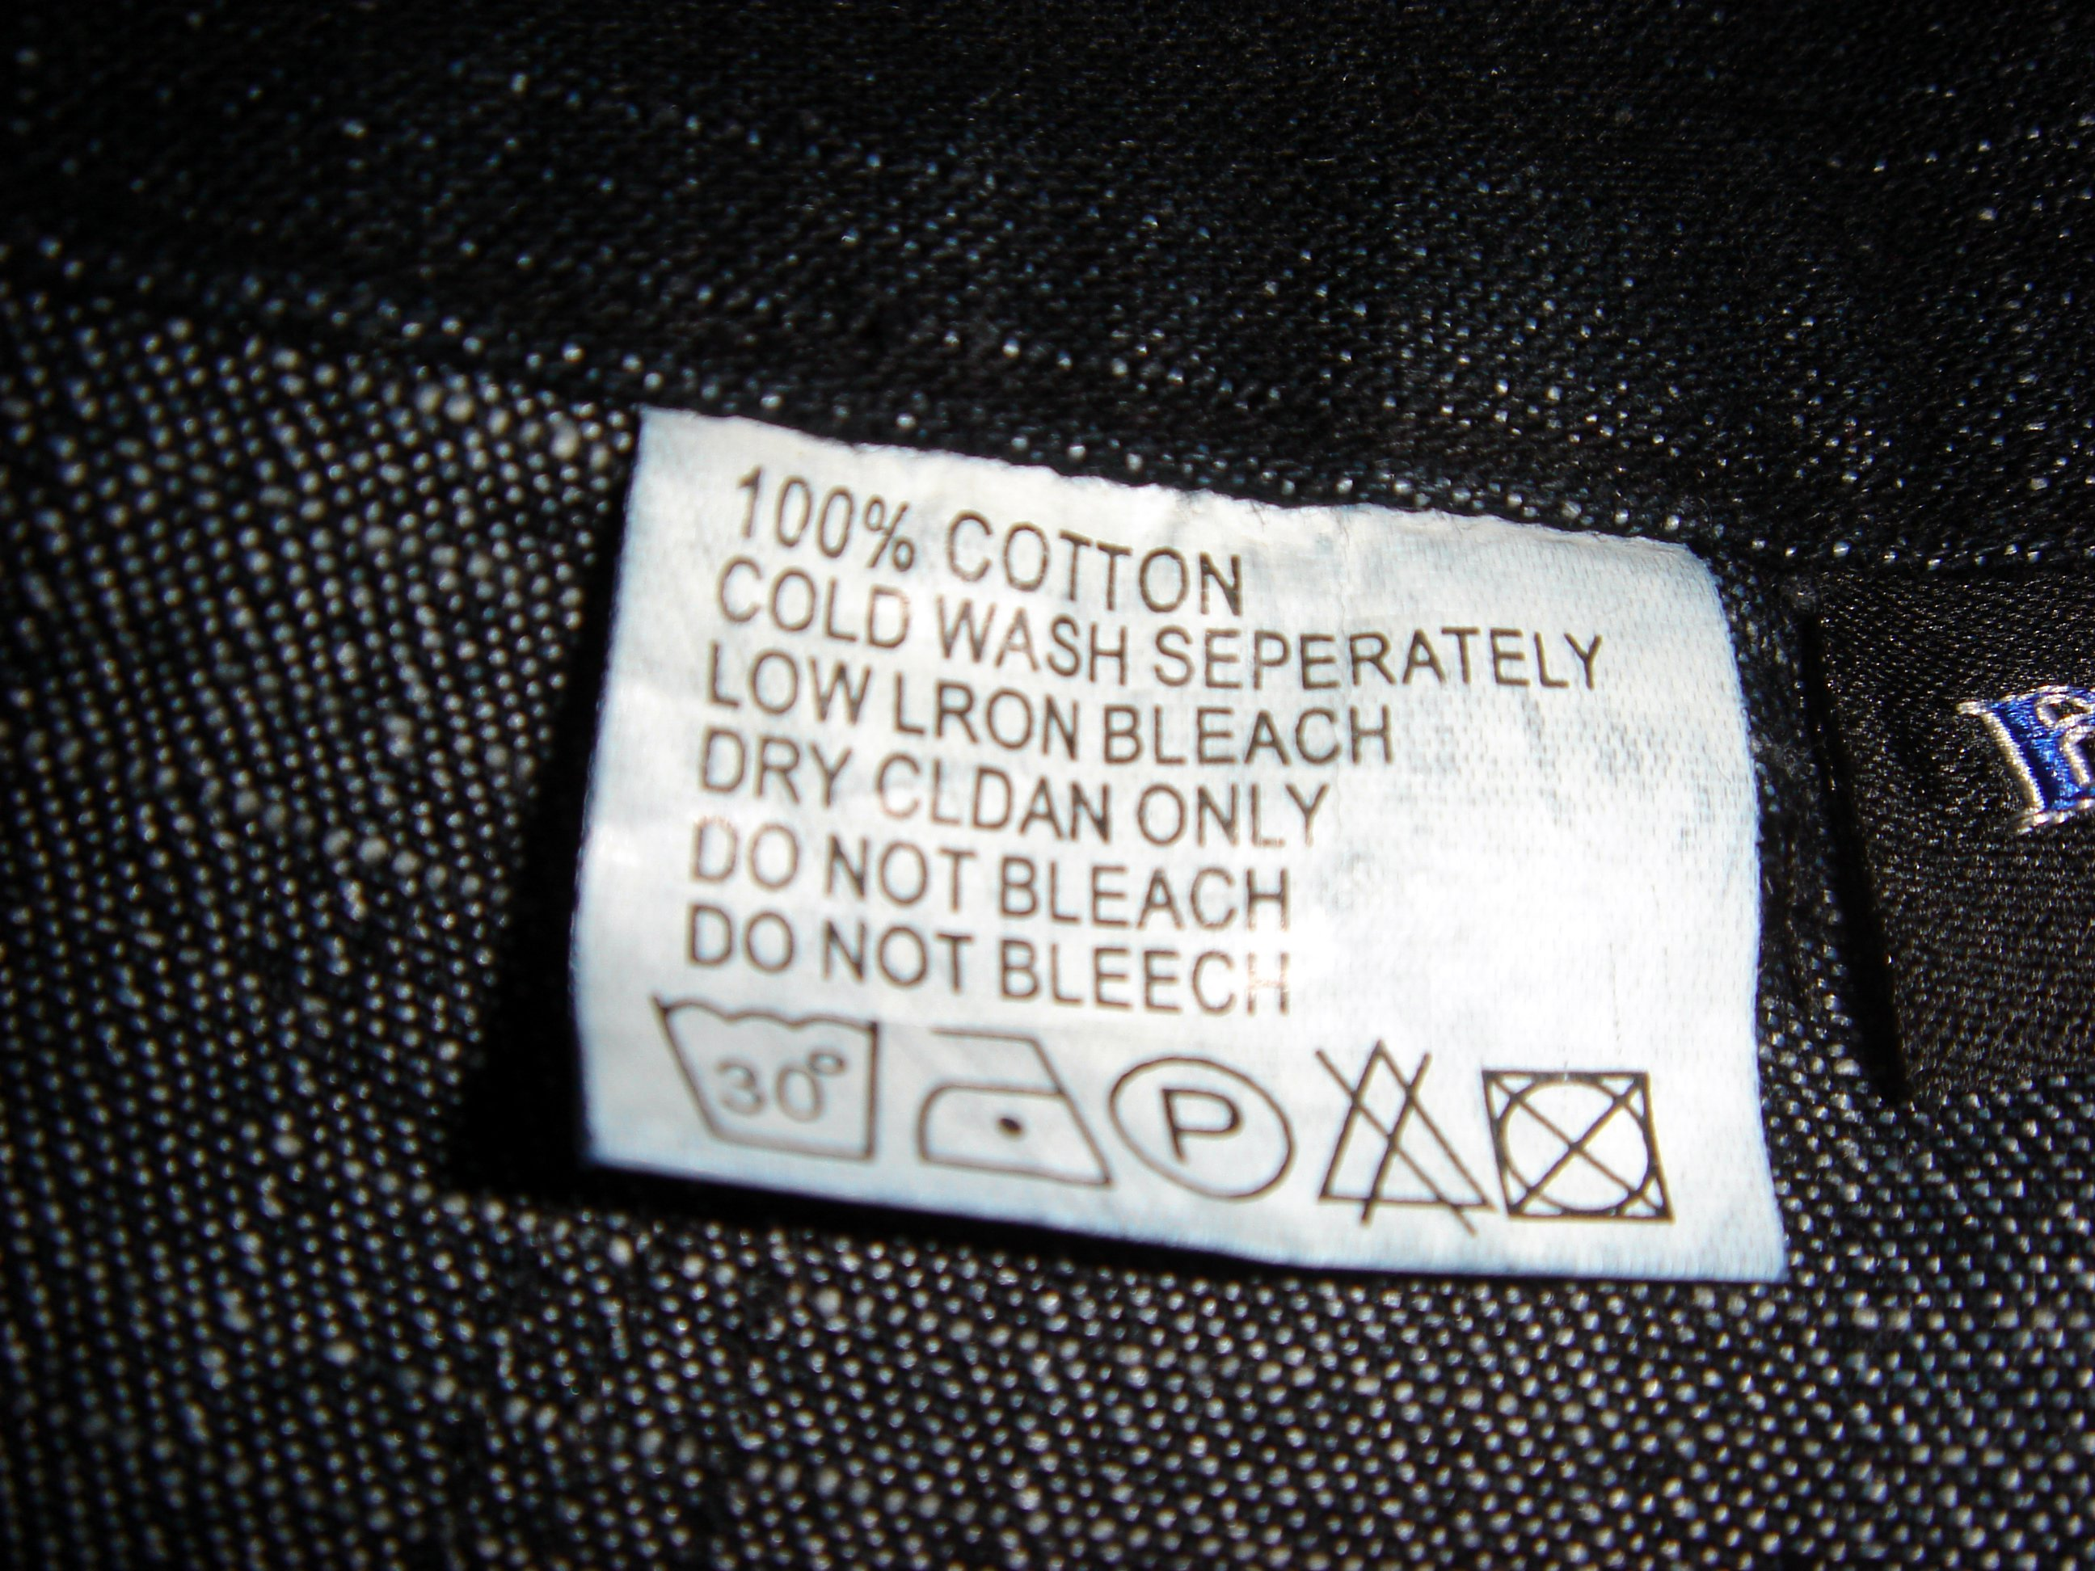
The Power of Labels
Labels on People
  Helpful?
  Problematic?
What are we doing?
  Giving information?
  Placing value?
Are labels accurate?
  Do they describe?
  Only half-true at best

Slide 4
Labels in the Church
Orthodox
Conservative
Baptist
Evangelical
Anabaptist
Liberal
Messianic
Charismatic
Fundamentalist
Pentecostal
Radical
Progressive
Christian Anarchist
Christian Nationalist

Slide 5
Matthew 7:1-5 (NRSVue)
¹ “Do not judge, so that you may not be judged.
² For the judgment you give will be the judgment you get,
and the measure you give will be the measure you get.
³ Why do you see the speck in your neighbor’s eye,
but do not notice the log in your own eye?
⁴ Or how can you say to your neighbor,
‘Let me take the speck out of your eye,’
while the log is in your own eye?
⁵ You hypocrite, first take the log out of your own eye,
and then you will see clearly
to take the speck out of your neighbor’s eye.

Slide 6
The meaning of Judgment
Greek word, κρίνω (krinō̄)
  Usually translated “judge”
  English words: critic, critical, criticism
  Root definition is to separate (the good from the bad)
  Who can separate the good from the bad? The Godly from the ungodly?

Slide 7
Luke 6:37-38 (NRSVue)
“Do not judge,
and you will not be judged;
do not condemn, [to put one down in vengeance]
and you will not be condemned.
Forgive,
and you will be forgiven;
³⁸ give,
and it will be given to you.
A good measure, pressed down,
shaken together, running over, will be put into your lap,
for the measure you give
will be the measure you get back.”

Slide 8
Luke 6:39-42a (NRSVue)
Word picture #1:
³⁹ He also told them a parable:
“Can a blind person guide a blind person?
Will not both fall into a pit?
⁴⁰ A disciple is not above the teacher, but every disciple who is fully qualified will be like the teacher.
⁴¹ Why do you see the speck in your neighbor’s eye but do not notice the log in your own eye? ⁴² Or how can you say to your neighbor, ‘Friend, let me take out the speck in your eye,’ when you yourself do not see the log in your own eye?

Slide 9
You hypocrite!
Word picture #2:
Matthew 7:5
You hypocrite, first take the log out of your own eye, and then you will see clearly to take the speck out of your neighbor’s eye.
Luke 6:42b
You hypocrite, first take the log out of your own eye, and then you will see clearly to take the speck out of your neighbor’s eye.

Slide 10
The meaning of Hypocrite
Greek word, ὑποκριτής hypokritēs
Hypocrite: Used in Greek of an actor, one who pretends to be someone else.
  Comes from ὑπό hypo: under and κρίνω (krinō̄).
  One who “judges from under” is a pretender, an actor.
  One who takes on the role of God.
    Self-righteousness instead of God’s righteousness

Slide 11
Judging Jesus John 7
The religious leaders judge Jesus
After this Jesus traveled throughout Galilee. He didn’t want to travel in Judea, because the Jewish authorities wanted to kill him. John 7:1 (CEB)
Jesus lags behind in coming to the Festival
Jesus starts teaching
¹⁴ Halfway through the festival, Jesus went up to the temple and started to teach. ¹⁵ Astonished, the Jewish leaders asked, “He’s never been taught! How has he mastered the Law?”
¹⁶ Jesus responded, “My teaching isn’t mine but comes from the one who sent me…” ³⁰ So they wanted to seize Jesus, but they couldn’t because his time hadn’t yet come. John 7:14–16 (CEB)

Slide 12
Jesus asked to judge John 8:2-11 (NRSVue)
⁴ …they said to him, “Teacher, this woman was caught in the very act of committing adultery. ⁵ Now in the law Moses commanded us to stone such women. Now what do you say?
⁷ When they kept on questioning him, he straightened up and said to them, “Let anyone among you who is without sin be the first to throw a stone at her.”
And Jesus said, “Neither do I condemn you. Go your way, and from now on do not sin again.

Slide 13
Judging or Testifying? (John 8:12-15 NRSVue)
¹² Again Jesus spoke to them, saying, “I am the light of the world…”
¹³ Then the Pharisees said to him,
“You are testifying on your own behalf; your testimony is not valid.”
¹⁴ Jesus answered, “…my testimony is valid…
¹⁵ You judge by human standards; I judge no one…
What is the difference between judging and testifying?
What is the difference between a judge and a witness?

Slide 14
The courtroom
Accuser and accused
  Who is right? Who is wrong?
  Who is guilty? Who is not guilty?
Witness gives testimony μαρτυρία marturia = martyr
  Tells the court what he or she has seen or heard.
  Testimony is limited to personal experience.
Judge gives judgment
  Knows the law.
  Judges the testimony of all witnesses.
  Announces the verdict.

Slide 15
Jesus and the Pharisees – Part 1
Jesus’s testimony
  ¹² Again Jesus spoke to them, saying, “I am the light of the world. Whoever follows me will never walk spoke to them, saying, “I am the light of the world. Whoever follows me will never walk in darkness but will have the light of life.”
The Pharisees respond:
  ¹³ Then the Pharisees said to him,
  “You are testifying on your own behalf; your testimony is not valid.”

Slide 16
Jesus and the Pharisees – Part 2
The Pharisees respond in judgment
  ¹³ Then the Pharisees said to him,
  “You are testifying on your own behalf; your testimony is not valid.”
The Pharisees give a counter-testimony
  ¹⁵ A single witness shall not suffice to convict a person of any crime or wrongdoing in connection with any offense that may be committed. Only on the evidence of two or three witnesses shall a charge be sustained. Deuteronomy 19:15 NRSVue

Slide 17
Jesus and the Pharisees – Part 3
The Pharisees give a counter-testimony
  ¹⁵ A single witness shall not suffice to convict a person of any crime or wrongdoing in connection with any offense that may be committed. Only on the evidence of two or three witnesses shall a charge be sustained. Deuteronomy 19:15 NRSVue
Jesus responds
  ¹⁴ Jesus answered, “Even if I testify on my own behalf, my testimony is valid because I know where I have come from and where I am going, but you do not know where I come from or where I am going.

Slide 18
Jesus and the Pharisees – Part 4
Jesus responds
  ¹⁴ Jesus answered, “Even if I testify on my own behalf, my testimony is valid…
Jesus continues
  ¹⁵ You judge by human standards; I judge no one. ¹⁶ Yet even if I do judge, my judgment is valid; for it is not I alone who judge, but I and the Father who sent me.
Summary of testimony
  ¹⁷ In your law it is written that the testimony of two witnesses is valid.
  ¹⁸ I testify on my own behalf, and
  the Father who sent me testifies on my behalf.”

Slide 19
The Teachings of Jesus
Matthew 7:1
  “Do not judge, so that you may not be judged. ² For the judgment you give will be the judgment you get, and the measure you give will be the measure you get.
Luke 6:37
  ³⁷ “Do not judge, and you will not be judged; do not condemn, and you will not be condemned.
John 8:15.
  ¹⁵ You judge by human standards; I judge no one.

Slide 20
New Testament Teachings
Apostle Paul in Romans 14:10
  ¹⁰ Why do you pass judgment on your brother or sister? Or you, why do you despise your brother or sister? For we will all stand before the judgment seat of God.
James in James 4:11–12
  ¹¹ Do not speak evil against one another, brothers and sisters. Whoever speaks evil against another or judges another speaks evil against the law and judges the law, but if you judge the law, you are not a doer of the law but a judge. ¹² There is one lawgiver and judge who is able to save and to destroy. So who, then, are you to judge your neighbor?

Slide 21
Apostle Paul (Romans 2:1-4 NRSVue)
¹ Therefore you are without excuse, whoever you are, when you judge others;
for in passing judgment on another you condemn yourself, because you, the judge, are doing the very same things.
² We know that God’s judgment on those who do such things is in accordance with truth.
³ Do you imagine, whoever you are, that when you judge those who do such things and yet do them yourself, you will escape the judgment of God?
⁴ Or do you despise the riches of his kindness and forbearance and patience?
Do you not realize that God’s kindness is meant to lead you to repentance?

Slide 22
The true goal
Not judgment, but salvation
John 3:16-17,19 (NRSVue)
  ¹⁶ “For God so loved the world that he gave his only Son, so that everyone who believes in him may not perish but may have eternal life.
  ¹⁷ “Indeed, God did not send the Son into the world to condemn [krino] the world but in order that the world might be saved through him.
  ¹⁹ And this is the judgment, that the light has come into the world, and people loved darkness rather than light because their deeds were evil.

Slide 23
The Disciples’ task
Ascension Commission (Acts 1:6-8 NRSVue)
  ⁶ So when they had come together, they asked him, “Lord, is this the time when you will restore the kingdom to Israel?” ⁷ He replied, “It is not for you to know the times or periods that the Father has set by his own authority. ⁸ But you will receive power when the Holy Spirit has come upon you, and you will be my witnesses in Jerusalem, in all Judea and Samaria, and to the ends of the earth.”

Slide 24
Blank

Slide 25
Judgment or Testimony?
Matthew 7:1–5; John 8:12–20
Focus Group
Paul Leichty
Agape Fellowship
March 1, 2026

Slide 26
Discussion Questions
What is the difference between judgment and testimony? Is this distinction helpful?
Why are we tempted to judge?
How does humility relate to judgment?
How does love relate to judgment?
What is forbearance?
  To delay or defer judgment
  Does God practice forbearance?
  Do we practice forbearance?

Slide 27
More Discussion Questions
What are the labels that you use for people?
  In what ways are those labels helpful?
  How are those labels harmful and turn into judgment?
How do you describe other people?
  Do you use labels freely?
  Do you recognize the complex uniqueness of each person?
How would you like to be described?
  Are there labels that you accept for yourself?
  How do you respond when a label seems negative?

Slide 28
Judgment or Testimony
 | Judgment | Testimony
Who? | God, the Judge | People, the Witnesses
Task? | To deliver a verdict | To share a testimony
 | People in boxes | Descriptive
 | We assign value | We share experience
Greek word | κρίνω krinō = judge | μαρτυρία marturia = witness, martyr
Goal | Salvation | Preparation

