Slide 1
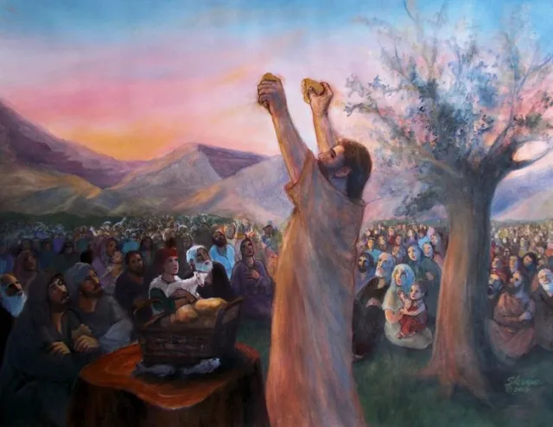
Feeding of the 4,000 Part 1
Mt 15:32-39 Mk 8:1-9
Mt 18:1-10
3/8/26

Slide 2
Jesus Testimonies:
Personal- about me and not others
What I was/did… how Jesus changed me
[ my uncleanness is being touched by Jesus ]
Glorifying to Jesus-
His way of working… in me
The overflow of what He did with me into others
Culture of Transformation

Slide 3
At that time the disciples came to Jesus, saying, “Who is the greatest in the kingdom of heaven?” ² And calling to him a child, he put him in the midst of them ³ and said, “Truly, I say to you, unless you turn and become like children, you will never enter the kingdom of heaven. ⁴ Whoever humbles himself like this child is the greatest in the kingdom of heaven.” Mt 18:1-4

Slide 4
“Whoever receives one such child in my name receives me, ⁶ but whoever causes one of these little ones who believe in me to sin, it would be better for him to have a great millstone fastened around his neck and to be drowned in the depth of the sea.
⁷ “Woe to the world for temptations to sin! For it is necessary that temptations come, but woe to the one by whom the temptation comes!”
Mt 18:6-7

Slide 5
Jesus went on from there and walked beside the Sea of Galilee. And he went up on the mountain and sat down there. ³⁰ And great crowds came to him, bringing with them the lame, the blind, the crippled, the mute, and many others, and they put them at his feet, and he healed them, ³¹ so that the crowd wondered, when they saw the mute speaking, the crippled healthy, the lame walking, and the blind seeing. And they glorified the God of Israel. Mt 15:29-31

Slide 6
In those days, when again a great crowd had gathered, and they had nothing to eat, he called his disciples to him and said to them, ² “I have compassion on the crowd, because they have been with me now three days and have nothing to eat. ³ And if I send them away hungry to their homes, they will faint on the way. And some of them have come from far away.” Mk 8:1-3

Slide 7
Jesus had been
ministering non-stop.
Then Jesus called his disciples to him and said, “I have compassion on the crowd because they have been with me now three days and have nothing to eat. And I am unwilling to send them away hungry, lest they faint on the way.” Mt 15:32

Slide 8
The crowd
had been fasting.
Then Jesus called his disciples to him and said, “I have compassion on the crowd because they have been with me now three days and have nothing to eat. And I am unwilling to send them away hungry, lest they faint on the way.” Mt 15:32

