Slide 1
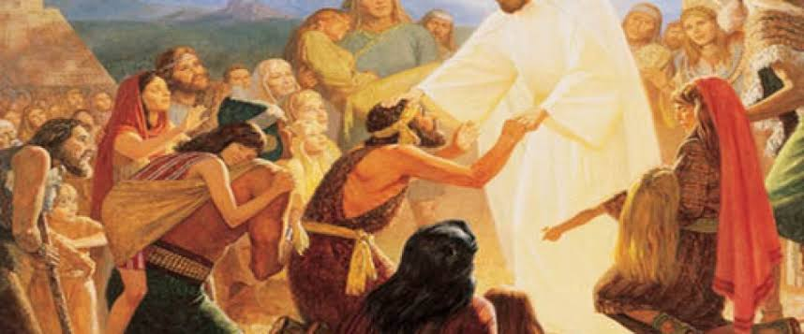
Seat of Jesus
Mt 15:29-31
Mk 7:24-30
Mk 7:31-37
2/22/26

Slide 2
Jesus went on from there and walked beside the Sea of Galilee. And he went up on the mountain and sat down there. ³⁰ And great crowds came to him, bringing with them the lame, the blind, the crippled, the mute, and many others, and they put them at his feet, and he healed them, ³¹ so that the crowd wondered, when they saw the mute speaking, the crippled healthy, the lame walking, and the blind seeing. And they glorified the God of Israel. Mt 15:29-31

Slide 3
Jesus – Sign Upgrade
And from there he arose and went away to the region of Tyre and Sidon. And he entered a house and did not want anyone to know, yet he could not be hidden. ²⁵ But immediately a woman whose little daughter had an unclean spirit heard of him and came and fell down at his feet. ²⁶ Now the woman was a Gentile, a Syrophoenician by birth. She begged him to cast the demon out of her daughter... ²⁹ And he said to her, “For this statement you may go your way; the demon has left your daughter.” ³⁰ And she went home and found the child lying in bed and the demon gone. Mk 7:24-26, 29-30

Slide 4
Jesus travels back
through Tyre and Sidon.
Then he returned from the region of Tyre and went through Sidon to the Sea of Galilee, in the region of the Decapolis. Mk 7:31

Slide 5
Jesus sat
on a mountain.
Jesus went on from there and walked beside the Sea of Galilee. And he went up on the mountain and sat down there. Mt 15:29

Slide 6
Faith – filled friends
came to Jesus.
And great crowds came to him, bringing with them the lame, the blind, the crippled, the mute, and many others, and they put them at his feet, and he healed them, ³¹ so that the crowd wondered, when they saw the mute speaking, the crippled healthy, the lame walking, and the blind seeing. And they glorified the God of Israel. Mt 15:30-31

Slide 7
Jesus hope was realized.
And great crowds came to him, bringing with them the lame, the blind, the crippled, the mute, and many others, and they put them at his feet, and he healed them, ³¹ so that the crowd wondered, when they saw the mute speaking, the crippled healthy, the lame walking, and the blind seeing. And they glorified the God of Israel. Mt 15:30-31

Slide 8
Jesus never moved.
And great crowds came to him, bringing with them the lame, the blind, the crippled, the mute, and many others, and they put them at his feet, and he healed them, ³¹ so that the crowd wondered, when they saw the mute speaking, the crippled healthy, the lame walking, and the blind seeing. And they glorified the God of Israel. Mt 15:30-31

Slide 9
There was one
special case.
And they brought to him a man who was deaf and mute, and they begged him to lay his hand on him. ³³ And taking him aside from the crowd privately, he put his fingers into his ears, and after spitting touched his tongue. ³⁴ And looking up to heaven, he sighed and said to him, “Ephphatha,” that is, “Be opened.” ³⁵ And his ears were opened, his tongue was released, and he spoke plainly. Mk 7:32-34

Slide 10
Jesus – Sign Upgrade
And taking him aside from the crowd privately, he put his fingers into his ears, and after spitting touched his tongue. ³⁴ And looking up to heaven, he sighed and said to him, “Ephphatha,” that is, “Be opened.” ³⁵ And his ears were opened, his tongue was released, and he spoke plainly. ³⁶ And Jesus charged them to tell no one. But the more he charged them, the more zealously they proclaimed it. ³⁷ And they were astonished beyond measure, saying, “He has done all things well. He even makes the deaf hear and the mute speak.” Mk 7:33 -37

