Slide 1
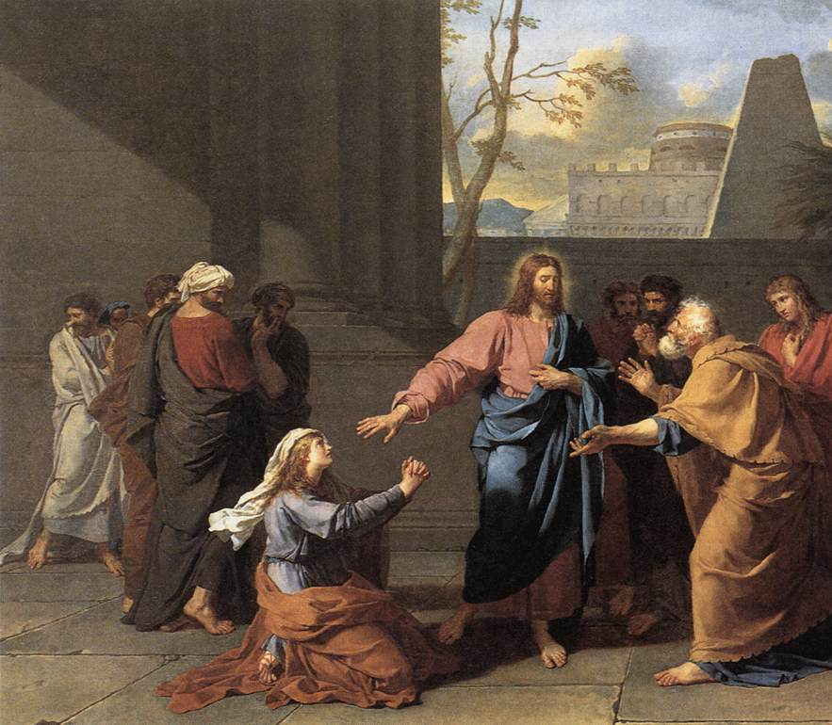
Canaanite Mercy Pt 3
Mt 15:21-28
Mk 6:31-52
Jn 6:1-17
Gen 12:1-3
Ex 33:2
Zech 14:20-21
Jn 5:19; 12:49; 14:31
1 Jn 3:8
2/15/26

Slide 2
Jesus Testimonies:
Personal- about me and not others
What I was/did… how Jesus changed me
[ my uncleanness is being touched by Jesus ]
Glorifying to Jesus-
His way of working… in me
The overflow of what He did with me into others
Culture of Transformation

Slide 3
Three Participants:
Jesus
The Disciples
A Woman
And Jesus went away from there and withdrew to the district of Tyre and Sidon.
Mt 15:21

Slide 4
The disciples had
“Withdrawal” PTSD.
Mt 14:22-25; Mk 6:31-52; Jn 6:1-17
John beheaded: “Let’s get away” Mk 6:31; Mt 14:13
They “boated” to a secluded place Mk 6:32
Crowds beat them to shore Mk 6:33-34
Jesus healed their sick all day Mt 14:14
Philip, “Where are we to buy bread?” Jn 6:5
Feeding of the 5,000 men Mt 14:15-21

Slide 5
The Disciples
(the last time Jesus withdrew)
Immediately he made the disciples get into the boat and go before him to the other side, while he dismissed the crowds. ²³ And after he had dismissed the crowds, he went up on the mountain by himself to pray. When evening came, he was there alone, ²⁴ but the boat by this time was a long way from the land, beaten by the waves, for the wind was against them. ²⁵ And in the fourth watch of the night he came to them, walking on the sea. Mt 14:22-25

Slide 6
The Disciples object:
²² And behold, a Canaanite woman from that region came out and was crying, “Have mercy on me, O Lord, Son of David; my daughter is severely oppressed by a demon.” ²³ But he did not answer her a word. And his disciples came and begged him, saying, “Send her away, for she is crying out after us.”
Mt 15:22-23

Slide 7
God was pleased to reveal his Son to me, in
order that I might preach him among the Gentiles, I did not immediately consult with anyone; ¹⁷ nor did I go up to Jerusalem to those who were apostles before me, but I went away into Arabia, and returned again to Damascus. ¹⁸ Then after three years I went up to Jerusalem to visit Cephas and remained with him fifteen days. ¹⁹ But I saw none of the other apostles except James the Lord’s brother. ²⁰ In what I am writing to you, before God, I do not lie!
Gal 1:16-20

Slide 8
He answered, “I was sent only to the lost sheep of the house of Israel.” ²⁵ But she came and knelt before him, saying, “Lord, help me.” ²⁶ And he answered, “It is not right to take the children’s bread and throw it to the dogs.” ²⁷ She said, “Yes, Lord, yet even the dogs eat the crumbs that fall from their masters’ table.” ²⁸ Then Jesus answered her, “O woman, great is your faith! Be it done for you as you desire.” And her daughter was healed instantly. Mt 15:24-28

Slide 9
This woman was a Canaanite.
A Canaanite woman from that region came out and was crying, “Have mercy on me, O Lord, Son of David; my daughter is severely oppressed by a demon.” But he did not answer her a word. And his disciples came and begged him, saying, “Send her away, for she is crying out after us.”
Mt 15:22-23

Slide 10
This woman
was an enemy.
I will send an angel before you, and I will drive out the Canaanites, the Amorites, the Hittites, the Perizzites, the Hivites, and the Jebusites. Ex 33:2

Slide 11
This woman
was ultimate “skeebala.”
And on that day there shall be inscribed on the bells of the horses, “Holy to the Lord.” And the pots in the house of the Lord shall be as the bowls before the altar. ²¹ And every pot in Jerusalem and Judah shall be holy to the Lord of hosts, so that all who sacrifice may come and take of them and boil the meat of the sacrifice in them. And there shall no longer be a Canaanite [ESV Trader] in the house of the Lord of hosts on that day. Zech 14:20-21

Slide 12
This woman
asked for mercy.
A Canaanite woman from that region came out and was crying, “Have mercy on me, O Lord, Son of David; my daughter is severely oppressed by a demon.” But he did not answer her a word. And his disciples came and begged him, saying, “Send her away, for she is crying out after us.” Mt 15:22-23

