Slide 1
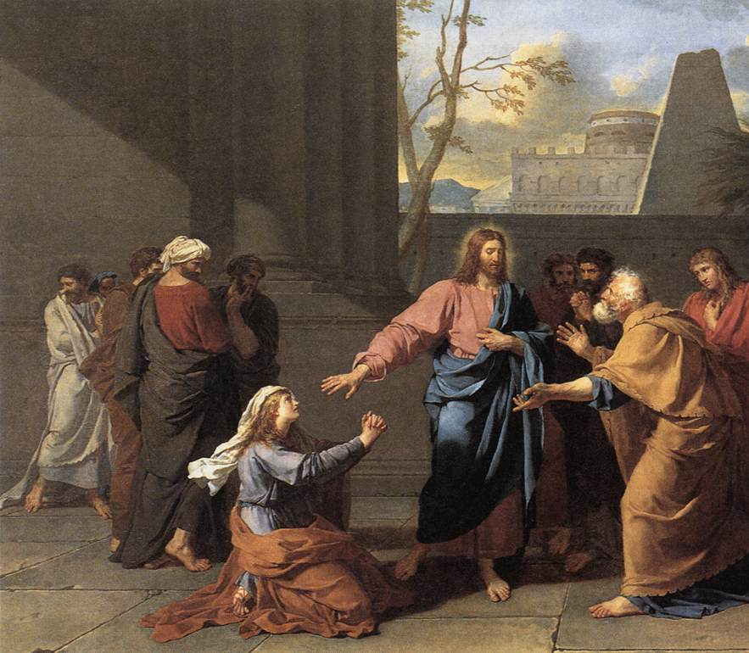
Canaanite Mercy
Mt 15:21-28
Gen 28:6, 38
Ex 33:2
Zech 14:20-21
Jn 5:19; 12:49; 14:31
1 Jn 3:8
2/1/26

Slide 2
And Jesus went away from there and withdrew to the district of Tyre and Sidon. ²² And behold, a Canaanite woman from that region came out and was crying, “Have mercy on me, O Lord, Son of David; my daughter is severely oppressed by a demon.” ²³ But he did not answer her a word. And his disciples came and begged him, saying, “Send her away, for she is crying out after us.” ²⁴ He answered, “I was sent only to the lost sheep of the house of Israel.” Mt 15:21-24

Slide 3
But she came and knelt before him, saying, “Lord, help me.” ²⁶ And he answered, “It is not right to take the children’s bread and throw it to the dogs.” ²⁷ She said, “Yes, Lord, yet even the dogs eat the crumbs that fall from their masters’ table.” ²⁸ Then Jesus answered her, “O woman, great is your faith! Be it done for you as you desire.” And her daughter was healed instantly. Mt 15:25-28

Slide 4
Three Participants:
Jesus
The Disciples
A Woman
One Territory:
Phoenicia / Canaanite / Asher

Slide 5
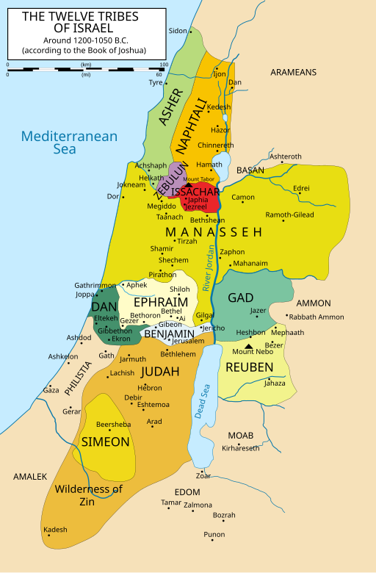

Slide 6
Asher’s Prophetic Destiny
Asher’s food shall be rich, and he shall yield royal delicacies. Gen 49:20
Phoenicia (Tyre and Sidon) History
And Hiram (King of Tyre) sent to Solomon, saying, “I have heard the message that you have sent to me. I am ready to do all you desire in the matter of cedar and cypress timber.” 1 Kings 5:8
“Son of man, say to the prince of Tyre, Thus says the Lord God: “Because your heart is proud, and you have said, ‘I am a god, I sit in the seat of the gods, in the heart of the seas,’…” Ez 28:2

Slide 7
Skeebala = Dung, excrement, manure
Indeed, I count everything as loss because of the surpassing worth of knowing Christ Jesus my Lord. For his sake I have suffered the loss of all things and count them as rubbish, in order that I may gain Christ ⁹ and be found in him, not having a righteousness of my own that comes from the law, but that which comes through faith in Christ, the righteousness from God that depends on faith…
Phil 3:8-9

Slide 8
Jesus was in tune with His Father in heaven
For I have not spoken on my own authority, but the Father who sent me has himself given me a com-mandment - what to say and what to speak. Jn 12:49
… “Truly, truly, I say to you, the Son can do nothing of his own accord, but only what he sees the Father doing. For whatever the Father does, that the Son does likewise. Jn 5:19
but I do as the Father has commanded me, so that the world may know that I love the Father. Jn 14:31

Slide 9
Jesus “withdrew” (retired)
to be with His Father
Mountains
Wilderness
In Matthew: 4:12; 12:15; 14:21; 15:21

Slide 10
Jesus “withdrew”
Jesus, aware of this, withdrew from there. And many followed him, and he healed them all. Mt 12:15
Now when he heard that John had been arrested, he withdrew into Galilee. ¹³ And leaving Nazareth he went and lived in Capernaum by the sea, in the territory of Zebulun and Naphtali Mt 14:12, 13
And Jesus went away from there and withdrew to the district of Tyre and Sidon. Mt 15:21

Slide 11
Jesus’ Impact on Earth
For God so loved the world, that he gave his only Son, that whoever believes in him should not perish but have eternal life. ¹⁷ For God did not send his Son into the world to condemn the world, but in order that the world might be saved through him.
Jn 3:16-17
Whoever makes a practice of sinning is of the devil, for the devil has been sinning from the beginning. The reason the Son of God appeared was to destroy the works of the devil. 1 Jn 3:8

Slide 12
The Disciples
(the last time Jesus withdrew)
After this Jesus went away to the other side of the Sea of Galilee… ² And a large crowd was following him, because they saw the signs that he was doing on the sick. ³ Jesus went up on the mountain, and there he sat down with his disciples… ⁵ Lifting up his eyes, then, and seeing that a large crowd was coming toward him, Jesus said to Philip, “Where are we to buy bread, so that these people may eat?” ¹⁶ When evening came, his disciples went down to the sea, ¹⁷ got into a boat, and started across the sea to Capernaum. It was now dark, and Jesus had not yet come to them. Jn 6:1-3, 5,16-17

Slide 13
And Jesus went away from there and withdrew to the district of Tyre and Sidon. ²² And behold, a Canaanite woman from that region came out and was crying, “Have mercy on me, O Lord, Son of David; my daughter is severely oppressed by a demon.” ²³ But he did not answer her a word. And his disciples came and begged him, saying, “Send her away, for she is crying out after us.”
Mt 15:21-23

Slide 14
He answered, “I was sent only to the lost sheep of the house of Israel.” ²⁵ But she came and knelt before him, saying, “Lord, help me.” ²⁶ And he answered, “It is not right to take the children’s bread and throw it to the dogs.” ²⁷ She said, “Yes, Lord, yet even the dogs eat the crumbs that fall from their masters’ table.” ²⁸ Then Jesus answered her, “O woman, great is your faith! Be it done for you as you desire.” And her daughter was healed instantly. Mt 15:24-28

Slide 15
This woman was a Canaanite.
A Canaanite woman from that region came out and was crying, “Have mercy on me, O Lord, Son of David; my daughter is severely oppressed by a demon.” But he did not answer her a word. And his disciples came and begged him, saying, “Send her away, for she is crying out after us.”
Mt 15:22-23

Slide 16
This woman
was an enemy.
I will send an angel before you, and I will drive out the Canaanites, the Amorites, the Hittites, the Perizzites, the Hivites, and the Jebusites. Ex 33:2

Slide 17
This woman
was ultimate “skeebala.”
And on that day there shall be inscribed on the bells of the horses, “Holy to the Lord.” And the pots in the house of the Lord shall be as the bowls before the altar. ²¹ And every pot in Jerusalem and Judah shall be holy to the Lord of hosts, so that all who sacrifice may come and take of them and boil the meat of the sacrifice in them. And there shall no longer be a Canaanite [ESV Trader] in the house of the Lord of hosts on that day. Zech 14:20-21

Slide 18
This woman
asked for mercy.
A Canaanite woman from that region came out and was crying, “Have mercy on me, O Lord, Son of David; my daughter is severely oppressed by a demon.” But he did not answer her a word. And his disciples came and begged him, saying, “Send her away, for she is crying out after us.” Mt 15:22-23

