Slide 1
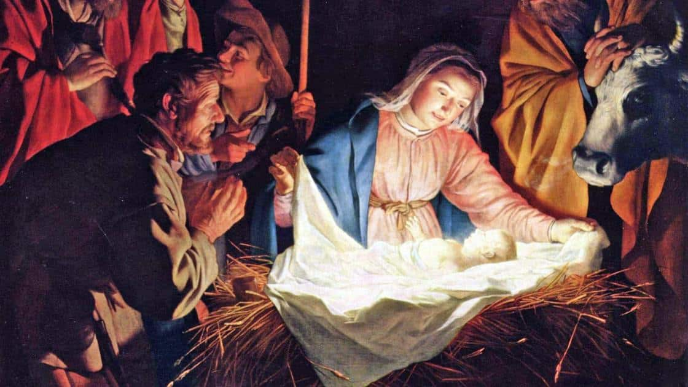
A Christmas Messiah
Luke 1:26-56; 2:1-24; Matthew 1:18-25; 2:18-25;
John 6:28-33; 1 Samuel 16:7-13
12/21/25

Slide 2
The manger scene includes
the unconventional story of:
A couple, Mary and Joseph.
And Joseph also went up from… the town of Nazareth, to Judea, to the city of… Bethlehem… ⁵ to be registered with Mary, his betrothed, who was with child. ⁶ And while they were there, the time came for her to give birth. ⁷ And she gave birth to her firstborn son and wrapped him in swaddling cloths and laid him in a manger, because there was no place for them in the inn. Lk 1:4-7 abv

Slide 3
The manger scene includes
the unconventional story of:
A Travel Lodge. (animal stall)
And while they were there, the time came for her to give birth. ⁷ And she gave birth to her firstborn son and wrapped him in swaddling cloths and laid him in a manger, because there was no place for them in the inn. Lk 2:6-7

Slide 4
The manger scene includes
the unconventional story of:
A Bed. (animal feeding trough)
And while they were there, the time came for her to give birth. ⁷ And she gave birth to her firstborn son and wrapped him in swaddling cloths and laid him in a manger, because there was no place for them in the inn. Lk 2:6-7; Jn 6:28-35

Slide 5
Our fathers ate the manna in the wilderness; as it is written, ‘He gave them bread from heaven to eat.’ ” ³² Jesus then said to them, “Truly, truly, I say to you, it was not Moses who gave you the bread from heaven, but my Father gives you the true bread from heaven. ³³ For the bread of God is he who comes down from heaven and gives life to the world.”
³⁵ Jesus said to them, “I am the bread of life; whoever comes to me shall not hunger, and whoever believes in me shall never thirst.
Jn 6:31-35

Slide 6
The manger scene includes
the unconventional story of witnesses:
Angels! Lk 2:9-14
And this will be a sign for you: you will find a baby wrapped in swaddling cloths and lying in a manger.” ¹³ And suddenly there was with the angel a multitude of the heavenly host praising God and saying, ¹⁴ “Glory to God in the highest, and on earth peace and good will toward all people!” Lk 2:112-14

Slide 7
The manger scene includes
the unconventional story of witnesses:
Shepherds! Lk 2:15-16
When the angels went away from them into heaven, the shepherds said to one another, “Let us go over to Bethlehem and see this thing that has happened, which the Lord has made known to us.” ¹⁶ And they went with haste and found Mary and Joseph, and the baby lying in a manger. Lk 2:15-16

Slide 8
The manger scene includes
the unconventional story of witnesses:
A heart prophecy! Lk 2:15-16
And in the same region there were shepherds out in the field, keeping watch over their flock by night. Lk 2:8
¹² And being warned in a dream not to return to Herod, they departed to their own country by another way. Mt 2:12

Slide 9
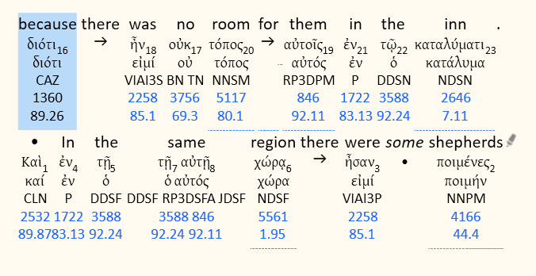
Lk 2:8
846; 3588; 5561

Slide 10
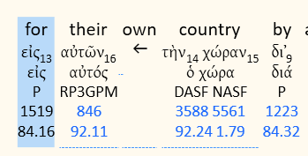
846; 3588; 5561
Mt 2:12

Slide 11
Samuel did what the Lord commanded and came to Bethlehem. The elders of the city came to meet him trembling and said, “Do you come peaceably?” ⁵ And he said… I have come to sacrifice to the Lord...” And he consecrated Jesse and his sons and invited them to the sacrifice. ⁶ When they came, he looked on Eliab and thought, “Surely the Lord’s anointed is before him.” ⁷ But the Lord said to Samuel, “Do not look on his appearance or on the height of his stature, because I have rejected him. For the Lord sees not as man sees: man looks on the outward appearance, but the Lord looks on the heart.”

Slide 12
… And Jesse made seven of his sons pass before Samuel. And Samuel said to Jesse, “The Lord has not chosen these.” ¹¹ Then Samuel said to Jesse, “Are all your sons here?” And he said, “There remains yet the youngest, but behold, he is keeping the sheep.” And Samuel said to Jesse, “Send and get him, for we will not sit down till he comes here.” ¹² And he sent and brought him in. Now he was ruddy and had beautiful eyes and was handsome. And the Lord said, “Arise, anoint him, for this is he.” 1 Sam 16:4-7; 10-12

Slide 13
The Birth Scene of a Messiah
And the angel said to them, “Fear not, for behold, I bring you good news of great joy that will be for all the people. ¹¹ For unto you is born this day in the city of David a Savior, who is Christ the Lord. ¹² And this will be a sign for you: you will find a baby wrapped in swaddling cloths and lying in a manger.”
Lk 2:10-12

