Slide 1
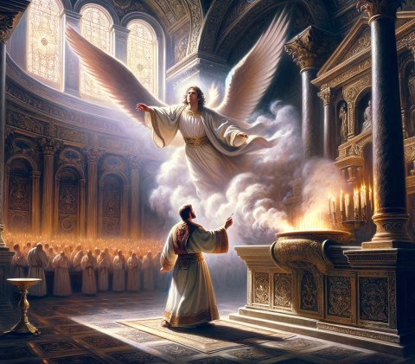
A Christmas Angel
Embedded Eternality- Gabriel
Daniel
8:16-26, 9:20-27
Luke
1:11-20, 26-38
2:8-14
Matthew
1:6-23; 2:12-14
12/7/25

Slide 2
Gabriel’s place is
in God’s presence.
And Zechariah said to the angel, “How shall I know this? For I am an old man, and my wife is advanced in years.” ¹⁹ And the angel answered him, “I am Gabriel. I stand in the presence of God, and I was sent to speak to you and to bring you this good news. Lk 1:18-19

Slide 3
Gabriel brings understanding regarding Jesus as Messiah or Christ.
He made me understand, speaking with me and saying, “O Daniel, I have now come out to give you insight and understanding… ²⁵ Know therefore and understand that from the going out of the word to restore and build Jerusalem to the coming of an anointed one, a prince… Dan 9:22, 25a

Slide 4
This angelic
understanding brings / includes GREAT PAIN!
And after the sixty-two weeks, an anointed one shall be cut off and shall have nothing. And the people of the prince who is to come shall destroy the city and the sanctuary. Its end shall come with a flood, and to the end there shall be war. Desolations are decreed. Dan 9:26

Slide 5
This angelic
understanding brings / includes GREAT Joy!
Seventy weeks are decreed about your people and your holy city, to finish the transgression, to put an end to sin, and to atone for iniquity, to bring in everlasting righteousness, to seal both vision and prophet, and to anoint a most holy place. Dan 9:24

Slide 6
Gabriel appears to Mary
In the sixth month the angel Gabriel was sent from God to a city of Galilee named Nazareth, ²⁷ to a virgin betrothed to a man whose name was Joseph, of the house of David. And the virgin’s name was Mary. ²⁸ And he came to her and said, “Greetings, O favored one, the Lord is with you!” ²⁹ But she was greatly troubled at the saying, and tried to discern what sort of greeting this might be. Lk 1:26-29

Slide 7
Gabriel appears to Mary
And the angel said to her, “Do not be afraid, Mary, for you have found favor with God. ³¹ And behold, you will conceive in your womb and bear a son, and you shall call his name Jesus. ³² He will be great and will be called the Son of the Most High. And the Lord God will give to him the throne of his father David, ³³ and he will reign over the house of Jacob forever, and of his kingdom there will be no end.”
³⁴ And Mary said to the angel, “How will this be, since I am a virgin?” Lk 1:30-34

Slide 8
And while they were there, the time came for her to give birth. ⁷ And she gave birth to her firstborn son and wrapped him in swaddling cloths and laid him in a manger, because there was no place for them in the inn. ⁸ And in the same region there were shepherds out in the field, keeping watch over their flock by night. ⁹ And an angel of the Lord appeared to them, and the glory of the Lord shone around them, and they were filled with great fear. Lk 2:6-9

Slide 9
And the angel said to them, “Fear not, for behold, I bring you good news of great joy that will be for all the people. ¹¹ For unto you is born this day in the city of David a Savior, who is Christ the Lord. ¹² And this will be a sign for you: you will find a baby wrapped in swaddling cloths and lying in a manger.” ¹³ And suddenly there was with the angel a multitude of the heavenly host praising God & saying, ¹⁴ “Glory to God in the highest, and on earth peace, Good will toward men.”
Lk 2:10-14

Slide 10
What are you doing with Gabriel’s News?

