Slide 1
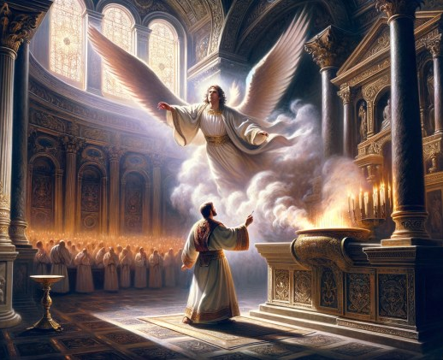
A Christmas Offering
Embedded Eternality
Lk 1:6-22, 57-66
Heb 4:10-16
Heb 12:24
Gen 4:1-4
2 Chr 5:11-14, 7:1-3
11/23/25

Slide 2
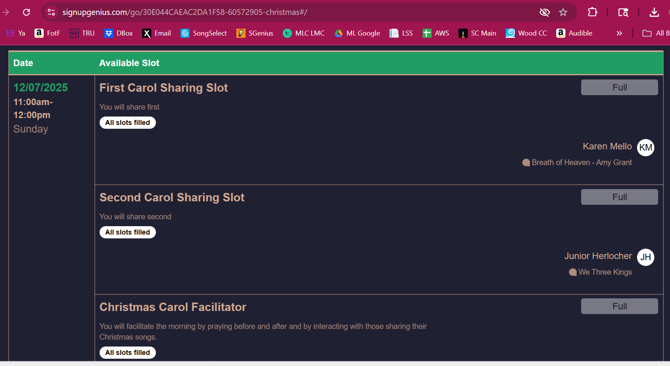

Slide 3
So then, there remains a Sabbath rest for the people of God, ¹⁰ for whoever has entered God’s rest has also rested from his works as God did from his.
¹¹ Let us therefore strive to enter that rest, so that no one may fall by the same sort of disobedience. ¹² For the word of God is living and active, sharper than any two-edged sword, piercing to the division of soul and of spirit, of joints and of marrow, and discerning the thoughts and intentions of the heart. Heb 4:9-12

Slide 4
Jesus is the
soul searcher.
For the word of God is living and active, sharper than any two-edged sword, piercing to the division of soul and of spirit, of joints and of marrow, and discerning the thoughts and intentions of the heart. ¹³ And no creature is hidden from his sight, but all are naked and exposed to the eyes of him to whom we must give account. Heb 4:12-13

Slide 5
And no creature is hidden from his sight, but all are naked and exposed to the eyes of him to whom we must give account. ¹⁴ Since then we have a great high priest who has passed through the heavens, Jesus, the Son of God, let us hold fast our confession. ¹⁵ For we do not have a high priest who is unable to sympathize with our weaknesses, but one who in every respect has been tempted as we are, yet without sin. ¹⁶ Let us then with confidence draw near to the throne of grace, that we may receive mercy and find grace to help in time of need. Heb 4:13-16

Slide 6
Elizabeth and Zechariah were “Faithers.” Lk 1:6
They had a silent soul cry.
Lk 1:7
And they were both righteous before God, walking blamelessly in all the commandments and statutes of the Lord. ⁷ But they had no child, because Elizabeth was barren, and both were advanced in years. Lk 1:6-7

Slide 7
Soul Cries are
really prayers.
And they were both righteous before God, walking blamelessly in all the commandments and statutes of the Lord. ⁷ But they had no child, because Elizabeth was barren, and both were advanced in years. Lk 1:6-7

Slide 8
Now while he was serving as priest before God when his division was on duty, ⁹ according to the custom of the priesthood, he was chosen by lot to enter the temple of the Lord and burn incense. ¹⁰ And the whole multitude of the people were praying outside at the hour of incense. ¹¹ And there appeared to him an angel of the Lord standing on the right side of the altar of incense. ¹² And Zechariah was troubled when he saw him, and fear fell upon him. Luke 1:8–11

Slide 9
But the angel said to him, “Do not be afraid, Zechariah, for your prayer has been heard, and your wife Elizabeth will bear you a son, and you shall call his name John. ¹⁴ And you will have joy and gladness, and many will rejoice at his birth, ¹⁵ for he will be great before the Lord. And he must not drink wine or strong drink, and he will be filled with the Holy Spirit, even from his mother’s womb. ¹⁶ And he will turn many of the children of Israel to the Lord their God... Lk 2:13-16

Slide 10
And Zechariah said to the angel, “How shall I know this? For I am an old man, and my wife is advanced in years.” ¹⁹ And the angel answered him, “I am Gabriel. I stand in the presence of God, and I was sent to speak to you and to bring you this good news. ²⁰ And behold, you will be silent and unable to speak until the day that these things take place, because you did not believe my words, which will be fulfilled in their time.”
Lk 1:18-20

Slide 11
Now the time came for Elizabeth to give birth, and she bore a son. ⁵⁸ And her neighbors and relatives heard that the Lord had shown great mercy to her, and they rejoiced with her. ⁵⁹ And on the eighth day they came to circumcise the child. And they would have called him Zechariah after his father, ⁶⁰ but his mother answered, “No; he shall be called John.” ⁶¹ And they said to her, “None of your relatives is called by this name.” Lk 1:57-61

Slide 12
And he asked for a writing tablet and wrote, “His name is John.” And they all wondered. ⁶⁴ And immediately his mouth was opened and his tongue loosed, and he spoke, blessing God. ⁶⁵ And fear came on all their neighbors. And all these things were talked about through all the hill country of Judea, ⁶⁶ and all who heard them laid them up in their hearts, saying, “What then will this child be?” For the hand of the Lord was with him. Lk 1:63-66

