Slide 1
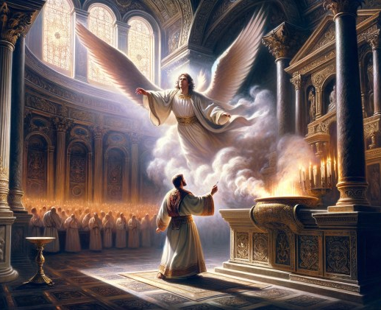
A Christmas Setting
Embedded Eternality
Lk 1:1-7, 2:4-5, Lk 3:23-38
Mt 1:1-17, 2:4
1 Chr 24:1-19
Ps 84:1-4
Ps 32:1-5
Is 55:6-12
11/16/25

Slide 2
In those days a decree went out from Caesar Augustus that all the world should be registered. ² This was the first registration when Quirinius was governor of Syria. ³ And all went to be registered, each to his own town. ⁴ And Joseph also went up from Galilee, from the town of Nazareth, to Judea, to the city of David, which is called Bethlehem, because he was of the house and lineage of David, ⁵ to be registered with Mary, his betrothed, who was with child.

Slide 3
And while they were there, the time came for her to give birth. ⁷ And she gave birth to her firstborn son and wrapped him in swaddling cloths and laid him in a manger, because there was no place for them in the inn. ⁸ And in the same region there were shepherds out in the field, keeping watch over their flock by night. ⁹ And an angel of the Lord appeared to them, and the glory of the Lord shone around them, and they were filled with great fear.

Slide 4
And the angel said to them, “Fear not, for behold, I bring you good news of great joy that will be for all the people. ¹¹ For unto you is born this day in the city of David a Savior, who is Christ the Lord. ¹² And this will be a sign for you: you will find a baby wrapped in swaddling cloths and lying in a manger.” ¹³ And suddenly there was with the angel a multitude of the heavenly host praising God and saying, ¹⁴ “Glory to God in the highest,
and on earth peace among those with whom he is pleased!” Lk 2:1-14

Slide 5
God’s plan is joyful!
(Joy to the World)
How lovely is your dwelling place, O LORD of hosts! ² My soul longs, yes, faints for the courts of the LORD; my heart and flesh sing for joy to the living God. ³ Even the sparrow finds a home, and the swallow a nest for herself, where she may lay her young, at your altars, O LORD of hosts, my King and my God. ⁴ Blessed are those who dwell in your house, ever singing your praise! Selah Ps 84:1-4

Slide 6
God’s plan is redemptive!
Blessed is the one whose transgression is forgiven,
whose sin is covered. ² Blessed is the man against whom the Lord counts no iniquity, and in whose spirit there is no deceit. ³ For when I kept silent, my bones wasted away through my groaning all day long. ⁴ For day and night your hand was heavy upon me; my strength was dried up as by the heat of summer. ⁵ I acknowledged my sin to you, and I did not cover my iniquity; I said, “I will confess my transgressions to the Lord,” and you forgave the iniquity of my sin. Selah Ps 32:1-5

Slide 7
God’s plan is the G.O.A.T.!
(O Come O Come Emmanuel)
Seek the Lord while he may be found; call upon him while he is near; ⁷ let the wicked forsake his way, and the unrighteous man his thoughts; let him return to the Lord, that he may have compassion on him, and to our God, for he will abundantly pardon. ⁸ For my thoughts are not your thoughts, neither are your ways my ways, declares the Lord. ⁹ For as the heavens are higher than the earth, so are my ways higher than your ways and my thoughts than your thoughts. Is 55:6-9

Slide 8
For as the rain and the snow come down from heaven and do not return there but water the earth, making it bring forth and sprout,
giving seed to the sower and bread to the eater, ¹¹ so shall my word be that goes out from my mouth; it shall not return to me empty, but it shall accomplish that which I purpose, and shall succeed in the thing for which I sent it. ¹² For you shall go out in joy and be led forth in peace; the mountains and the hills before you shall break forth into singing, and all the trees of the field shall clap their hands. Is 55:10-12

Slide 9
Zechariah is from
the line of Abijah. Lk 1:5
Elizabeth is from
the line of Aaron. Lk 1:5
In the days of Herod, king of Judea, there was a priest named Zechariah, of the division of Abijah. And he had a wife from the daughters of Aaron, and her name was Elizabeth. Lk 1:5

Slide 10
Mary is from the
line of Adam,
Abraham, & David. Lk 3:23-38
the son of Melea, the son of Menna, the son of Mattatha, the son of Nathan, the son of David, ³² the son of Jesse, the son of Obed, the son of Boaz, the son of Sala, the son of Nahshon,
Lk 3:31-32

Slide 11
Joseph is from the
line of Abraham,
& David. Mt 1:1-16
… and Salmon the father of Boaz by Rahab, and Boaz the father of Obed by Ruth, and Obed the father of Jesse, ⁶ and Jesse the father of David the king. And David was the father of Solomon by the wife of Uriah, Mt 1:5-6

Slide 12
Both couple’s
genealogies converge
at David.
Joseph Matthew 1:5-6
Mary Luke 3:31-32
Zechariah and Elizabeth Luke 1:5
1 Chronicles 24:7-19

Slide 13
David leads us to Bethlehem. Lk 2:4-5
And Joseph also went up from Galilee, from the town of Nazareth, to Judea, to the city of David, which is called Bethlehem, because he was of the house and lineage of David, ⁵ to be registered with Mary, his betrothed, who was with child. ⁶ And while they were there, the time came for her to give birth. Lk 2:4-6

