Slide 1

Repentance
Soul Care Principles for Life
Mt 4:12-17; Heb 12:1, 4; 1 Jn 1:5-10, 2 Pet 2:19; Ja 4:6-10; Is 9:1-6
9/21/25

Slide 2
Now when he heard that John had been arrested, he withdrew into Galilee. ¹³ And leaving Nazareth he went and lived in Capernaum by the sea, in the territory of Zebulun and Naphtali, ¹⁴ so that what was spoken by the prophet Isaiah might be fulfilled: ¹⁵ “The land of Zebulun and the land of Naphtali,
the way of the sea, beyond the Jordan, Galilee of the Gentiles- ¹⁶ the people dwelling in darkness
have seen a great light, and for those dwelling in the region and shadow of death, on them a light has dawned.” ¹⁷ From that time Jesus began to preach, saying, “Repent, for the kingdom of heaven is at hand.” Mt 4:12-17

Slide 3
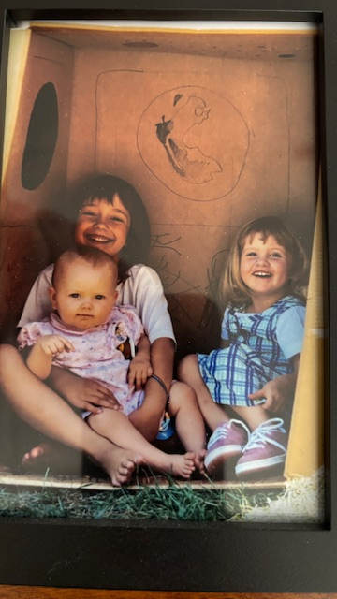
Your Ship
Individuals
Relationships
Earth, Dark Space,
Heavens

Slide 4
God shines light into
my [ suitcase ] soul.
But if we walk in the light, as he is in the light, we have fellowship with one another, and the blood of Jesus his Son cleanses us from all sin. ⁸ If we say we have no sin, we deceive ourselves, and the truth is not in us. ⁹ If we confess our sins, he is faithful and just to forgive us our sins and to cleanse us from all unrighteousness. 1 Jn 1:7-9

Slide 5
But he gives more grace. Therefore it says, “God opposes the proud but gives grace to the humble.” ⁷ Submit yourselves therefore to God. Resist the devil, and he will flee from you. ⁸ Draw near to God, and he will draw near to you. Cleanse your hands, you sinners, and purify your hearts, you double-minded. ⁹ Be wretched and mourn and weep. Let your laughter be turned to mourning and your joy to gloom. ¹⁰ Humble yourselves before the Lord, and he will exalt you. Ja 4:6-10

Slide 6
Repentance brings our thinking into alignment with God’s thinking.
Rob Reimer- Soul Care E-course Lesson 11, Principle 2, Repentance

Slide 7
Pride is the ultimate enemy of True Confession.
Rob Reimer- Soul Care E-course Lesson 11, Principle 2, Repentance

Slide 8
I must walk in
REPENTANCE
every day.
From that time Jesus began to preach, saying, “Repent, for the kingdom of heaven is at hand.”
Mt 4:12-17

