Slide 1
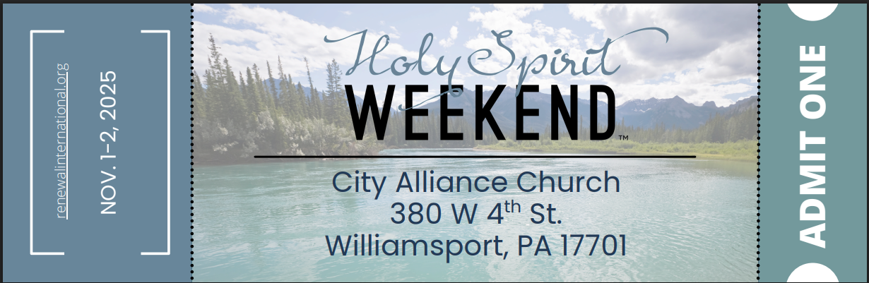
A Living Soul
Soul Care Principles for Life
1 John 1:5-7, 2:1-3; Jeremiah 17:7-10; Mark 7:5-7; Romans 12:1-2; 2 Corinthians 5:14-17
9/14/25

Slide 2
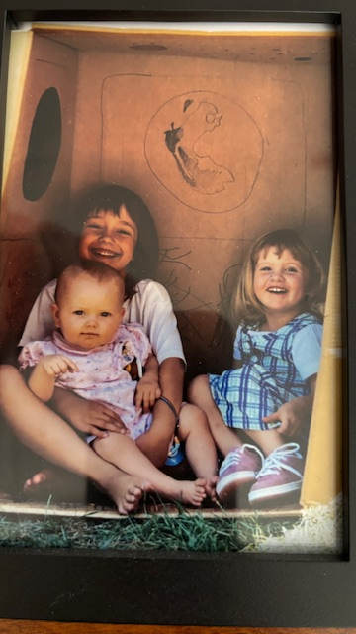
Now
Individuals
Relationships
Earth, Moon
Heavens
Not Yet

Slide 3
My heart is like a
weed infested garden.
Blessed is the man who trusts in the Lord,
whose trust is the Lord. ⁸ He is like a tree planted by water, that sends out its roots by the stream, and does not fear when heat comes, for its leaves remain green, and is not anxious in the year of drought, for it does not cease to bear fruit.” ⁹ The heart is deceitful above all things, and desperately sick; who can understand it? Jer 17:7-9

Slide 4
Above everything else
God is concerned
about my heart.
You hypocrites! Well did Isaiah prophesy of you, when he said: ⁸ “ ‘This people honors me with their lips, but their heart is far from me; ⁹ in vain do they worship me… ’ ” ¹⁰ And he called the people to him and said to them, “Hear and understand: ¹¹ it is not what goes into the mouth that defiles a person, but what comes out of the mouth;” Mt 15:7-11 abv

Slide 5
For the Word of God is living and active, sharper than any two-edged sword, piercing to the division of soul and of spirit, of joints and of marrow, and discerning the thoughts and intentions of the heart. ¹³ And no creature is hidden from HIS sight, but all are naked and exposed to the eyes of him to whom we must give account.
Heb 4:12-13

Slide 6
the life (Jesus) was made manifest, and we have seen it, and testify to it and proclaim to you the eternal life, which was with the Father and was made manifest to us— ³ that which we have seen and heard we proclaim also to you, so that you too may have fellowship with us; and indeed our fellowship is with the Father and with his Son Jesus Christ. ⁴ And we are writing these things so that our joy may be complete. 1 Jn 1:2-4

Slide 7
Walking in the Light
⁵ This is the message we have heard from him and proclaim to you, that God is light, and in him is no darkness at all. ⁶ If we say we have fellowship with him while we walk in darkness, we lie and do not practice the truth. ⁷ But if we walk in the light, as he is in the light, we have fellowship with one another, and the blood of Jesus his Son cleanses us from all sin. 1 Jn 1:5-7

Slide 8
I, Dale Rintelman, desire to invoke the work of Jesus to clean my heart!

Slide 9
… and Jesus died for all, that those who live might no longer live for themselves but for Him who for their sake died and was raised.
¹⁶ From now on, therefore, we regard no one according to the flesh. Even though we once regarded Christ according to the flesh, we regard him thus no longer. ¹⁷ Therefore, if anyone is in Christ, he is a new creation. The old has passed away; behold, the new has come. 2 Cor 5:15-17

Slide 10
I, Dale Rintelman, will walk in the light so that others will encounter my Fellowshipping Lord God continually!

Slide 11
Soul Care Principles:
Embraced wholeheartedly:
Holy Spirit Weekend
$75 / person – We will help!!
10% discount: GRPSCC10 at checkout
At City Alliance on Saturday 11/1:
“I am with Pastor Dale”
https://renewalinternational.org/events-1/holy-spirit-weekend-williamsport-pa

Slide 12
I anticipate & am Praying for:
Healings
Deliverances
Filling of the Holy Spirit
Testimonies of Freedom in Christ Jesus

